Slide 1
Subsetting Data in R

Slide 2
Reminder
Refresh the website and get the latest version of the labs and slides! We are constantly making improvements.

Slide 3
Recap
Use <- to save (assign) values to objects
Use c() to combine vectors
length(), class(), and str() tell you information about an object
The sequence seq() function helps you create numeric vectors (from,to, by, and length.out arguments)
The repeat rep() function helps you create vectors with the each and times arguments
Reproducible science makes everyone’s life easier!
readrhas helpful functions like read_csv() that can help you import data into R
📃 Day 2 Cheatsheet

Slide 4
Overview
In this module, we will show you how to:
Look at your data in different ways
Create a data frame and a tibble
Create new variables/make rownames a column
Rename columns of a data frame
Subset rows of a data frame
Subset columns of a data frame
Add/remove new columns to a data frame
Order the columns of a data frame
Order the rows of a data frame

Slide 5
Setup
We will largely focus on the dplyr package which is part of the tidyverse.

Slide 6


Slide 7
Some resources on how to use dplyr:
https://dplyr.tidyverse.org/
https://cran.r-project.org/web/packages/dplyr/vignettes/dplyr.html
https://www.opencasestudies.org/

Slide 8
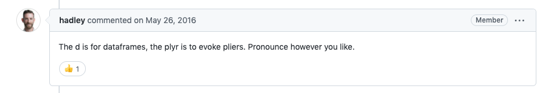
Why dplyr?

Slide 9
The dplyr package is one of the most helpful packages for altering your data to get it into a form that is useful for creating visualizations, summarizing, or more deeply analyzing.
So you can imagine using pliers on your data.

Slide 10


Slide 11
Loading in dplyr and tidyverse
See this website for a list of the packages included in the tidyverse: https://www.tidyverse.org/packages/
library(tidyverse) # loads dplyr and other packages!

Slide 12
Getting data to work with
We will work with data called er about heat-related ER visits between 2011 and 2022, as reported by the state of Colorado, specifically made available by the Colorado Environmental Public Health Tracking program website. Full dataset available at https://coepht.colorado.gov/heat-related-illness.
er <- read_csv("https://daseh.org/data/CO_ER_heat_visits.csv")
Rows: 768 Columns: 6 ── Column specification ──────────────────────────────────────────────────────── Delimiter: "," chr (1): county dbl (5): rate, lower95cl, upper95cl, visits, year ℹ Use `spec()` to retrieve the full column specification for this data. ℹ Specify the column types or set `show_col_types = FALSE` to quiet this message.

Slide 13
Checking the data dim()
The dim(), nrow(), and ncol() functions are good options to check the dimensions of your data before moving forward.
dim(er) # rows, columns
[1] 768 6
nrow(er) # number of rows
[1] 768
ncol(er) # number of columns
[1] 6

Slide 14
Checking the data: glimpse()
In addition to head() and tail(), the glimpse()function of the dplyr package is another great function to look at your data.
glimpse(er)
Rows: 768 Columns: 6 $ county <chr> "Adams", "Adams", "Adams", "Adams", "Adams", "Adams", "Adams… $ rate <dbl> 6.729918, 4.843983, 6.836648, 3.080950, 3.356538, 8.848504, … $ lower95cl <dbl> NA, 2.848937, 4.359735, 1.711087, 1.892912, 6.124961, 4.2920… $ upper95cl <dbl> 9.236776, NA, 9.313561, 4.846996, 5.232461, 11.572046, 8.977… $ visits <dbl> 29, 23, 31, 15, 16, 42, 32, 37, 36, 24, 35, 45, 0, 0, NA, 0,… $ year <dbl> 2011, 2012, 2013, 2014, 2015, 2016, 2017, 2018, 2019, 2020, …
This dataset has information about both the rate of ER visits for heat-related illness and the number of visits, broken out by both year and CO county.

Slide 15
Checking your data: slice_sample()
What if you want to see the middle of your data? You can use the slice_sample() function of the dplyr package to see a random set of rows. You can specify the number of rows with the n argument.
slice_sample(er, n = 2)
# A tibble: 2 × 6 county rate lower95cl upper95cl visits year <chr> <dbl> <dbl> <dbl> <dbl> <dbl> 1 Hinsdale 0 0 0 0 2021 2 Prowers NA NA NA NA 2012
slice_sample(er, n = 2)
# A tibble: 2 × 6 county rate lower95cl upper95cl visits year <chr> <dbl> <dbl> <dbl> <dbl> <dbl> 1 Huerfano NA NA NA NA 2013 2 San Juan 0 0 0 0 2021

Slide 16
Data frames and tibbles

Slide 17
Data frames
An older version of data in tables is called a data frame. The mtcars dataset is an example of this.
class(mtcars)
[1] "data.frame"
head(mtcars)
mpg cyl disp hp drat wt qsec vs am gear carb Mazda RX4 21.0 6 160 110 3.90 2.620 16.46 0 1 4 4 Mazda RX4 Wag 21.0 6 160 110 3.90 2.875 17.02 0 1 4 4 Datsun 710 22.8 4 108 93 3.85 2.320 18.61 1 1 4 1 Hornet 4 Drive 21.4 6 258 110 3.08 3.215 19.44 1 0 3 1 Hornet Sportabout 18.7 8 360 175 3.15 3.440 17.02 0 0 3 2 Valiant 18.1 6 225 105 2.76 3.460 20.22 1 0 3 1

Slide 18
tibble
Tibbles are a fancier version of data frames:
We don’t have to use head to see a preview of it
We see the dimensions
We see the data types for each column
er
# A tibble: 768 × 6 county rate lower95cl upper95cl visits year <chr> <dbl> <dbl> <dbl> <dbl> <dbl> 1 Adams 6.73 NA 9.24 29 2011 2 Adams 4.84 2.85 NA 23 2012 3 Adams 6.84 4.36 9.31 31 2013 4 Adams 3.08 1.71 4.85 15 2014 5 Adams 3.36 1.89 5.23 16 2015 6 Adams 8.85 6.12 11.6 42 2016 7 Adams 6.63 4.29 8.98 32 2017 8 Adams 7.11 4.77 9.44 37 2018 9 Adams 6.76 4.53 8.99 36 2019 10 Adams 4.76 2.82 6.70 24 2020 # ℹ 758 more rows

Slide 19
Creating a tibble
If we wanted to create a tibble (“fancy” data frame), we can using the tibble() function on a data frame.
tbl_mtcars <- tibble(mtcars) tbl_mtcars
# A tibble: 32 × 11 mpg cyl disp hp drat wt qsec vs am gear carb <dbl> <dbl> <dbl> <dbl> <dbl> <dbl> <dbl> <dbl> <dbl> <dbl> <dbl> 1 21 6 160 110 3.9 2.62 16.5 0 1 4 4 2 21 6 160 110 3.9 2.88 17.0 0 1 4 4 3 22.8 4 108 93 3.85 2.32 18.6 1 1 4 1 4 21.4 6 258 110 3.08 3.22 19.4 1 0 3 1 5 18.7 8 360 175 3.15 3.44 17.0 0 0 3 2 6 18.1 6 225 105 2.76 3.46 20.2 1 0 3 1 7 14.3 8 360 245 3.21 3.57 15.8 0 0 3 4 8 24.4 4 147. 62 3.69 3.19 20 1 0 4 2 9 22.8 4 141. 95 3.92 3.15 22.9 1 0 4 2 10 19.2 6 168. 123 3.92 3.44 18.3 1 0 4 4 # ℹ 22 more rows
Note don’t necessarily need to use head() with tibbles, as they conveniently print a portion of the data.

Slide 20
Summary of tibbles and data frames
We generally recommend using tibbles, but you are likely to run into lots of data frames with your work.
Most functions work for both so you don’t need to worry about it much!
It can be helpful to convert data frames to tibbles though just to see more about the data more easily. The tibble() function helps us do that.

Slide 21
Data frames vs tibbles - watch out for rownames
Note that this conversion can remove row names - which some data frames have. For example, mtcars (part of R) has row names. In this case we would want to make the rownames a new column first before making into a tibble.
head(mtcars, n = 2)
mpg cyl disp hp drat wt qsec vs am gear carb Mazda RX4 21 6 160 110 3.9 2.620 16.46 0 1 4 4 Mazda RX4 Wag 21 6 160 110 3.9 2.875 17.02 0 1 4 4
head(tibble(mtcars), n = 2)
# A tibble: 2 × 11 mpg cyl disp hp drat wt qsec vs am gear carb <dbl> <dbl> <dbl> <dbl> <dbl> <dbl> <dbl> <dbl> <dbl> <dbl> <dbl> 1 21 6 160 110 3.9 2.62 16.5 0 1 4 4 2 21 6 160 110 3.9 2.88 17.0 0 1 4 4

Slide 22
rownames_to_column function
There is a function that specifically helps you do that.
head(rownames_to_column(mtcars), n = 2)
rowname mpg cyl disp hp drat wt qsec vs am gear carb 1 Mazda RX4 21 6 160 110 3.9 2.620 16.46 0 1 4 4 2 Mazda RX4 Wag 21 6 160 110 3.9 2.875 17.02 0 1 4 4
head(tibble(rownames_to_column(mtcars)), n = 2)
# A tibble: 2 × 12 rowname mpg cyl disp hp drat wt qsec vs am gear carb <chr> <dbl> <dbl> <dbl> <dbl> <dbl> <dbl> <dbl> <dbl> <dbl> <dbl> <dbl> 1 Mazda RX4 21 6 160 110 3.9 2.62 16.5 0 1 4 4 2 Mazda RX4 W… 21 6 160 110 3.9 2.88 17.0 0 1 4 4

Slide 23
Data for now
Let’s stick with the tibble ER data for our next lesson
head(er)
# A tibble: 6 × 6 county rate lower95cl upper95cl visits year <chr> <dbl> <dbl> <dbl> <dbl> <dbl> 1 Adams 6.73 NA 9.24 29 2011 2 Adams 4.84 2.85 NA 23 2012 3 Adams 6.84 4.36 9.31 31 2013 4 Adams 3.08 1.71 4.85 15 2014 5 Adams 3.36 1.89 5.23 16 2015 6 Adams 8.85 6.12 11.6 42 2016

Slide 24
Renaming Columns

Slide 25
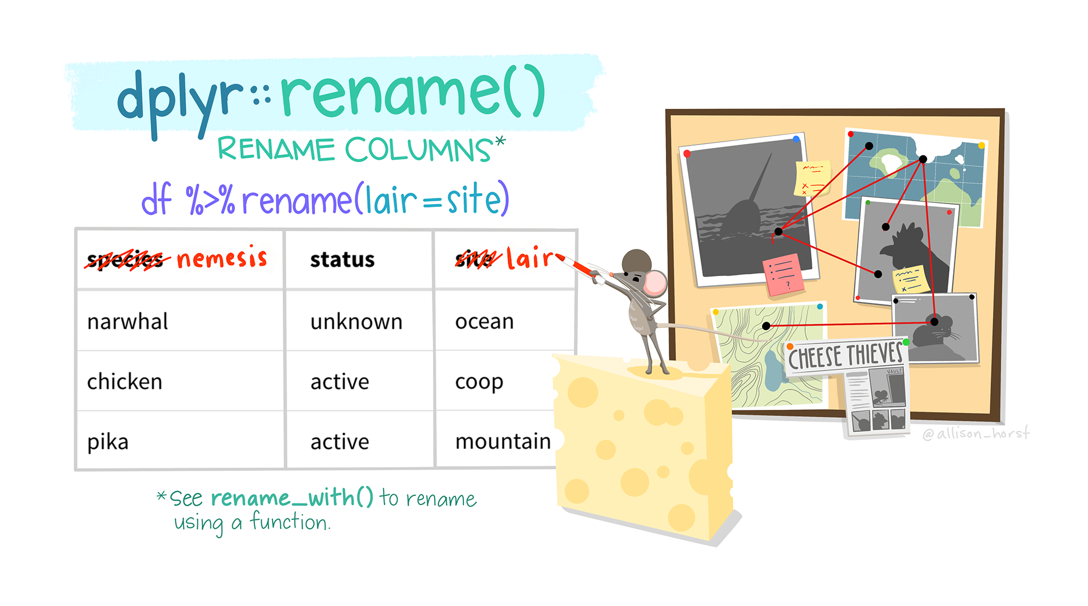
rename function

Slide 26
“Artwork by @allison_horst”. https://allisonhorst.com/

Slide 27
checking names of columns, we can use the colnames() function
colnames(er)
[1] "county" "rate" "lower95cl" "upper95cl" "visits" "year"

Slide 28
Renaming Columns of a data frame or tibble
To rename columns in dplyr, you can use the rename function.
Let’s rename lower95CI to lower_95_CI_limit. Notice the new name is listed first, similar to how a new object is assigned on the left!
The lower95CI is the lower bound of the estimated rate of ER visits for a particular county and year.
# general format! not code! {data you are creating or changing} <- rename({data you are using}, {New Name} = {Old name})
renamed_er<- rename(er, lower_95_CI_limit = lower95cl) head(renamed_er)
# A tibble: 6 × 6 county rate lower_95_CI_limit upper95cl visits year <chr> <dbl> <dbl> <dbl> <dbl> <dbl> 1 Adams 6.73 NA 9.24 29 2011 2 Adams 4.84 2.85 NA 23 2012 3 Adams 6.84 4.36 9.31 31 2013 4 Adams 3.08 1.71 4.85 15 2014 5 Adams 3.36 1.89 5.23 16 2015 6 Adams 8.85 6.12 11.6 42 2016

Slide 29
Take Care with Column Names
When you can, avoid spaces, special punctuation, or numbers in column names, as these require special treatment to refer to them.
See https://daseh.org/resources/quotes_vs_backticks.html for more guidance.
# this will cause an error renamed_er <- rename(er, lower_95%_CI_limit = lower95cl)
# this will work renamed_er <- rename(er, `lower_95%_CI_limit` = lower95cl) head(renamed_er, 2)
# A tibble: 2 × 6 county rate `lower_95%_CI_limit` upper95cl visits year <chr> <dbl> <dbl> <dbl> <dbl> <dbl> 1 Adams 6.73 NA 9.24 29 2011 2 Adams 4.84 2.85 NA 23 2012

Slide 30
Unusual Column Names
It’s best to avoid unusual column names where possible, as things get tricky later.
We just showed the use of ` backticks` . You may see people use quotes as well.

Slide 31
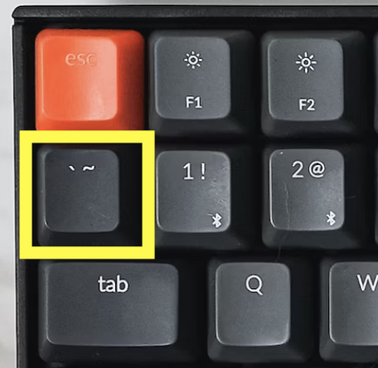

Slide 32
Other atypical column names are those with:
spaces
number without characters
number starting the name
other punctuation marks like % (besides “_” or “.” and not at the beginning)

Slide 33
A solution!
Rename tricky column names so that you don’t have to deal with them later!

Slide 34


Slide 35
Be careful about copy pasting code!
Curly quotes will not work!
# this will cause an error! renamed_er <- rename(er, ‘lower_95%_CI_limit’ = lower95cl)
# this will work! renamed_er <- rename(er, 'lower_95%_CI_limit' = lower95cl)
Also true for double quotes
# this will cause an error! renamed_er <- rename(er, “lower_95%_CI_limit” = lower95cl)
# this will work! renamed_er <- rename(er, "lower_95%_CI_limit" = lower95cl)

Slide 36
Rename multiple columns
A comma can separate different column names to change.
renamed_er <- rename(er, lower_95perc_CI_limit = lower95cl, upper_95perc_CI_limit = upper95cl) head(renamed_er, 3)
# A tibble: 3 × 6 county rate lower_95perc_CI_limit upper_95perc_CI_limit visits year <chr> <dbl> <dbl> <dbl> <dbl> <dbl> 1 Adams 6.73 NA 9.24 29 2011 2 Adams 4.84 2.85 NA 23 2012 3 Adams 6.84 4.36 9.31 31 2013

Slide 37
Renaming all columns of a data frame: dplyr
To rename all columns you use the rename_with(). In this case we will use toupper() to make all letters upper case. Could also use tolower() function.
er_upper <- rename_with(er, toupper) head(er_upper, 3)
# A tibble: 3 × 6 COUNTY RATE LOWER95CL UPPER95CL VISITS YEAR <chr> <dbl> <dbl> <dbl> <dbl> <dbl> 1 Adams 6.73 NA 9.24 29 2011 2 Adams 4.84 2.85 NA 23 2012 3 Adams 6.84 4.36 9.31 31 2013
rename_with(er_upper, tolower)
# A tibble: 768 × 6 county rate lower95cl upper95cl visits year <chr> <dbl> <dbl> <dbl> <dbl> <dbl> 1 Adams 6.73 NA 9.24 29 2011 2 Adams 4.84 2.85 NA 23 2012 3 Adams 6.84 4.36 9.31 31 2013 4 Adams 3.08 1.71 4.85 15 2014 5 Adams 3.36 1.89 5.23 16 2015 6 Adams 8.85 6.12 11.6 42 2016 7 Adams 6.63 4.29 8.98 32 2017 8 Adams 7.11 4.77 9.44 37 2018 9 Adams 6.76 4.53 8.99 36 2019 10 Adams 4.76 2.82 6.70 24 2020 # ℹ 758 more rows

Slide 38
janitor package
If you need to do lots of naming fixes - look into the janitor package!
#install.packages("janitor") library(janitor)

Slide 39
janitor clean_names
The clean_names function can intuit what fixes you might need.
The yearly_co2_emissions dataset contains estimated CO2 emissions for 265 countries between the years 1751 and 2014.
yearly_co2 <- read_csv("https://daseh.org/data/Yearly_CO2_Emissions_1000_tonnes.csv")
Rows: 192 Columns: 265 ── Column specification ──────────────────────────────────────────────────────── Delimiter: "," chr (1): country dbl (264): 1751, 1752, 1753, 1754, 1755, 1756, 1757, 1758, 1759, 1760, 1761,... ℹ Use `spec()` to retrieve the full column specification for this data. ℹ Specify the column types or set `show_col_types = FALSE` to quiet this message.

Slide 40
yearly_co2 column names
head(yearly_co2, n = 2)
# A tibble: 2 × 265 country `1751` `1752` `1753` `1754` `1755` `1756` `1757` `1758` `1759` `1760` <chr> <dbl> <dbl> <dbl> <dbl> <dbl> <dbl> <dbl> <dbl> <dbl> <dbl> 1 Afghani… NA NA NA NA NA NA NA NA NA NA 2 Albania NA NA NA NA NA NA NA NA NA NA # ℹ 254 more variables: `1761` <dbl>, `1762` <dbl>, `1763` <dbl>, `1764` <dbl>, # `1765` <dbl>, `1766` <dbl>, `1767` <dbl>, `1768` <dbl>, `1769` <dbl>, # `1770` <dbl>, `1771` <dbl>, `1772` <dbl>, `1773` <dbl>, `1774` <dbl>, # `1775` <dbl>, `1776` <dbl>, `1777` <dbl>, `1778` <dbl>, `1779` <dbl>, # `1780` <dbl>, `1781` <dbl>, `1782` <dbl>, `1783` <dbl>, `1784` <dbl>, # `1785` <dbl>, `1786` <dbl>, `1787` <dbl>, `1788` <dbl>, `1789` <dbl>, # `1790` <dbl>, `1791` <dbl>, `1792` <dbl>, `1793` <dbl>, `1794` <dbl>, …

Slide 41
janitor clean_names can intuit fixes
The clean_names function can intuit what fixes you might need. Here it make sure year names aren’t just a number, so that the colnames don’t need ticks or quotes to be used.
clean_names(yearly_co2)
# A tibble: 192 × 265 country x1751 x1752 x1753 x1754 x1755 x1756 x1757 x1758 x1759 x1760 x1761 <chr> <dbl> <dbl> <dbl> <dbl> <dbl> <dbl> <dbl> <dbl> <dbl> <dbl> <dbl> 1 Afghanistan NA NA NA NA NA NA NA NA NA NA NA 2 Albania NA NA NA NA NA NA NA NA NA NA NA 3 Algeria NA NA NA NA NA NA NA NA NA NA NA 4 Andorra NA NA NA NA NA NA NA NA NA NA NA 5 Angola NA NA NA NA NA NA NA NA NA NA NA 6 Antigua an… NA NA NA NA NA NA NA NA NA NA NA 7 Argentina NA NA NA NA NA NA NA NA NA NA NA 8 Armenia NA NA NA NA NA NA NA NA NA NA NA 9 Australia NA NA NA NA NA NA NA NA NA NA NA 10 Austria NA NA NA NA NA NA NA NA NA NA NA # ℹ 182 more rows # ℹ 253 more variables: x1762 <dbl>, x1763 <dbl>, x1764 <dbl>, x1765 <dbl>, # x1766 <dbl>, x1767 <dbl>, x1768 <dbl>, x1769 <dbl>, x1770 <dbl>, # x1771 <dbl>, x1772 <dbl>, x1773 <dbl>, x1774 <dbl>, x1775 <dbl>, # x1776 <dbl>, x1777 <dbl>, x1778 <dbl>, x1779 <dbl>, x1780 <dbl>, # x1781 <dbl>, x1782 <dbl>, x1783 <dbl>, x1784 <dbl>, x1785 <dbl>, # x1786 <dbl>, x1787 <dbl>, x1788 <dbl>, x1789 <dbl>, x1790 <dbl>, …

Slide 42
more of clean_names
clean_names can also get rid of spaces and replace them with _.
test <- tibble(`col 1` = c(1,2,3), `col 2` = c(2,3,4)) test
# A tibble: 3 × 2 `col 1` `col 2` <dbl> <dbl> 1 1 2 2 2 3 3 3 4
clean_names(test)
# A tibble: 3 × 2 col_1 col_2 <dbl> <dbl> 1 1 2 2 2 3 3 3 4

Slide 43
GUT CHECK: Which of the following would work well with a column called counties_of_seattle_with_population_over_10,000?
A. Renaming it using rename function to something simpler like seattle_counties_over_10thous.
B. Keeping it as is and use backticks around the column name when you use it.
C. Keeping it as is and use quotes around the column name when you use it.

Slide 44
Summary
data frames are simpler version of a data table
tibbles are fancier tidyverse version
tibbles are made with tibble()
if your original data has rownames, you need to use rownames_to_column before converting to tibble
the rename() function of dplyr can help you rename columns
avoid using punctuation (except underscores), spaces, and numbers (to start or alone) in column names
if you must do a nonstandard column name - typically use backticks around it. See https://daseh.org/resources/quotes_vs_backticks.html.
avoid copy and pasting code from other sources - quotation marks will change!
check out janitor if you need to make lots of column name changes

Slide 45
Lab Part 1
🏠 Class Website
💻 Lab
📃 Day 3 Cheatsheet
📃 Posit’s dplyr Cheatsheet

Slide 46
Subsetting Columns

Slide 47
Let’s get our data again
We’ll work with the CO heat-related ER visits dataset again.
This time lets also make it a smaller subset so it is easier for us to see the full dataset as we work through examples.
# er<-read_csv("https://daseh.org/data/CO_ER_heat_visits.csv") set.seed(1234) er_30 <-slice_sample(er, n = 30)

Slide 48
Subset columns of a data frame - tidyverse way:
To grab a vector version (or “pull” out) the year column the tidyverse way we can use the pull function:
pull(er_30, year)
[1] 2018 2015 2021 2019 2014 2012 2017 2016 2012 2012 2017 2016 2020 2014 2020 [16] 2014 2011 2022 2018 2013 2017 2021 2015 2020 2012 2016 2013 2014 2017 2022

Slide 49
Subset columns of a data frame: dplyr
The select command from dplyr allows you to subset (still a tibble!)
select(er_30, year)
# A tibble: 30 × 1 year <dbl> 1 2018 2 2015 3 2021 4 2019 5 2014 6 2012 7 2017 8 2016 9 2012 10 2012 # ℹ 20 more rows

Slide 50
GUT CHECK: What function would be useful for getting a vector version of a column?
A. pull()
B. select()

Slide 51
Select multiple columns
We can use select to select for multiple columns.
select(er_30, year, rate, county)
# A tibble: 30 × 3 year rate county <dbl> <dbl> <chr> 1 2018 NA Garfield 2 2015 NA Chaffee 3 2021 15.9 Pueblo 4 2019 0 Rio Grande 5 2014 0 Lake 6 2012 NA Chaffee 7 2017 NA Chaffee 8 2016 0 Teller 9 2012 NA Prowers 10 2012 0 Hinsdale # ℹ 20 more rows

Slide 52
Select columns of a data frame: dplyr
The select command from dplyr allows you to subset columns matching patterns:
head(er_30, 2)
# A tibble: 2 × 6 county rate lower95cl upper95cl visits year <chr> <dbl> <dbl> <dbl> <dbl> <dbl> 1 Garfield NA NA NA NA 2018 2 Chaffee NA NA NA NA 2015
select(er_30, ends_with("cl"))
# A tibble: 30 × 2 lower95cl upper95cl <dbl> <dbl> 1 NA NA 2 NA NA 3 9.54 22.2 4 0 0 5 0 0 6 NA NA 7 NA NA 8 0 0 9 NA NA 10 0 0 # ℹ 20 more rows

Slide 53
See the Select “helpers”
Here are a few:
last_col() starts_with() ends_with() contains()
Type tidyselect:: in the console and see what RStudio suggests:

Slide 54
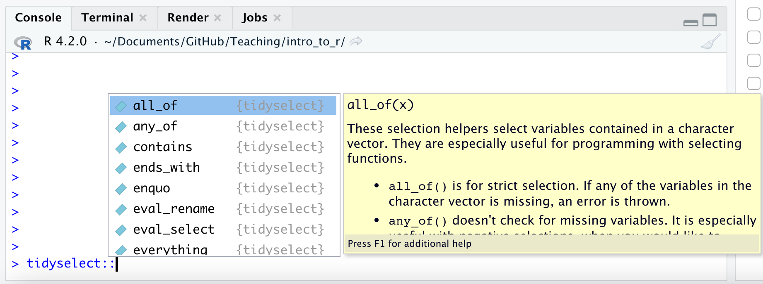

Slide 55
Combining tidyselect helpers with regular selection
head(er_30, 2)
# A tibble: 2 × 6 county rate lower95cl upper95cl visits year <chr> <dbl> <dbl> <dbl> <dbl> <dbl> 1 Garfield NA NA NA NA 2018 2 Chaffee NA NA NA NA 2015
select(er_30, ends_with("cl"), year)
# A tibble: 30 × 3 lower95cl upper95cl year <dbl> <dbl> <dbl> 1 NA NA 2018 2 NA NA 2015 3 9.54 22.2 2021 4 0 0 2019 5 0 0 2014 6 NA NA 2012 7 NA NA 2017 8 0 0 2016 9 NA NA 2012 10 0 0 2012 # ℹ 20 more rows

Slide 56
Multiple tidyselect functions
Follows OR logic.
select(er_30, ends_with("cl"), starts_with("r"))
# A tibble: 30 × 3 lower95cl upper95cl rate <dbl> <dbl> <dbl> 1 NA NA NA 2 NA NA NA 3 9.54 22.2 15.9 4 0 0 0 5 0 0 0 6 NA NA NA 7 NA NA NA 8 0 0 0 9 NA NA NA 10 0 0 0 # ℹ 20 more rows

Slide 57
The where() function can help select columns of a specific class
is.character() and is.numeric() are often the most helpful
head(er_30, 2)
# A tibble: 2 × 6 county rate lower95cl upper95cl visits year <chr> <dbl> <dbl> <dbl> <dbl> <dbl> 1 Garfield NA NA NA NA 2018 2 Chaffee NA NA NA NA 2015
select(er_30, where(is.numeric))
# A tibble: 30 × 5 rate lower95cl upper95cl visits year <dbl> <dbl> <dbl> <dbl> <dbl> 1 NA NA NA NA 2018 2 NA NA NA NA 2015 3 15.9 9.54 22.2 26 2021 4 0 0 0 0 2019 5 0 0 0 0 2014 6 NA NA NA NA 2012 7 NA NA NA NA 2017 8 0 0 0 0 2016 9 NA NA NA NA 2012 10 0 0 0 0 2012 # ℹ 20 more rows

Slide 58
Subsetting Rows

Slide 59
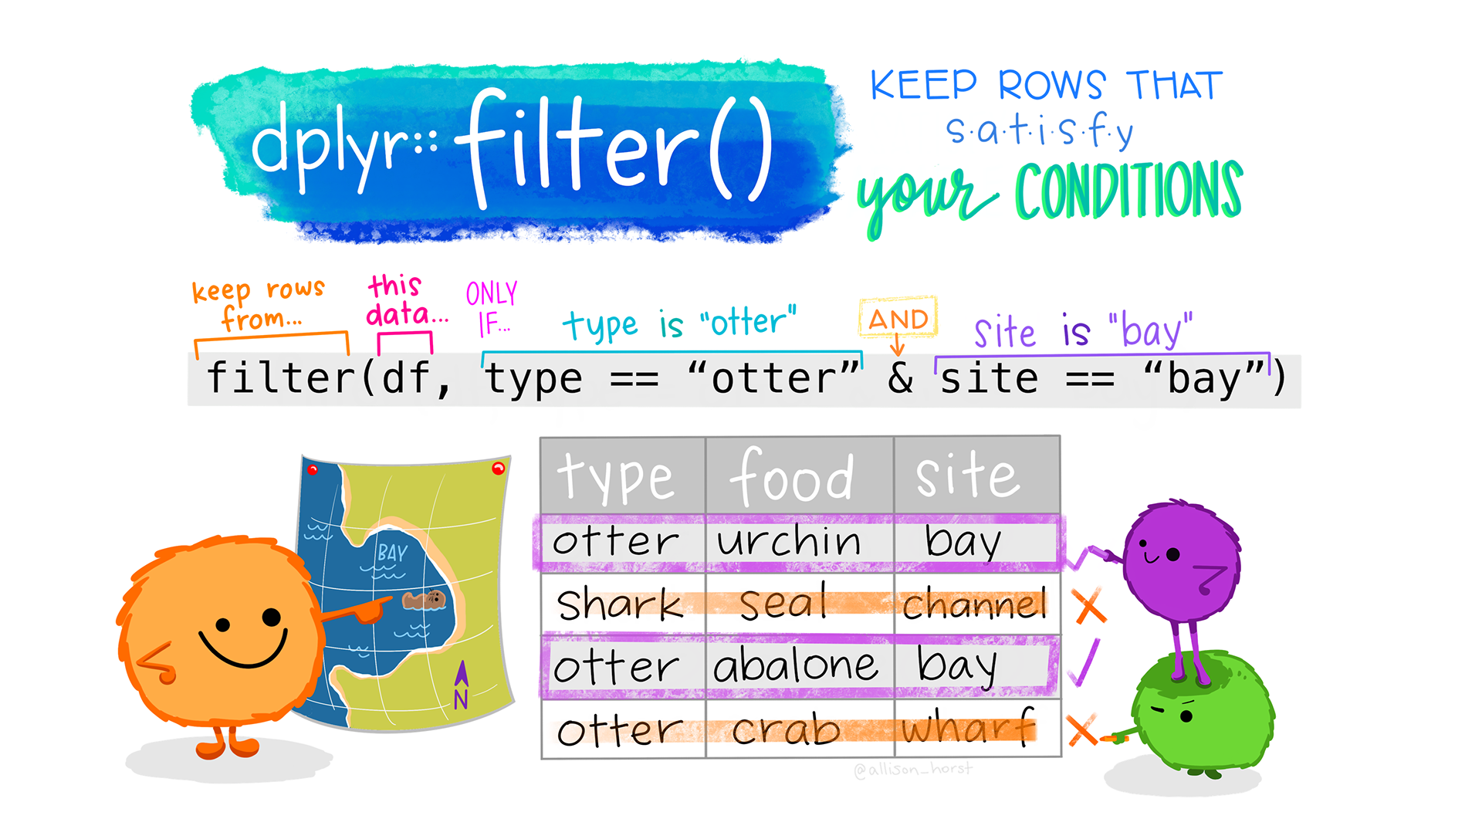
filter function

Slide 60
“Artwork by @allison_horst”. https://allisonhorst.com/

Slide 61
Subset rows of a data frame: dplyr
The command in dplyr for subsetting rows is filter.
filter(er_30, year > 2020)
# A tibble: 4 × 6 county rate lower95cl upper95cl visits year <chr> <dbl> <dbl> <dbl> <dbl> <dbl> 1 Pueblo 15.9 9.54 22.2 26 2021 2 Otero NA NA NA NA 2022 3 Mesa 12.0 7.12 18.2 19 2021 4 Chaffee 0 0 0 0 2022

Slide 62
Subset rows of a data frame: dplyr
You can have multiple logical conditions using the following:
== : equals to
!=: not equal to (! : not/negation)
> / <: greater than / less than
>= or <=: greater than or equal to / less than or equal to
& : AND
| : OR

Slide 63
Common error for filter
If you try to filter for a column that does not exist it will not work:
misspelled column name
column that was already removed

Slide 64
Subset rows of a data frame: dplyr
You can filter by two conditions using & or commas (must meet both conditions):
filter(er_30, rate > 9, year == 2012)
filter(er_30, rate > 9 & year == 2012) # same result
# A tibble: 0 × 6 # ℹ 6 variables: county <chr>, rate <dbl>, lower95cl <dbl>, upper95cl <dbl>, # visits <dbl>, year <dbl>

Slide 65
Subset rows of a data frame: dplyr
If you want OR statements (meaning the data can meet either condition does not need to meet both), you need to use | between conditions:
filter(er_30, rate > 9 | year == 2012)
# A tibble: 6 × 6 county rate lower95cl upper95cl visits year <chr> <dbl> <dbl> <dbl> <dbl> <dbl> 1 Pueblo 15.9 9.54 22.2 26 2021 2 Chaffee NA NA NA NA 2012 3 Prowers NA NA NA NA 2012 4 Hinsdale 0 0 0 0 2012 5 Mesa 12.0 7.12 18.2 19 2021 6 Phillips 0 0 0 0 2012

Slide 66
Subset rows of a data frame: dplyr
The %in% operator can be used find values from a pre-made list (using c()) for a single column at a time.
filter(er_30, county %in% c("Denver","Larimer","Pueblo"))
# A tibble: 3 × 6 county rate lower95cl upper95cl visits year <chr> <dbl> <dbl> <dbl> <dbl> <dbl> 1 Pueblo 15.9 9.54 22.2 26 2021 2 Denver 2.95 1.75 4.46 19 2013 3 Larimer 5.49 3.16 8.45 17 2014
filter(er_30, county == "Denver"| county == "Larimer"| county == "Pueblo") #equivalent
# A tibble: 3 × 6 county rate lower95cl upper95cl visits year <chr> <dbl> <dbl> <dbl> <dbl> <dbl> 1 Pueblo 15.9 9.54 22.2 26 2021 2 Denver 2.95 1.75 4.46 19 2013 3 Larimer 5.49 3.16 8.45 17 2014

Slide 67
Subset rows of a data frame: dplyr
The %in% operator can be used find values from a pre-made list (using c()) for a single column at a time with different columns.
filter(er_30, year %in% c(2013,2021), county %in% c("Denver","Pueblo"))
# A tibble: 2 × 6 county rate lower95cl upper95cl visits year <chr> <dbl> <dbl> <dbl> <dbl> <dbl> 1 Pueblo 15.9 9.54 22.2 26 2021 2 Denver 2.95 1.75 4.46 19 2013

Slide 68
Be careful with column names and filter
This will not work the way you might expect! Best to stick with nothing but the column name if it is a typical name.
filter(er_30, "year" > 2014)
# A tibble: 30 × 6 county rate lower95cl upper95cl visits year <chr> <dbl> <dbl> <dbl> <dbl> <dbl> 1 Garfield NA NA NA NA 2018 2 Chaffee NA NA NA NA 2015 3 Pueblo 15.9 9.54 22.2 26 2021 4 Rio Grande 0 0 0 0 2019 5 Lake 0 0 0 0 2014 6 Chaffee NA NA NA NA 2012 7 Chaffee NA NA NA NA 2017 8 Teller 0 0 0 0 2016 9 Prowers NA NA NA NA 2012 10 Hinsdale 0 0 0 0 2012 # ℹ 20 more rows

Slide 69
Don’t use quotes for atypical names
Atypical names are those with punctuation, spaces, start with a number, or are just a number.
er_30_rename <- rename(er_30, `year!` = year) filter(er_30_rename, "year!" > 2013) # will not work correctly
# A tibble: 30 × 6 county rate lower95cl upper95cl visits `year!` <chr> <dbl> <dbl> <dbl> <dbl> <dbl> 1 Garfield NA NA NA NA 2018 2 Chaffee NA NA NA NA 2015 3 Pueblo 15.9 9.54 22.2 26 2021 4 Rio Grande 0 0 0 0 2019 5 Lake 0 0 0 0 2014 6 Chaffee NA NA NA NA 2012 7 Chaffee NA NA NA NA 2017 8 Teller 0 0 0 0 2016 9 Prowers NA NA NA NA 2012 10 Hinsdale 0 0 0 0 2012 # ℹ 20 more rows

Slide 70
Be careful with column names and filter
Using backticks works!
filter(er_30_rename, `year!` > 2013)
# A tibble: 23 × 6 county rate lower95cl upper95cl visits `year!` <chr> <dbl> <dbl> <dbl> <dbl> <dbl> 1 Garfield NA NA NA NA 2018 2 Chaffee NA NA NA NA 2015 3 Pueblo 15.9 9.54 22.2 26 2021 4 Rio Grande 0 0 0 0 2019 5 Lake 0 0 0 0 2014 6 Chaffee NA NA NA NA 2017 7 Teller 0 0 0 0 2016 8 Boulder 3.51 1.77 5.83 12 2017 9 Fremont NA NA NA NA 2016 10 Kiowa NA NA NA NA 2020 # ℹ 13 more rows

Slide 71
Be careful with column names and filter
filter(er_30, "county" == "Denver") # this will not work
# A tibble: 0 × 6 # ℹ 6 variables: county <chr>, rate <dbl>, lower95cl <dbl>, upper95cl <dbl>, # visits <dbl>, year <dbl>

Slide 72
Be careful with column names and filter
filter(er_30, county == "Denver")# this works!
# A tibble: 1 × 6 county rate lower95cl upper95cl visits year <chr> <dbl> <dbl> <dbl> <dbl> <dbl> 1 Denver 2.95 1.75 4.46 19 2013

Slide 73
filter() is tricky
Try not use anything special for the column names in filter(). This is why it is good to not use atypical column names. Then you can just use the column name!

Slide 74
Always good to check each step!
Did the filter work the way you expected? Did the dimensions change?

Slide 75


Slide 76
https://media.giphy.com/media/5b5OU7aUekfdSAER5I/giphy.gif

Slide 77
GUT CHECK: If we want to keep just rows that meet either or two conditions, what code should we use?
A. filter() with |
B. filter() with &

Slide 78
Summary
pull() to get values out of a data frame/tibble
select() is the tidyverse way to get a tibble with only certain columns
you can select() based on patterns in the column names
you can also select() based on column class with the where() function
you can combine multiple tidyselect functions together like select(starts_with("C"), ends_with("state"))
you can combine multiple patterns with the c() function like select(starts_with(c("A", "C"))) (see extra slides at the end for more info!)
filter() can be used to filter out rows based on logical conditions
avoid using quotes when referring to column names with filter()

Slide 79
Summary Continued
== is the same as equivalent to
& means both conditions must be met to remain after filter()
| means either conditions needs to be met to remain after filter()

Slide 80
Lab Part 2
🏠 Class Website
💻 Lab
📃 Day 3 Cheatsheet
📃 Posit’s dplyr Cheatsheet

Slide 81
Get the data
#er <- read_csv("https://daseh.org/data/CO_ER_heat_visits.csv") set.seed(1234) er_30 <-slice_sample(er, n = 30)

Slide 82
Combining filter and select
You can combine filter and select to subset the rows and columns, respectively, of a data frame:
select(filter(er_30, year > 2012), county)
# A tibble: 25 × 1 county <chr> 1 Garfield 2 Chaffee 3 Pueblo 4 Rio Grande 5 Lake 6 Chaffee 7 Teller 8 Boulder 9 Fremont 10 Kiowa # ℹ 15 more rows

Slide 83
Nesting
In R, the common way to perform multiple operations is to wrap functions around each other in a “nested” form.
head(select(er_30, year, county), 2)
# A tibble: 2 × 2 year county <dbl> <chr> 1 2018 Garfield 2 2015 Chaffee

Slide 84
Nesting can get confusing looking
select(filter(er_30, year > 2000 & county == "Denver"), year, rate)
# A tibble: 1 × 2 year rate <dbl> <dbl> 1 2013 2.95

Slide 85
Assigning Temporary Objects
One can also create temporary objects and reassign them:
er_30_Den <- filter(er_30, year > 2000 & county == "Denver") er_30_Den <- select(er_30_Den, year, rate) head(er_30_Den)
# A tibble: 1 × 2 year rate <dbl> <dbl> 1 2013 2.95

Slide 86
Using the pipe (comes with dplyr):
The pipe |> makes this much more readable. It reads left side “pipes” into right side. Pipe er_30 into filter, then pipe that into select:
er_30 |> filter(year > 2000 & county == "Denver") |> select(year, rate)
# A tibble: 1 × 2 year rate <dbl> <dbl> 1 2013 2.95

Slide 87
Alternative Pipes
There are multiple ways to write a pipe and you might also see this (they work the same!):
%>% - called the tydiverse pipe
RStudio CMD/Ctrl + Shift + M shortcut. We find that people often mix up %>% and %in%.
|> - called the base pipe
Follow this link to add a shortcut

Slide 88
Adding/Removing Columns

Slide 89
Adding columns to a data frame: dplyr (tidyverse way)
The mutate function in dplyr allows you to add or modify columns of a data frame.
# General format - Not the code! {data object to update} <- mutate({data to use}, {new variable name} = {new variable source})
er_30 <- mutate(er_30, newcol = rate * 2) head(er_30, 4)
# A tibble: 4 × 7 county rate lower95cl upper95cl visits year newcol <chr> <dbl> <dbl> <dbl> <dbl> <dbl> <dbl> 1 Garfield NA NA NA NA 2018 NA 2 Chaffee NA NA NA NA 2015 NA 3 Pueblo 15.9 9.54 22.2 26 2021 31.8 4 Rio Grande 0 0 0 0 2019 0

Slide 90
Use mutate to modify existing columns
The mutate function in dplyr allows you to add or modify columns of a data frame.
# General format - Not the code! {data object to update} <- mutate({data to use}, {variable name to change} = {variable modification})
er_30 <- mutate(er_30, newcol = newcol / 2) head(er_30, 4)
# A tibble: 4 × 7 county rate lower95cl upper95cl visits year newcol <chr> <dbl> <dbl> <dbl> <dbl> <dbl> <dbl> 1 Garfield NA NA NA NA 2018 NA 2 Chaffee NA NA NA NA 2015 NA 3 Pueblo 15.9 9.54 22.2 26 2021 15.9 4 Rio Grande 0 0 0 0 2019 0

Slide 91
You can pipe data into mutate
er_30 <- er_30 |> mutate(newcol = newcol / 2) head(er_30,4)
# A tibble: 4 × 7 county rate lower95cl upper95cl visits year newcol <chr> <dbl> <dbl> <dbl> <dbl> <dbl> <dbl> 1 Garfield NA NA NA NA 2018 NA 2 Chaffee NA NA NA NA 2015 NA 3 Pueblo 15.9 9.54 22.2 26 2021 7.95 4 Rio Grande 0 0 0 0 2019 0

Slide 92
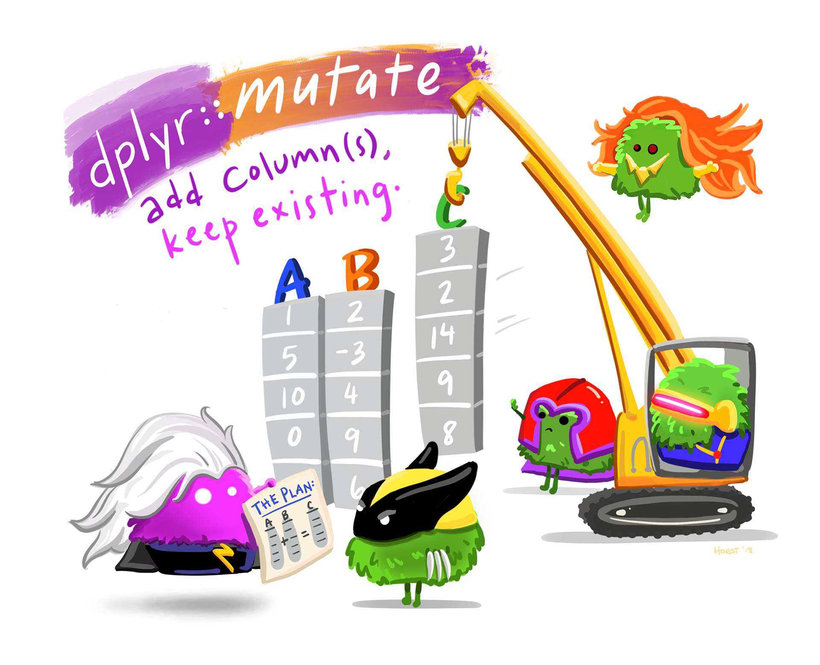
mutate function

Slide 93
“Artwork by @allison_horst”. https://allisonhorst.com/

Slide 94
Removing columns of a data frame: dplyr
The NULL method is still very common.
The select function can remove a column with exclamation mark (!) our using the minus sign (-):
select(er_30, !newcol)
# A tibble: 6 × 6 county rate lower95cl upper95cl visits year <chr> <dbl> <dbl> <dbl> <dbl> <dbl> 1 Garfield NA NA NA NA 2018 2 Chaffee NA NA NA NA 2015 3 Pueblo 15.9 9.54 22.2 26 2021 4 Rio Grande 0 0 0 0 2019 5 Lake 0 0 0 0 2014 6 Chaffee NA NA NA NA 2012
Or, you can simply select the columns you want to keep, ignoring the ones you want to remove.

Slide 95
Removing columns in a data frame: dplyr
You can use c() to list the columns to remove.
Remove newcol and year:
select(er_30, !c(newcol, year))
# A tibble: 30 × 5 county rate lower95cl upper95cl visits <chr> <dbl> <dbl> <dbl> <dbl> 1 Garfield NA NA NA NA 2 Chaffee NA NA NA NA 3 Pueblo 15.9 9.54 22.2 26 4 Rio Grande 0 0 0 0 5 Lake 0 0 0 0 6 Chaffee NA NA NA NA 7 Chaffee NA NA NA NA 8 Teller 0 0 0 0 9 Prowers NA NA NA NA 10 Hinsdale 0 0 0 0 # ℹ 20 more rows

Slide 96
Ordering columns

Slide 97
Ordering the columns of a data frame: dplyr
The select function can reorder columns.
head(er_30, 2)
# A tibble: 2 × 7 county rate lower95cl upper95cl visits year newcol <chr> <dbl> <dbl> <dbl> <dbl> <dbl> <dbl> 1 Garfield NA NA NA NA 2018 NA 2 Chaffee NA NA NA NA 2015 NA
er_30 |> select(year, rate, county) |> head(2)
# A tibble: 2 × 3 year rate county <dbl> <dbl> <chr> 1 2018 NA Garfield 2 2015 NA Chaffee

Slide 98
Ordering the columns of a data frame: dplyr
The select function can reorder columns. Put newcol first, then select the rest of columns:
select(er_30, newcol, everything())
# A tibble: 3 × 7 newcol county rate lower95cl upper95cl visits year <dbl> <chr> <dbl> <dbl> <dbl> <dbl> <dbl> 1 NA Garfield NA NA NA NA 2018 2 NA Chaffee NA NA NA NA 2015 3 7.95 Pueblo 15.9 9.54 22.2 26 2021

Slide 99
Ordering the columns of a data frame: dplyr
In addition to select we can also use the relocate() function of dplyr to rearrange the columns for more complicated moves with the .before and .after arguments.
For example, let say we just wanted year to be before `rate``.
head(er_30, 1)
# A tibble: 1 × 7 county rate lower95cl upper95cl visits year newcol <chr> <dbl> <dbl> <dbl> <dbl> <dbl> <dbl> 1 Garfield NA NA NA NA 2018 NA
er_year_fix <- relocate(er_30, year, .before = rate) head(er_year_fix, 1)
# A tibble: 1 × 7 county year rate lower95cl upper95cl visits newcol <chr> <dbl> <dbl> <dbl> <dbl> <dbl> <dbl> 1 Garfield 2018 NA NA NA NA NA

Slide 100
Ordering rows

Slide 101
Ordering the rows of a data frame: dplyr
The arrange function can reorder rows By default, arrange orders in increasing order:
arrange(er_30, year)
# A tibble: 30 × 7 county rate lower95cl upper95cl visits year newcol <chr> <dbl> <dbl> <dbl> <dbl> <dbl> <dbl> 1 Saguache 0 0 0 0 2011 0 2 Chaffee NA NA NA NA 2012 NA 3 Prowers NA NA NA NA 2012 NA 4 Hinsdale 0 0 0 0 2012 0 5 Phillips 0 0 0 0 2012 0 6 Denver 2.95 1.75 4.46 19 2013 1.47 7 San Miguel NA NA NA NA 2013 NA 8 Lake 0 0 0 0 2014 0 9 Delta 0 0 0 0 2014 0 10 Adams 3.08 1.71 4.85 15 2014 1.54 # ℹ 20 more rows

Slide 102
Ordering the rows of a data frame: dplyr
Use the desc to arrange the rows in descending order:
arrange(er_30, desc(year))
# A tibble: 30 × 7 county rate lower95cl upper95cl visits year newcol <chr> <dbl> <dbl> <dbl> <dbl> <dbl> <dbl> 1 Otero NA NA NA NA 2022 NA 2 Chaffee 0 0 0 0 2022 0 3 Pueblo 15.9 9.54 22.2 26 2021 7.95 4 Mesa 12.0 7.12 18.2 19 2021 6.01 5 Kiowa NA NA NA NA 2020 NA 6 Park NA NA NA NA 2020 NA 7 Rio Blanco NA NA NA NA 2020 NA 8 Rio Grande 0 0 0 0 2019 0 9 Garfield NA NA NA NA 2018 NA 10 Dolores 0 0 0 0 2018 0 # ℹ 20 more rows

Slide 103
Ordering the rows of a data frame: dplyr
You can combine increasing and decreasing orderings:
arrange(er_30, rate, desc(year)) |> head(n = 2)
# A tibble: 2 × 7 county rate lower95cl upper95cl visits year newcol <chr> <dbl> <dbl> <dbl> <dbl> <dbl> <dbl> 1 Chaffee 0 0 0 0 2022 0 2 Rio Grande 0 0 0 0 2019 0
arrange(er_30, desc(year), rate) |> head(n = 2)
# A tibble: 2 × 7 county rate lower95cl upper95cl visits year newcol <chr> <dbl> <dbl> <dbl> <dbl> <dbl> <dbl> 1 Chaffee 0 0 0 0 2022 0 2 Otero NA NA NA NA 2022 NA

Slide 104
GUT CHECK: What function would be useful for changing a column to be a percentage instead of a ratio?
A. filter()
B. select()
C. mutate()

Slide 105
GUT CHECK: How would we interpret er_30 |> filter(year > 2020) |> select(year, rate)?
A. Get the er_30 data, then filter it for rows with year values over 2020, then select only the year and rate columns.
B. Get the er_30 data, then filter it rows with year values over 2020, then select for rows that have values for year and rate.

Slide 106
Summary
select() and filter() can be combined together
you can do sequential steps in a few ways:
nesting them inside one another using parentheses ()
creating intermediate data objects in between
using pipes |> (like “then” statements)
select() and relocate() can be used to reorder columns
arrange() can be used to reorder rows
can remove rows with filter()
can remove a column in a few ways:
using select() with exclamation mark in front of column name(s)
not selecting it (without exclamation mark)

Slide 107
Summary cont…
mutate() can be used to create new variables or modify them
# General format - Not the code! {data object to update} <- mutate({data to use}, {new variable name} = {new variable source})
er_30 <- mutate(ER_30, newcol = count/2.2)

Slide 108
A note about base R:
The $ operator is similar to pull(). This is the base R way to do this:
er_30$year
[1] 2018 2015 2021 2019 2014 2012 2017 2016 2012 2012 2017 2016 2020 2014 2020 [16] 2014 2011 2022 2018 2013 2017 2021 2015 2020 2012 2016 2013 2014 2017 2022
Although it is easier (for this one task), mixing and matching the $ operator with tidyverse functions usually doesn’t work. Therefore, we want to let you know about it in case you see it, but we suggest that you try working with the tidyverse way.

Slide 109
Adding new columns to a data frame: base R
You can add a new column (or modify an existing one) using the $ operator instead of mutate.
Just want you to be aware of this as it is very common.
er_30$newcol <- er_30$rate/2.2 head(er_30,3)
# A tibble: 3 × 7 county rate lower95cl upper95cl visits year newcol <chr> <dbl> <dbl> <dbl> <dbl> <dbl> <dbl> 1 Garfield NA NA NA NA 2018 NA 2 Chaffee NA NA NA NA 2015 NA 3 Pueblo 15.9 9.54 22.2 26 2021 7.22
Even though $ is easier for creating new columns, mutate is really powerful, so it’s worth getting used to.

Slide 110
Lab Part 3
🏠 Class Website
💻 Lab
📃 Day 3 Cheatsheet
📃 Posit’s dplyr Cheatsheet

Slide 111


Slide 112
Image by Gerd Altmann from Pixabay

Slide 113
Extra Slides

Slide 114
Multiple patterns with tidyselect
Need to combine the patterns with the c() function.
select(er_30, ends_with("cl"), starts_with("r"))
# A tibble: 30 × 3 lower95cl upper95cl rate <dbl> <dbl> <dbl> 1 NA NA NA 2 NA NA NA 3 9.54 22.2 15.9 4 0 0 0 5 0 0 0 6 NA NA NA 7 NA NA NA 8 0 0 0 9 NA NA NA 10 0 0 0 # ℹ 20 more rows
select(er_30, starts_with(c("r", "l"))) # here we combine two patterns
# A tibble: 30 × 2 rate lower95cl <dbl> <dbl> 1 NA NA 2 NA NA 3 15.9 9.54 4 0 0 5 0 0 6 NA NA 7 NA NA 8 0 0 9 NA NA 10 0 0 # ℹ 20 more rows

Slide 115
Nuances about filter()
test <- tibble(A = c(1,2,3,4), B = c(1,2,3,4)) test
# A tibble: 4 × 2 A B <dbl> <dbl> 1 1 1 2 2 2 3 3 3 4 4 4
# These are technically the same but >= is easier to read # Separating can cause issues filter(test, B > 2 | B==2)
# A tibble: 3 × 2 A B <dbl> <dbl> 1 2 2 2 3 3 3 4 4
filter(test, B >= 2)
# A tibble: 3 × 2 A B <dbl> <dbl> 1 2 2 2 3 3 3 4 4

Slide 116
Order of operations for filter()
Order can matter. Think of individual statements separately first.
filter(test, A>3 | B==2 & B>2) # A is greater than 3 or B is equal to 2 AND (think but also) B must be greater than 2 , thus 2 is dropped.
# A tibble: 1 × 2 A B <dbl> <dbl> 1 4 4
filter(test, A>3 & B>2 | B==2) # A is greater than 3 AND B is greater than 2 leaving only 4s OR B is equal to 2, (since this comes later, 2 is preserved)
# A tibble: 2 × 2 A B <dbl> <dbl> 1 2 2 2 4 4

Slide 117
Ordering the column names of a data frame: alphabetically
Using the base R order() function.
order(colnames(er_30))
[1] 1 3 7 2 4 5 6
er_30 |> select(order(colnames(er_30)))
# A tibble: 30 × 7 county lower95cl newcol rate upper95cl visits year <chr> <dbl> <dbl> <dbl> <dbl> <dbl> <dbl> 1 Garfield NA NA NA NA NA 2018 2 Chaffee NA NA NA NA NA 2015 3 Pueblo 9.54 7.22 15.9 22.2 26 2021 4 Rio Grande 0 0 0 0 0 2019 5 Lake 0 0 0 0 0 2014 6 Chaffee NA NA NA NA NA 2012 7 Chaffee NA NA NA NA NA 2017 8 Teller 0 0 0 0 0 2016 9 Prowers NA NA NA NA NA 2012 10 Hinsdale 0 0 0 0 0 2012 # ℹ 20 more rows

Slide 118
which() function
Instead of removing rows like filter, which() simply shows where the values occur if they pass a specific condition. We will see that this can be helpful later when we want to select and filter in more complicated ways.
which(select(er_30, year) == 2012)
[1] 6 9 10 25
select(er_30, year) == 2012 |> head(10)
year [1,] FALSE [2,] FALSE [3,] FALSE [4,] FALSE [5,] FALSE [6,] TRUE [7,] FALSE [8,] FALSE [9,] TRUE [10,] TRUE [11,] FALSE [12,] FALSE [13,] FALSE [14,] FALSE [15,] FALSE [16,] FALSE [17,] FALSE [18,] FALSE [19,] FALSE [20,] FALSE [21,] FALSE [22,] FALSE [23,] FALSE [24,] FALSE [25,] TRUE [26,] FALSE [27,] FALSE [28,] FALSE [29,] FALSE [30,] FALSE

Slide 119
Remove a column in base R
er_30$year <- NULL

Slide 120
Renaming Columns of a data frame: base R
We can use the colnames function to extract and/or directly reassign column names of df:
colnames(er_30) # just prints
[1] "county" "rate" "lower95cl" "upper95cl" "visits" "year" [7] "newcol"
colnames(er_30)[1:2] <- c("County", "Rate") # reassigns head(er_30)
# A tibble: 6 × 7 County Rate lower95cl upper95cl visits year newcol <chr> <dbl> <dbl> <dbl> <dbl> <dbl> <dbl> 1 Garfield NA NA NA NA 2018 NA 2 Chaffee NA NA NA NA 2015 NA 3 Pueblo 15.9 9.54 22.2 26 2021 7.22 4 Rio Grande 0 0 0 0 2019 0 5 Lake 0 0 0 0 2014 0 6 Chaffee NA NA NA NA 2012 NA

Slide 121
Subset rows of a data frame with indices:
Let’s select rows 1 and 3 from df using brackets:
er_30[ c(1, 3), ]
# A tibble: 2 × 7 County Rate lower95cl upper95cl visits year newcol <chr> <dbl> <dbl> <dbl> <dbl> <dbl> <dbl> 1 Garfield NA NA NA NA 2018 NA 2 Pueblo 15.9 9.54 22.2 26 2021 7.22

Slide 122
Subset columns of a data frame:
We can also subset a data frame using the bracket [, ] subsetting.
For data frames and matrices (2-dimensional objects), the brackets are [rows, columns] subsetting. We can grab the x column using the index of the column or the column name (“year”)
er_30[, 6]
# A tibble: 30 × 1 year <dbl> 1 2018 2 2015 3 2021 4 2019 5 2014 6 2012 7 2017 8 2016 9 2012 10 2012 # ℹ 20 more rows
er_30[, "year"]
# A tibble: 30 × 1 year <dbl> 1 2018 2 2015 3 2021 4 2019 5 2014 6 2012 7 2017 8 2016 9 2012 10 2012 # ℹ 20 more rows

Slide 123
Subset columns of a data frame:
We can select multiple columns using multiple column names:
er_30[, c("County", "Rate")]
# A tibble: 30 × 2 County Rate <chr> <dbl> 1 Garfield NA 2 Chaffee NA 3 Pueblo 15.9 4 Rio Grande 0 5 Lake 0 6 Chaffee NA 7 Chaffee NA 8 Teller 0 9 Prowers NA 10 Hinsdale 0 # ℹ 20 more rows

