Slide 1
Reproducibility

Slide 2

What is Reproducibility

Slide 3
Content adapted from Candace Savonen.

Slide 4
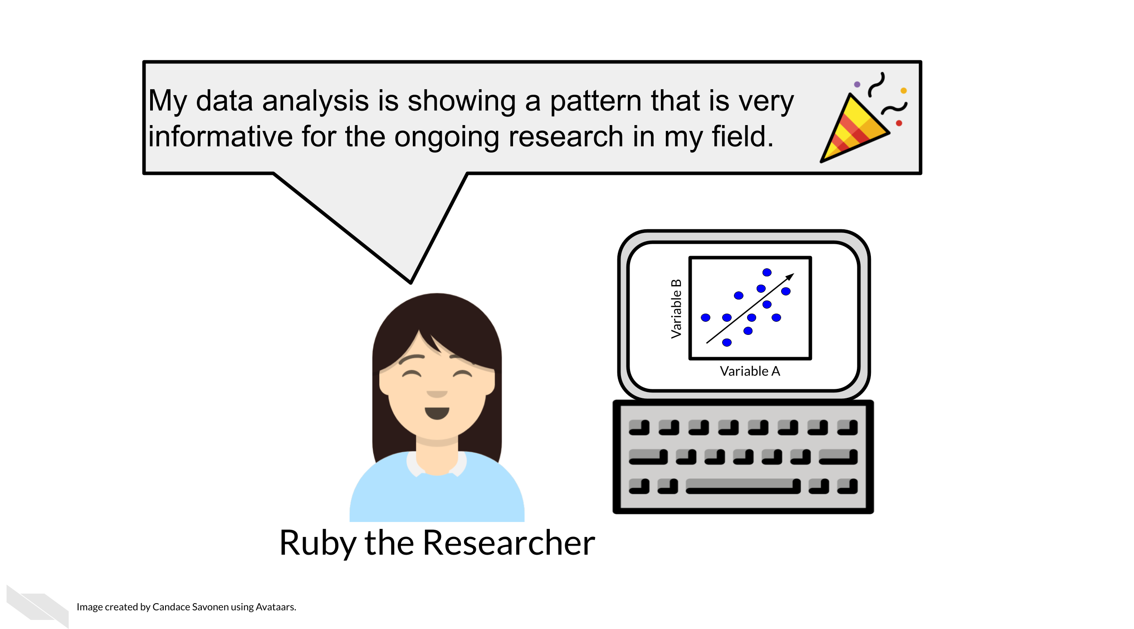

Slide 5
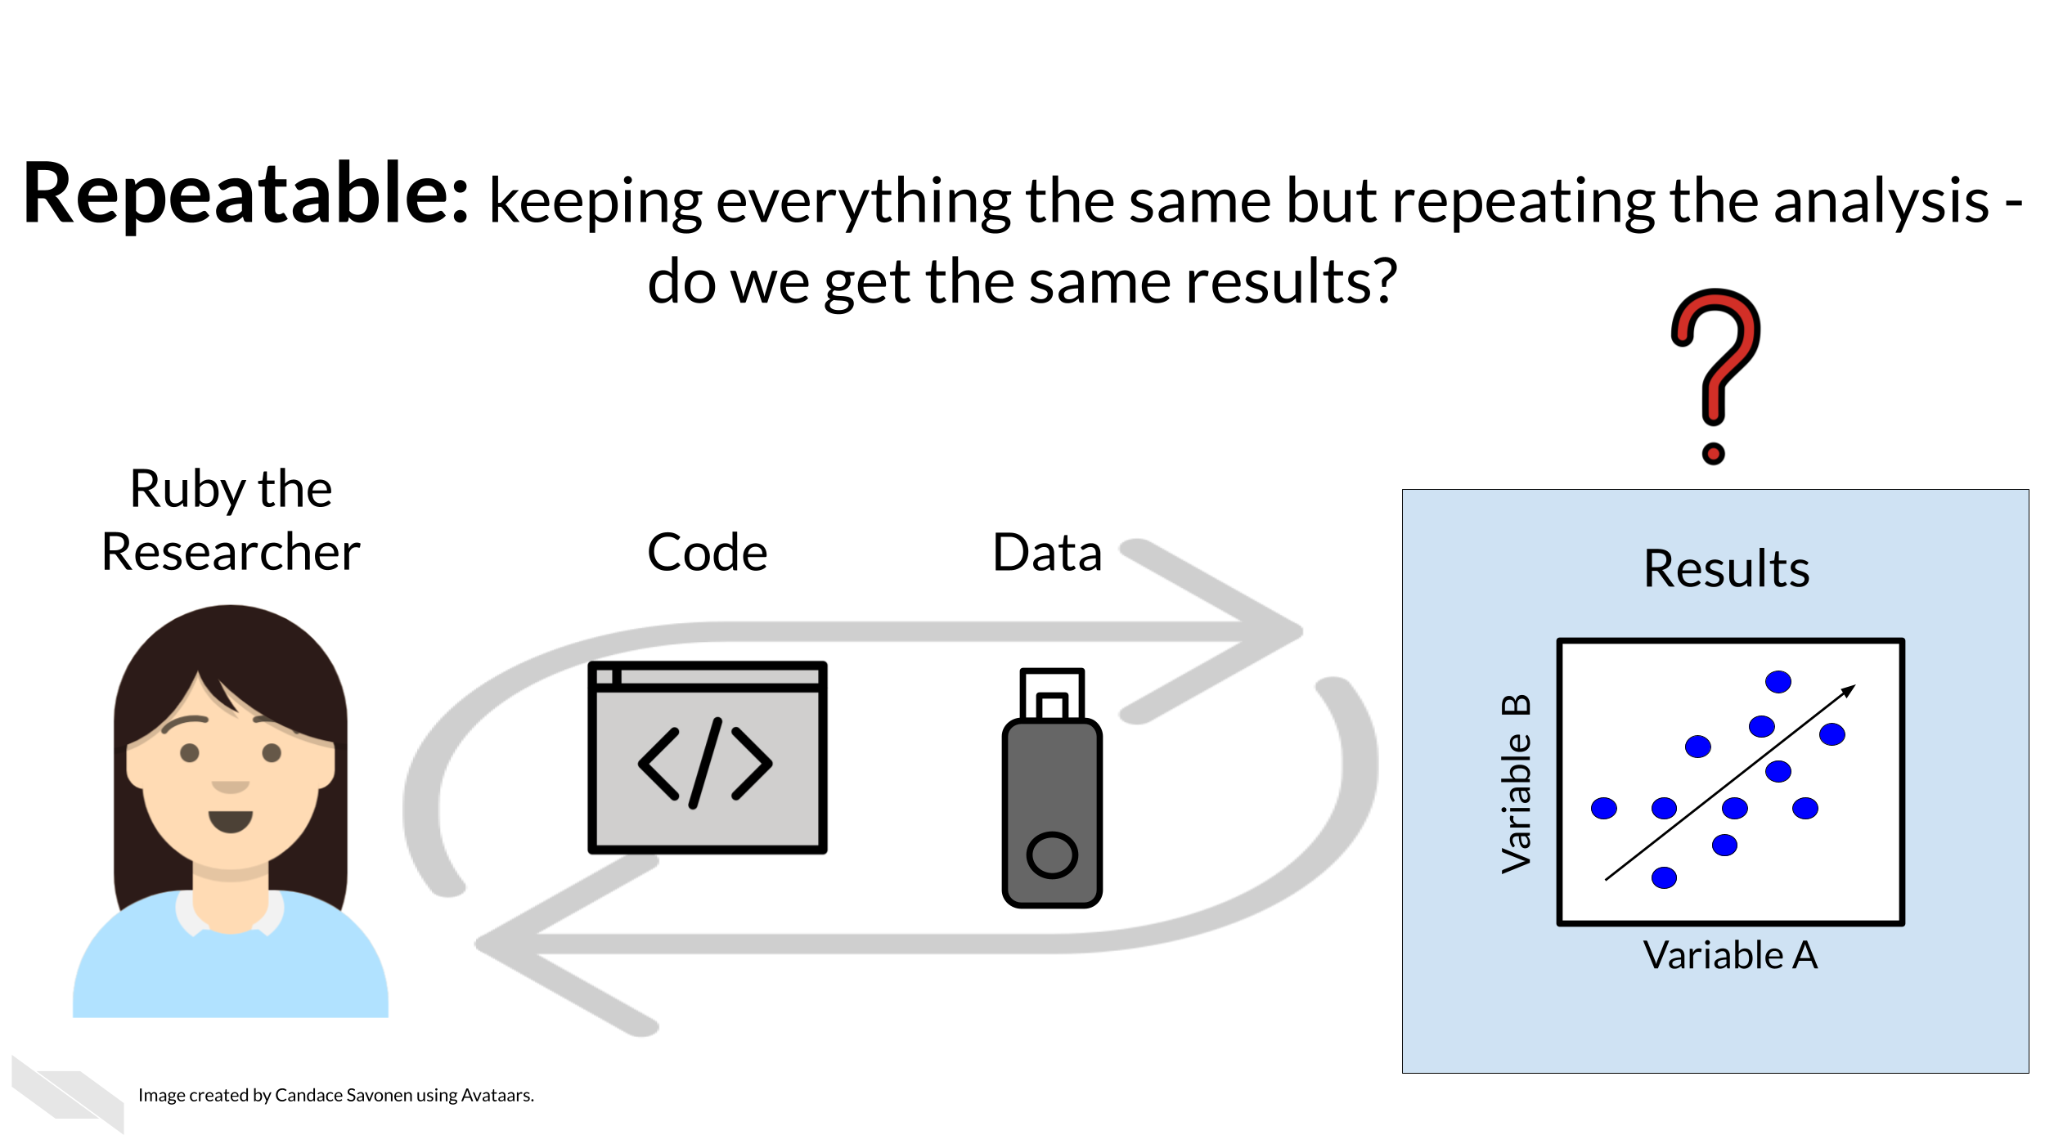

Slide 6
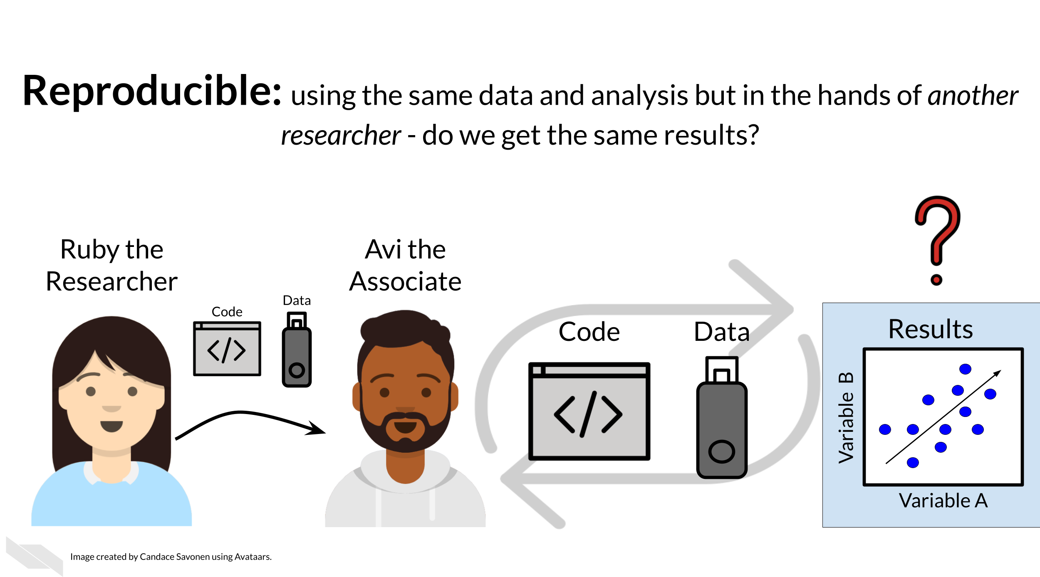

Slide 7
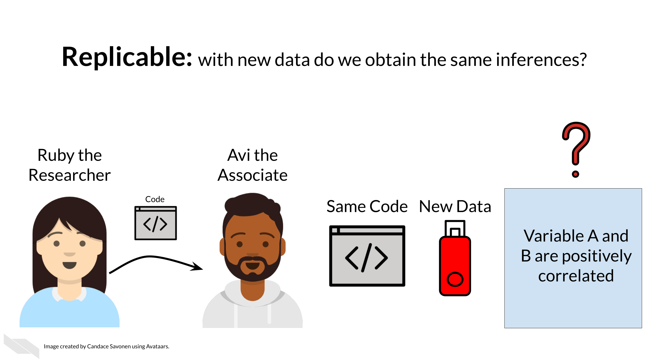

Slide 8
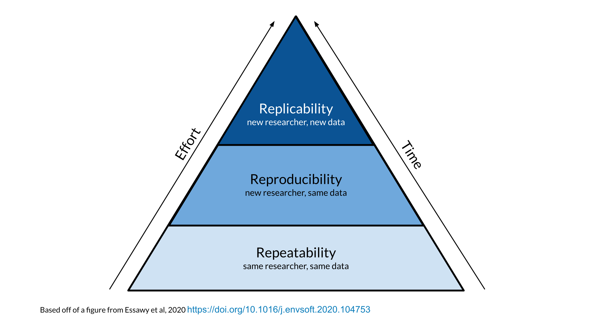
Reproducibility vs Repeatability vs Replicability

Slide 9
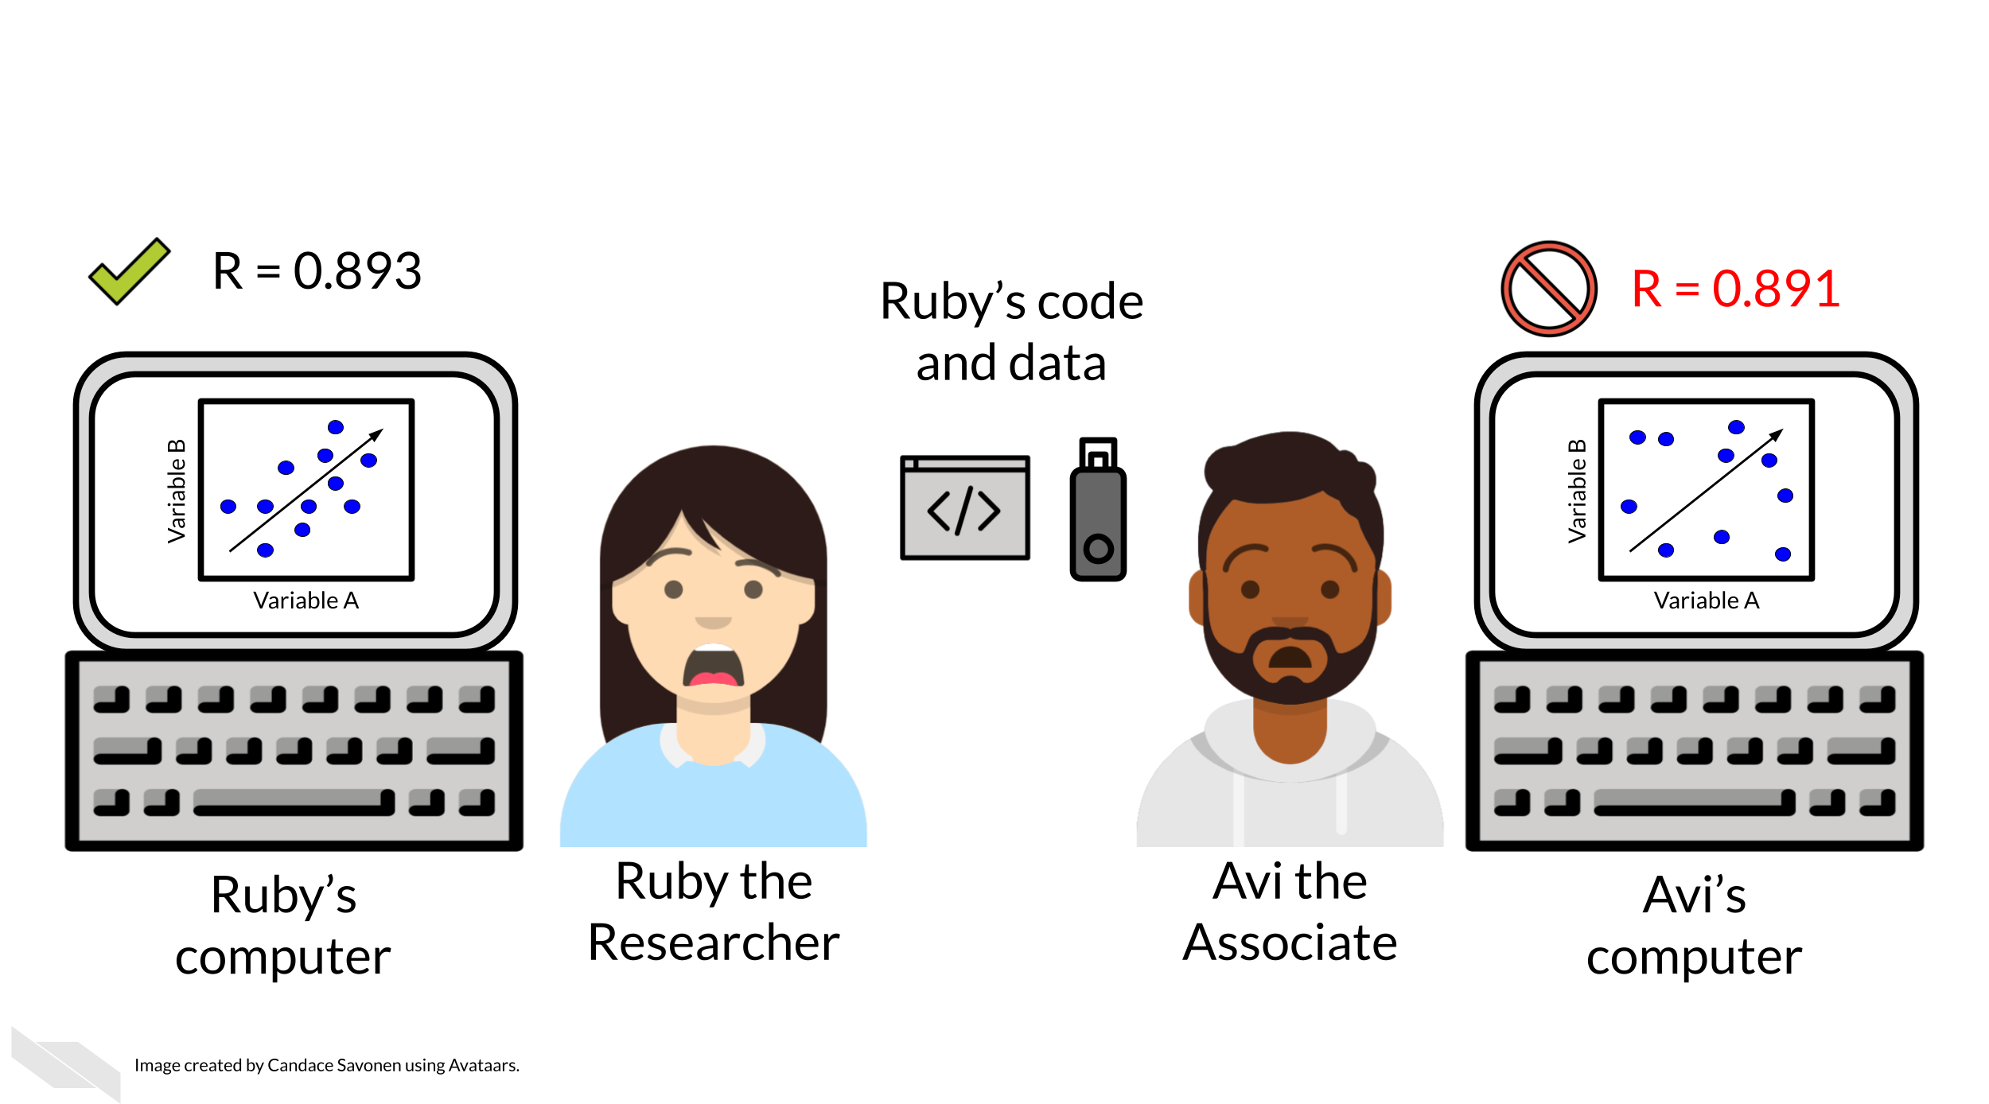
Why Reproducibility is important…

Slide 10
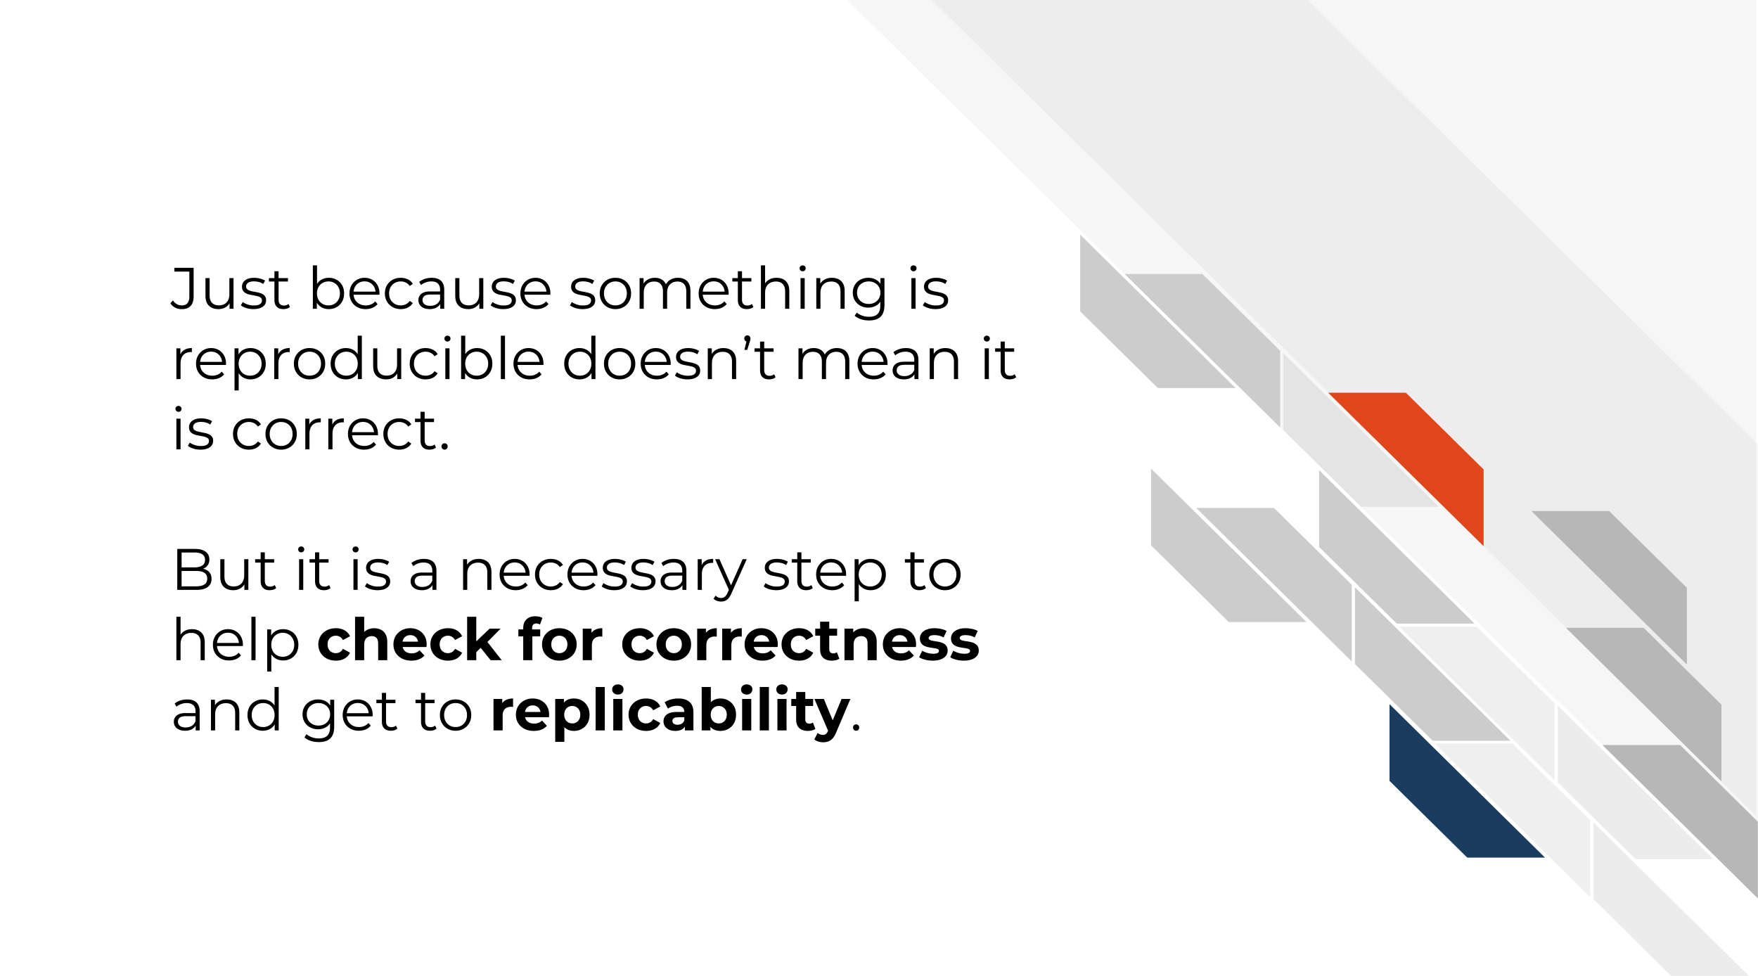
We can’t get to replicability without reproducibility

Slide 11
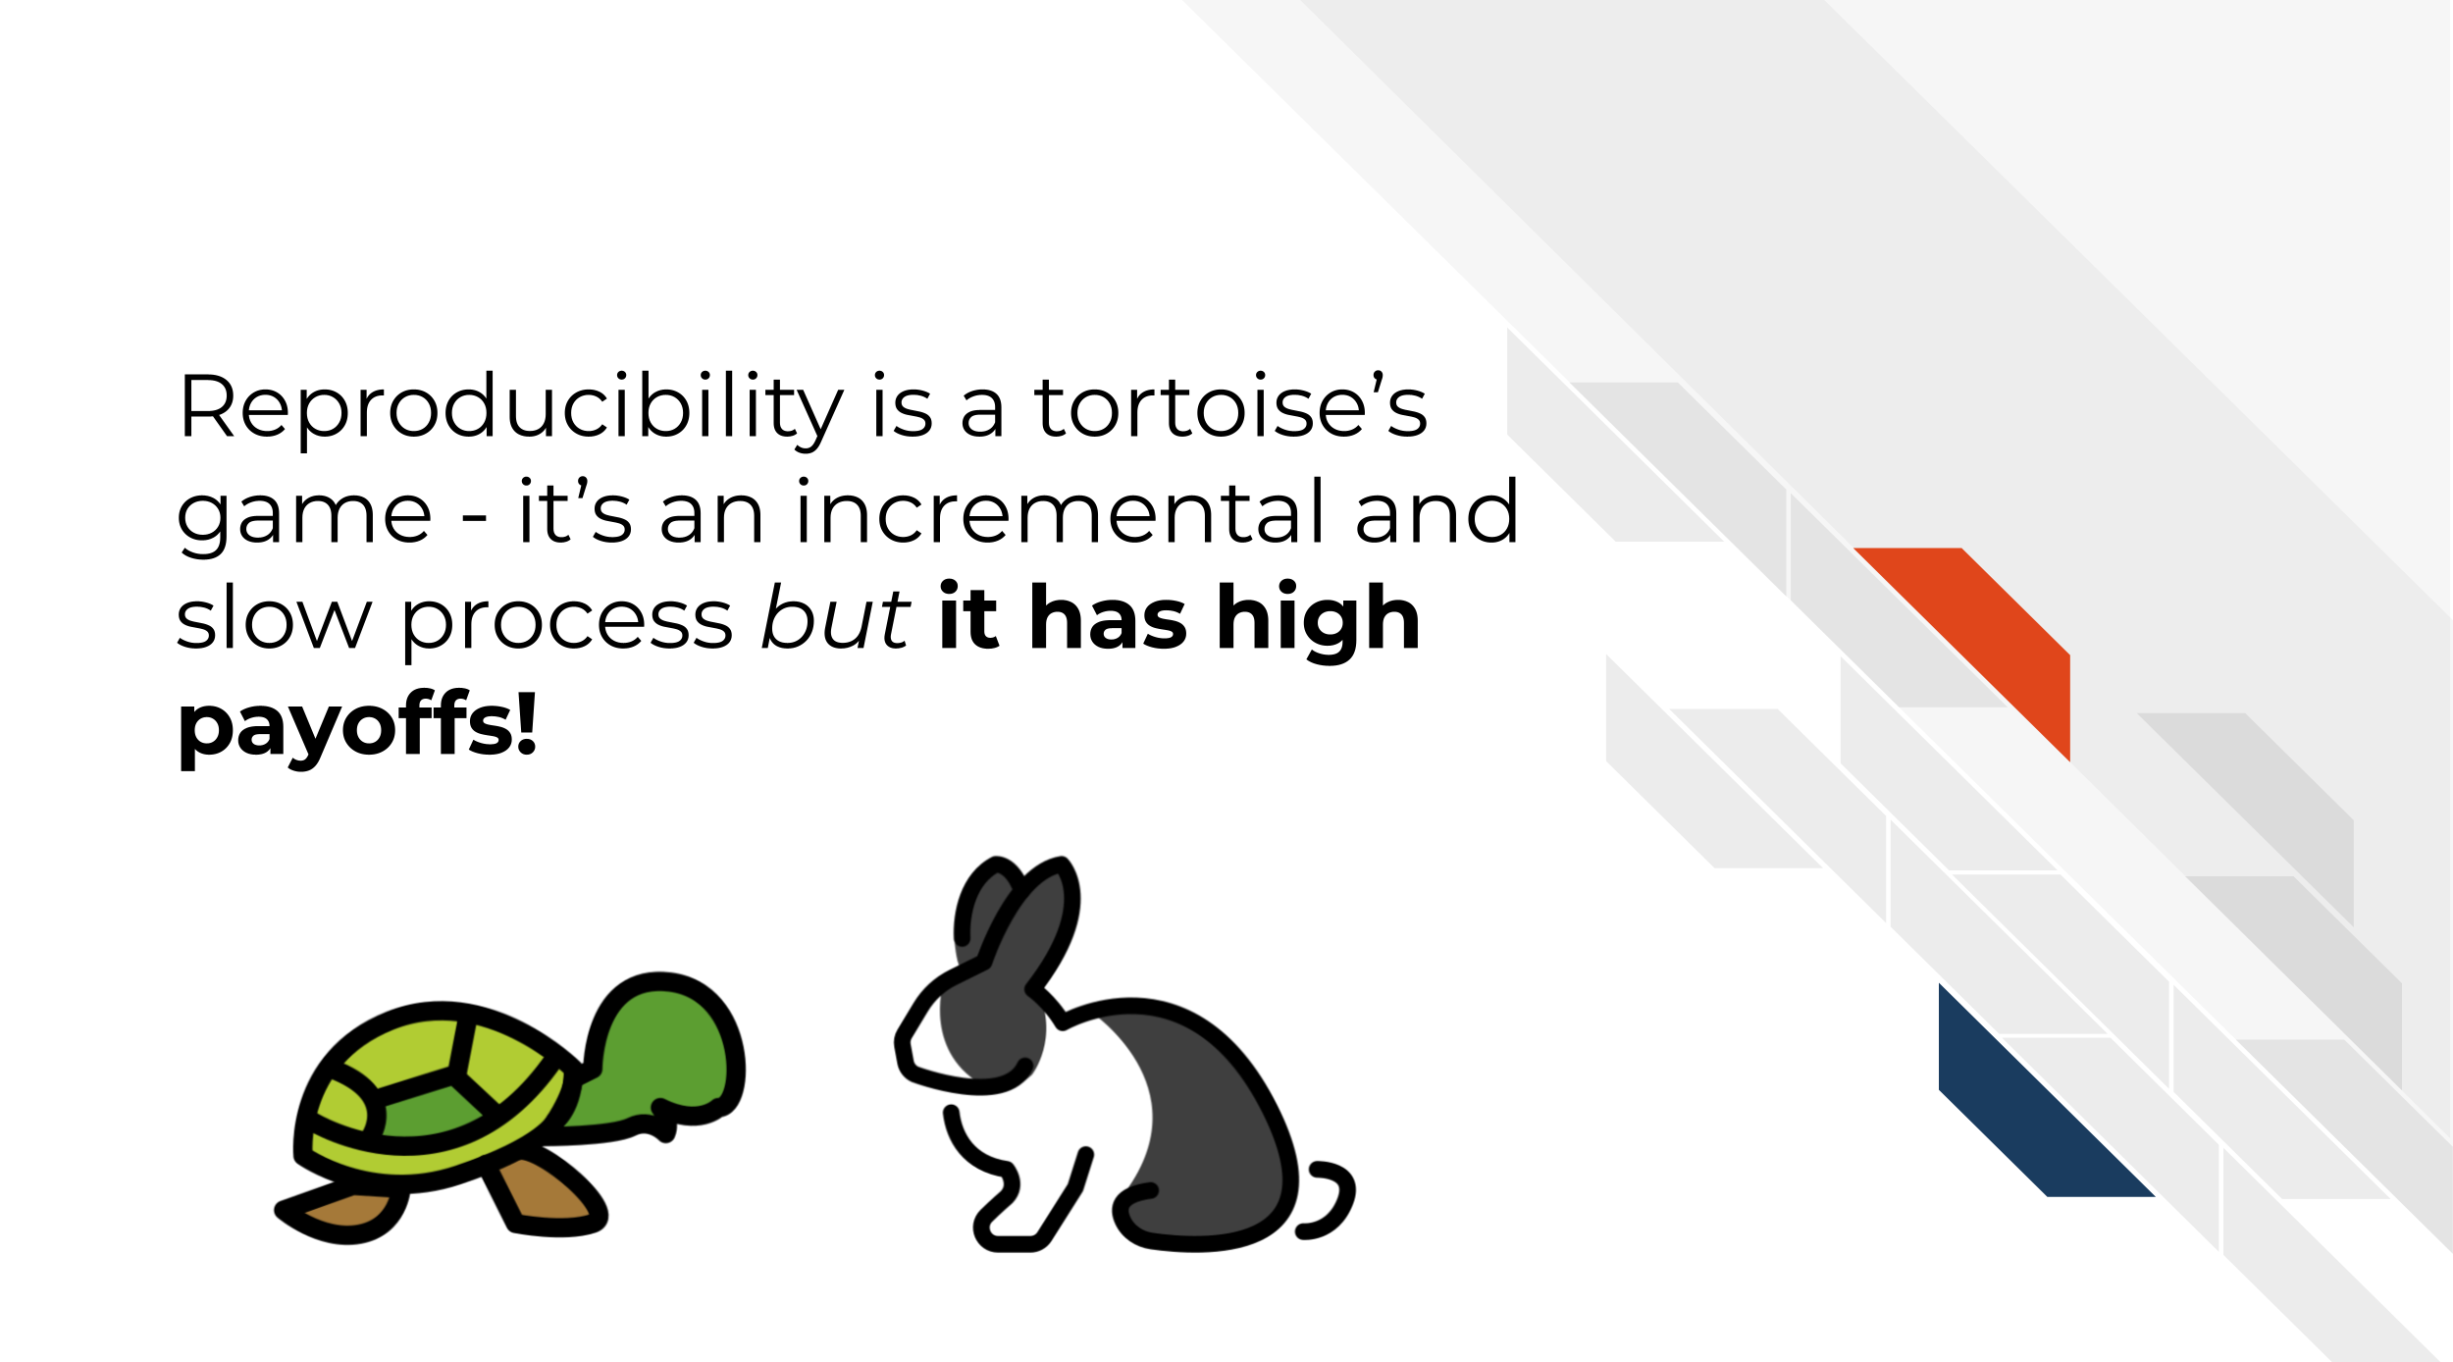
It’s worth the wait

Slide 12
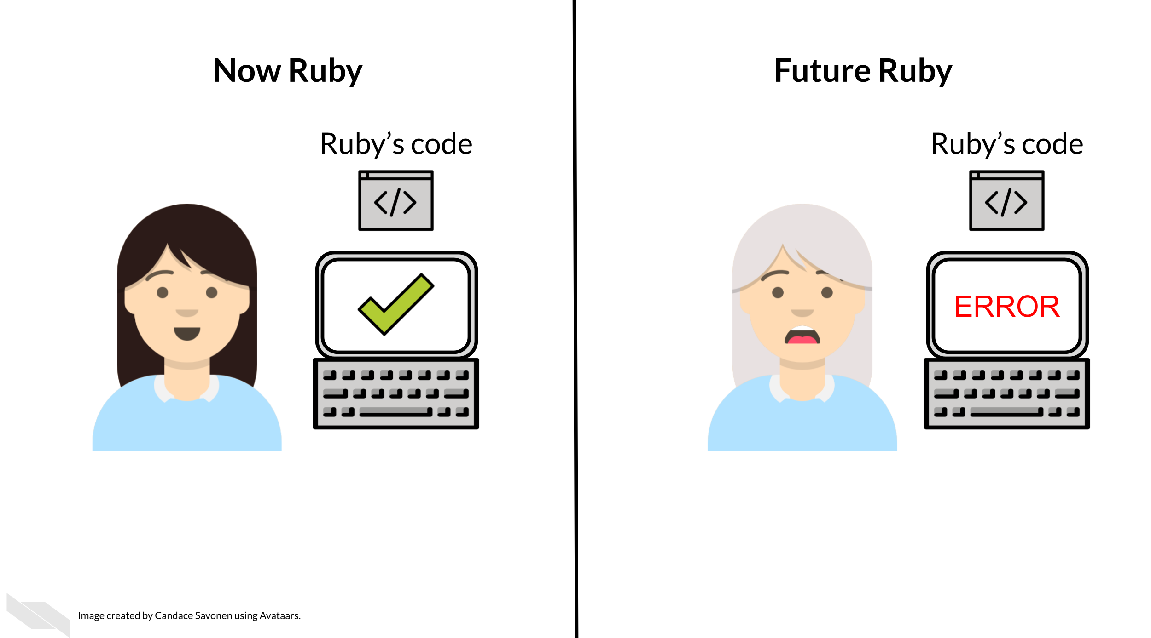
Reproducibility can also be for your future self!

Slide 13
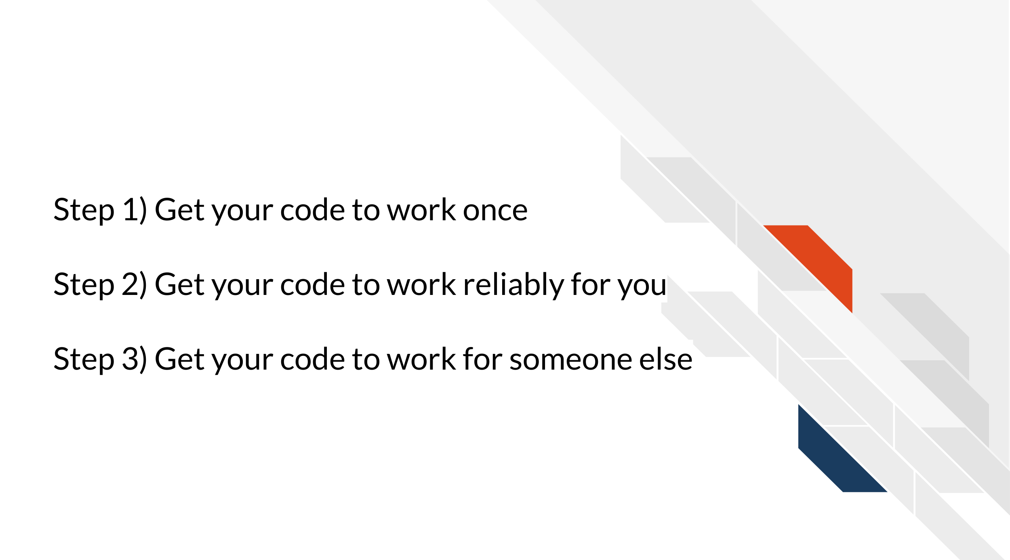
The process

Slide 14

R Markdown

Slide 15
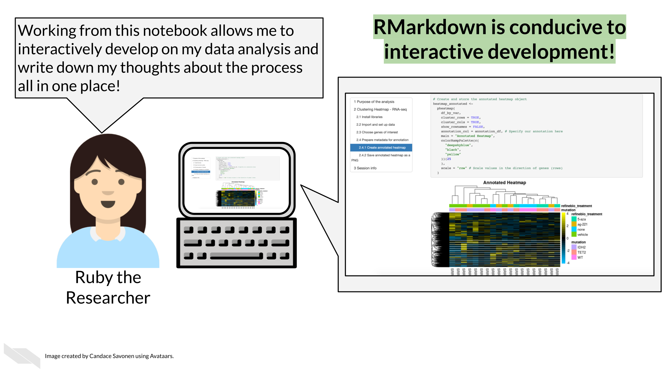
R Markdown lets you test your work

Slide 16
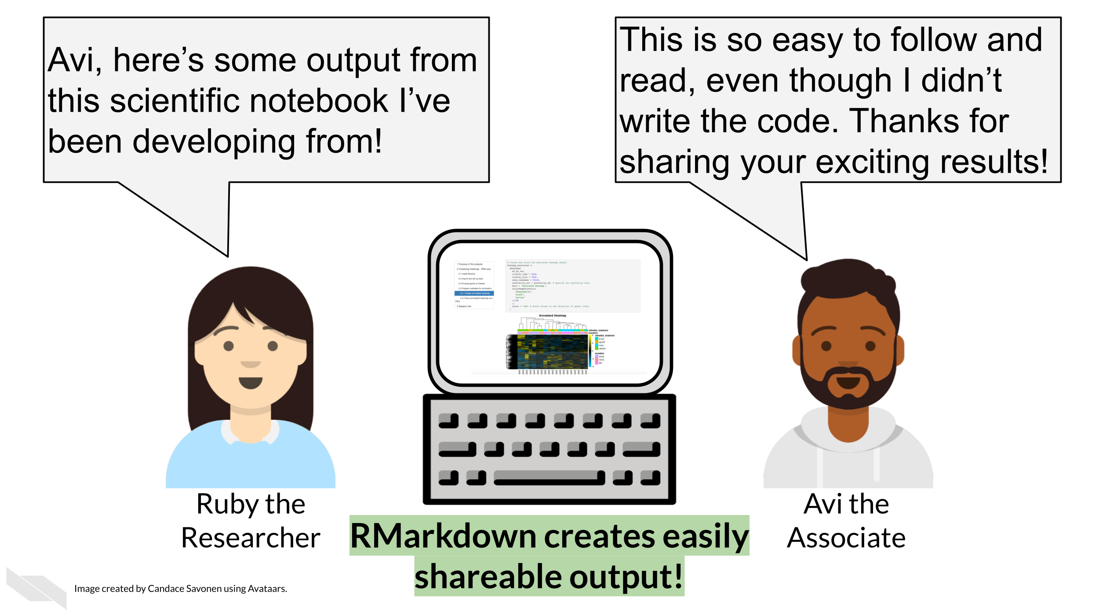
R Markdown allows you to more clearly show what you did

Slide 17
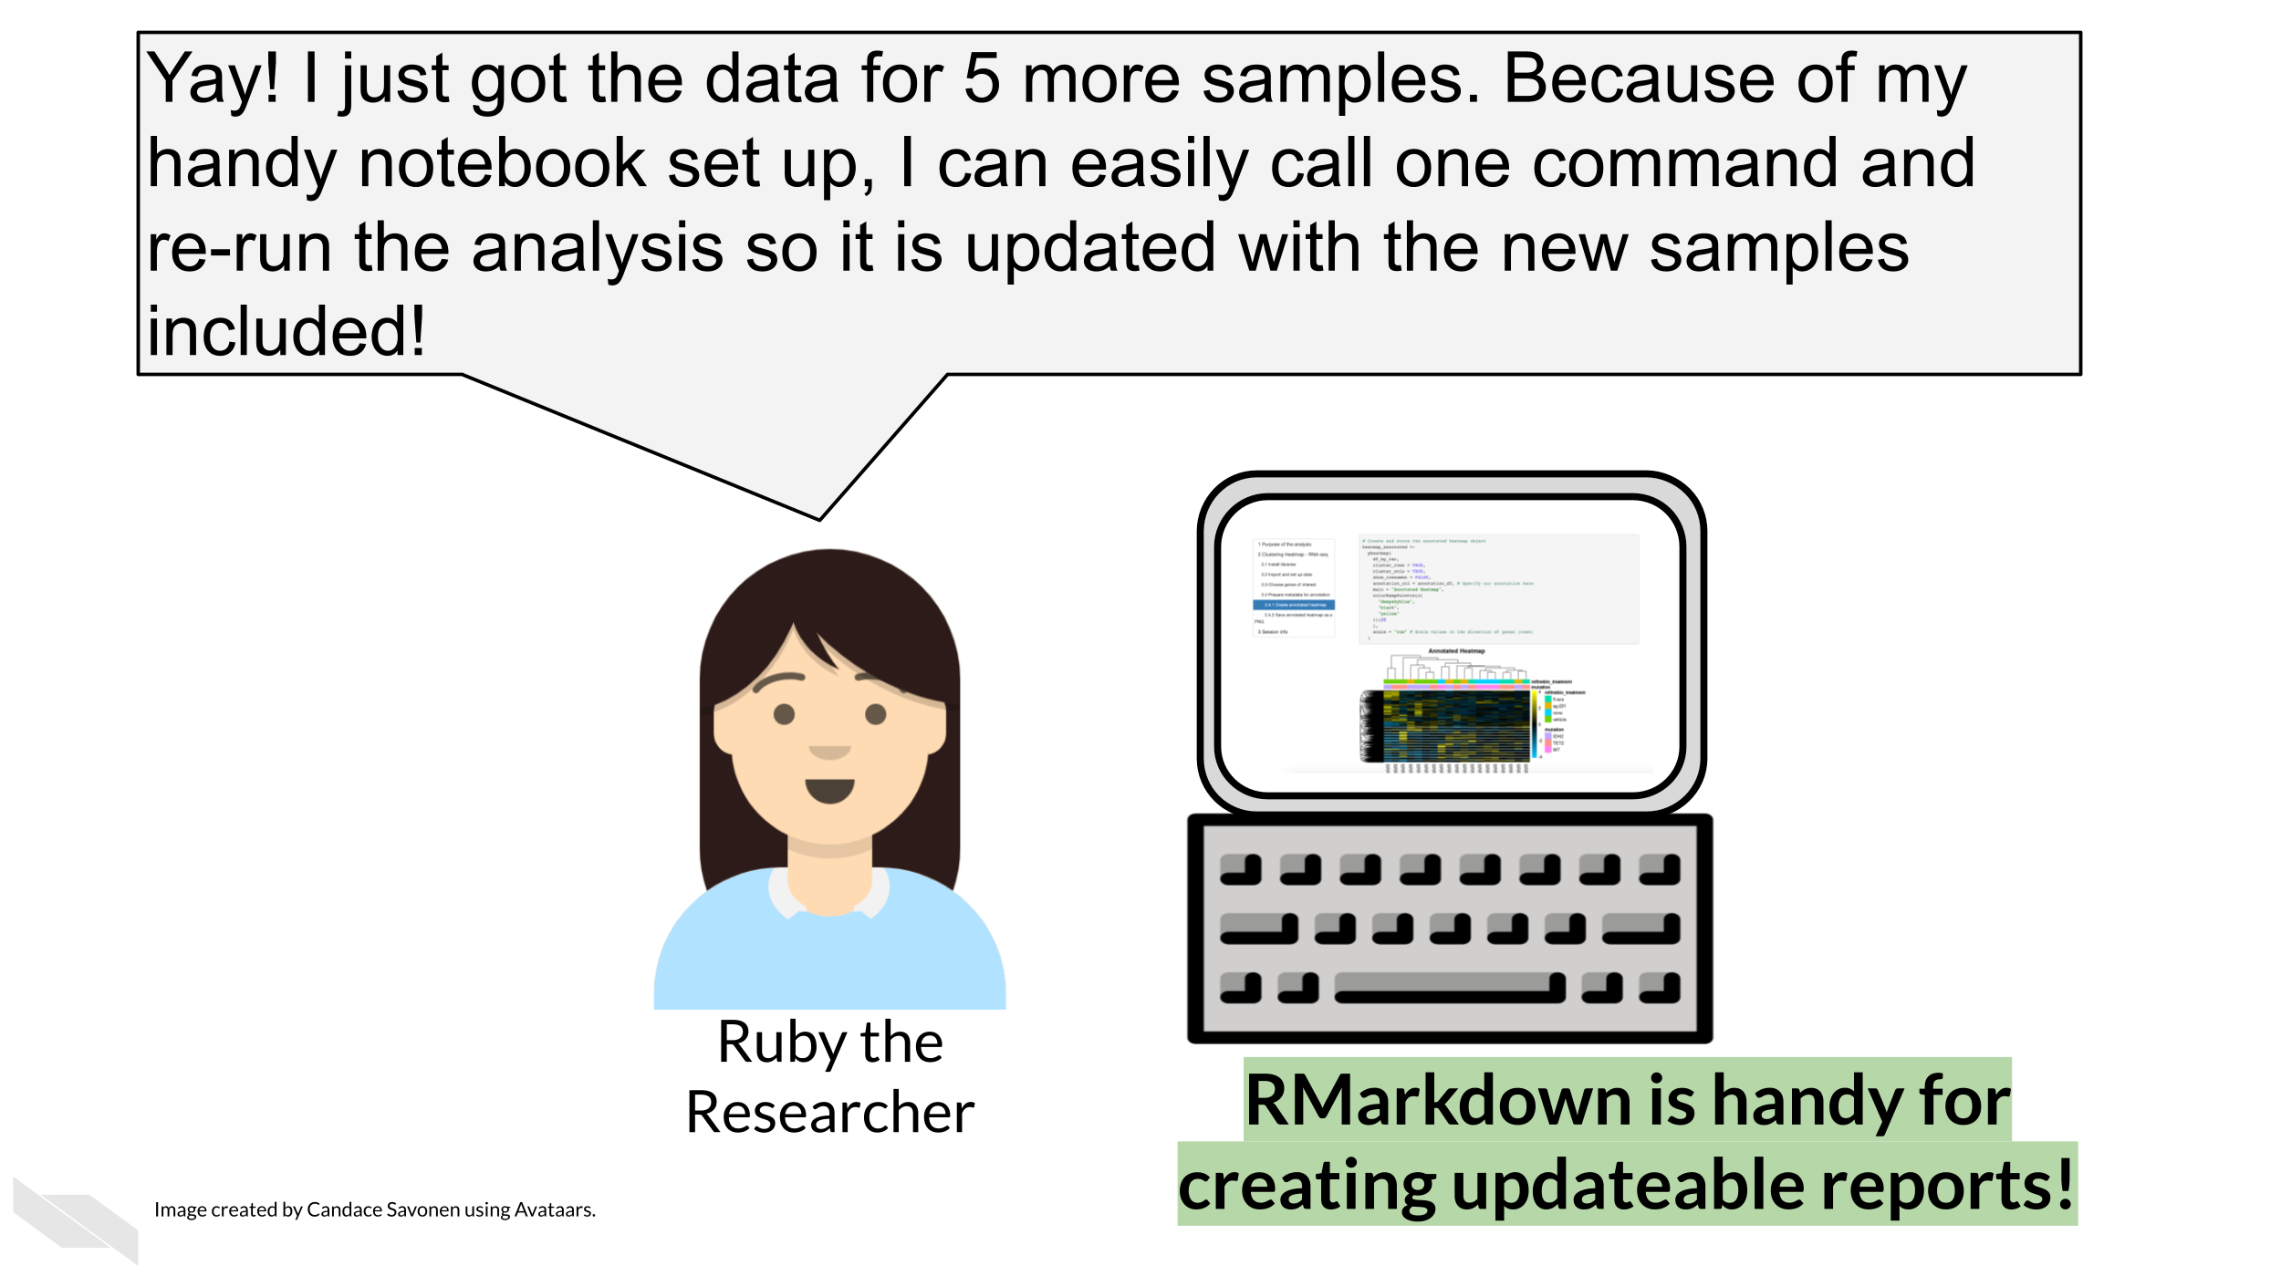
R Markdown makes it easier to update code and see results

Slide 18
Clean your environment
Regularly cleaning your environment and trying your code again, can help ensure that your code is running as expected.
Occasionally we might forget to save a step of our code in our R Markdown file that we ran only in the console. This will help us figure that out.

Slide 19
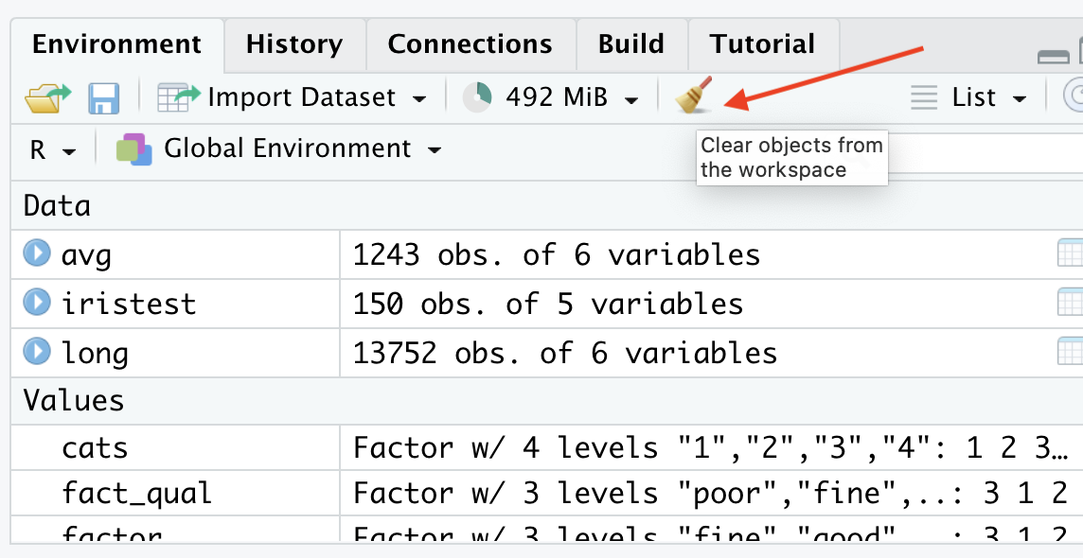

Slide 20
Check if your file knits regularly
Regularly checking if your file knits will help you spot a missing step or error earlier when you have less code to try to identify where your code might have gone wrong.

Slide 21
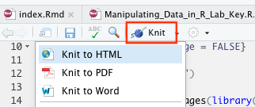

Slide 22
Tell your future self and others what you did!
Provide sufficient detail so that you can understand what you did.

Slide 23
Need random numbers to stay consistent?
Use set.seed() : sets the starting state for the random number generator (RNG) in R.
set.seed(123) sample(10)
[1] 3 10 2 8 6 9 1 7 5 4
set.seed(123) sample(10)
[1] 3 10 2 8 6 9 1 7 5 4
set.seed(456) sample(10)
[1] 5 3 6 10 4 9 1 2 8 7
Note that these are only psuedo random and the values are created doing calculations based on the given seed. Thus the same “random” values will be reproduced by everyone using the same seed with set.seed.

Slide 24
R Markdown syntax
Before:
After knit:

Slide 25
R Markdown syntax
Go to Help > Cheat Sheets > R Markdown Cheat Sheet (which will download it)
Or checkout Help > Cheat Sheets > R Markdown Reference Guide
Or checkout the 🏠 Class Website!

Slide 26
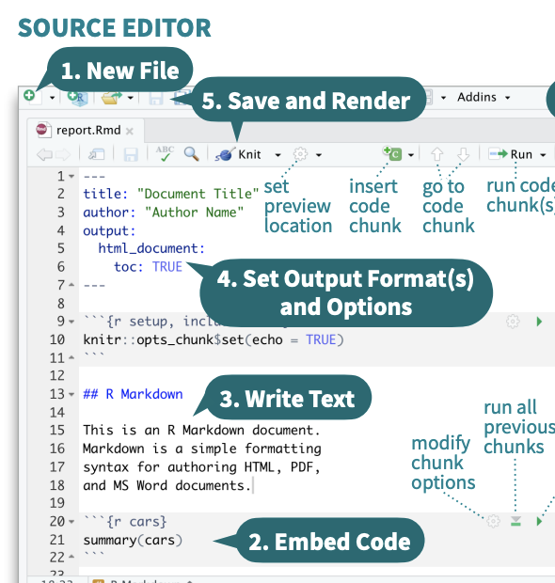

Slide 27
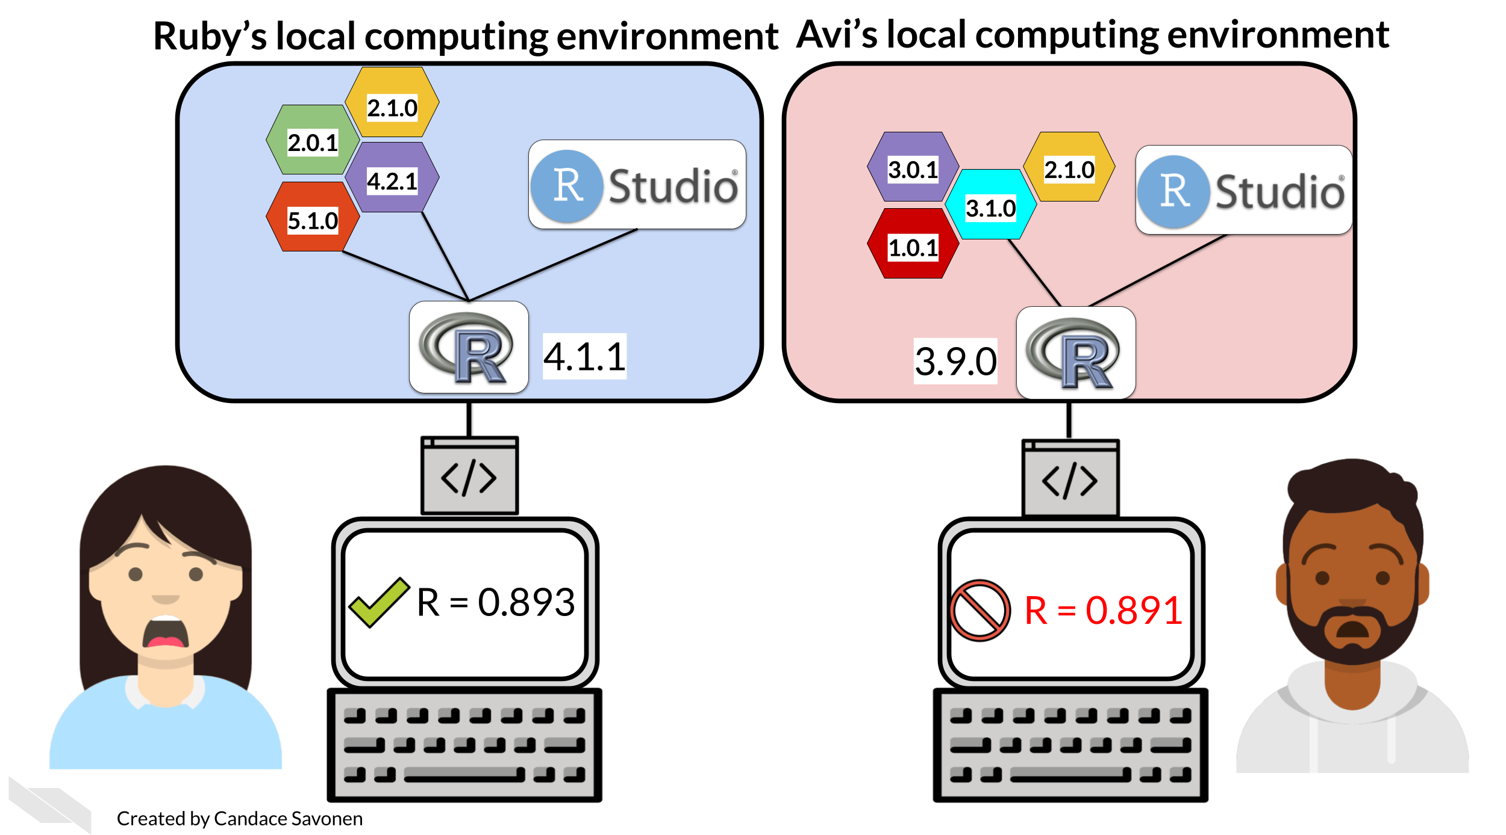
Versions matter

Slide 28
Session info can help
sessionInfo()

Slide 29
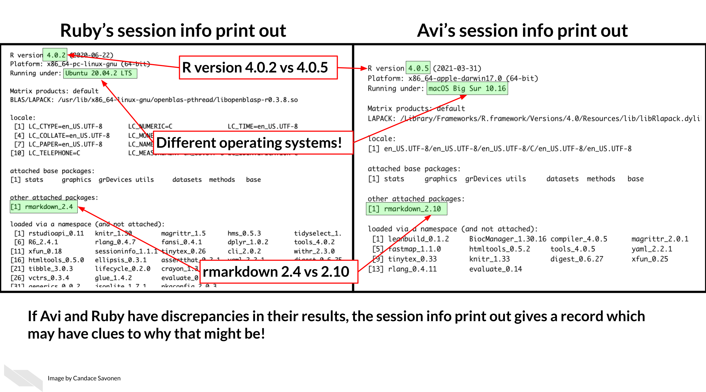

Slide 30
GUT CHECK: Why is reproducibility so important?
A. It helps to ensure that your code is working consistently and it helps others understand what you did
B. It ensures that your code is correct

Slide 31
GUT CHECK: What is NOT a practice to improve the reproducibility of our work?
A. Using R Markdown files to describe what your code is doing
B. Using scripts instead of R Markdown files
C. Testing your code with R Markdown files or the run previous button
D. Regularly cleaning the environment

Slide 32
More resources
These are just some quick tips, for more information:
Reproducibility in Cancer Informatics course
Advanced Reproducibility in Cancer Informatics course
The RMarkdown book
Jenny Bryan’s organizational strategies.
Write efficient R code for science.

Slide 33
Summary
To help make your work more reproducible:
Use R Markdown
Clean your environment regularly
Check the knit of your R Markdown regularly
Tell your future self and others what you did!
Print session info!
🏠 Class Website 💻 Lab 📃 Day 2 Cheatsheet 📃 Posit’s R Markdown Cheatsheet

Slide 34


Slide 35
Image by Gerd Altmann from Pixabay

