Slide 1
RStudio

Slide 2
Working with R – RStudio
RStudio is an Integrated Development Environment (IDE) for R it helps you:
write code - makes suggestions
view the output of your code, including plots
find errors
manage files
View documentation

Slide 4
[source]
RStudio used to be the name of a company that is now called Posit.

Slide 5
RStudio
First it is important to be familiar with the layout. When you first open RStudio, you will see 3 panes.

Slide 6
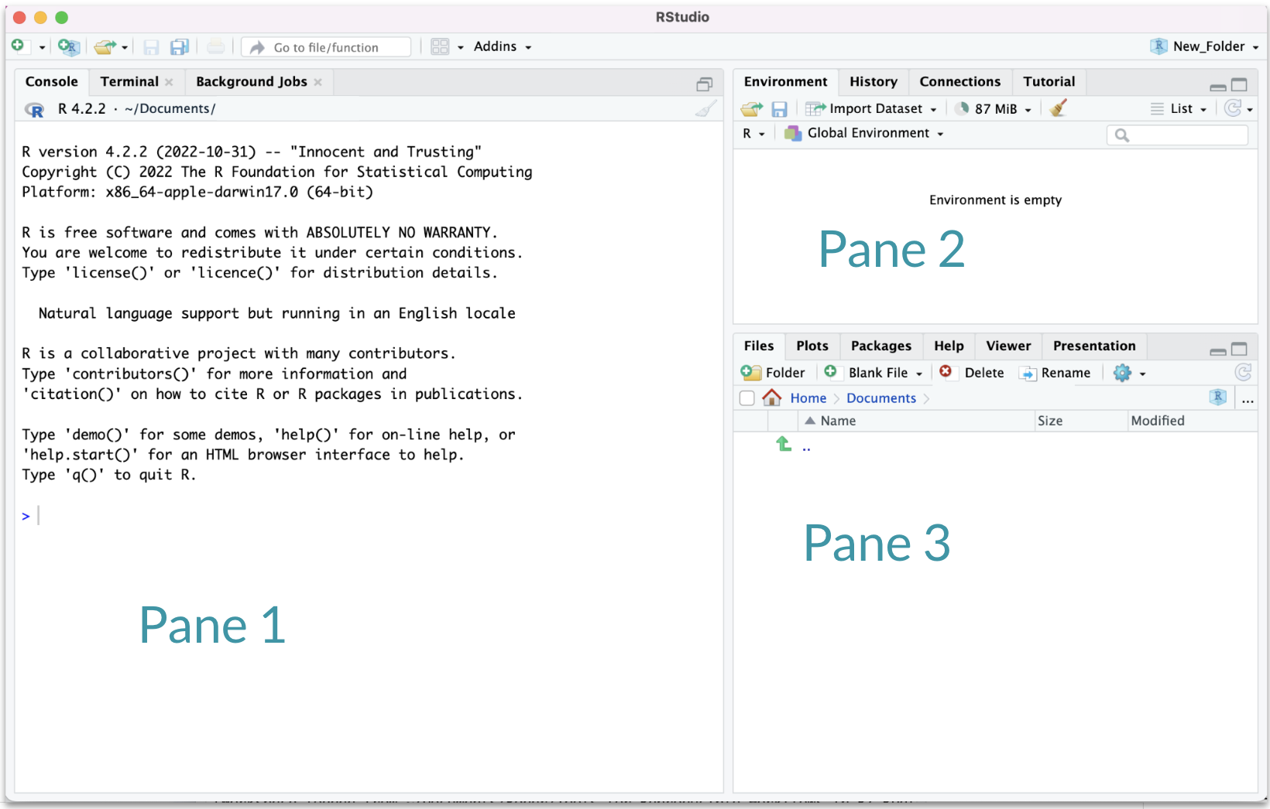

Slide 7
Hidden Pane
To save a copy of your code. You must open a file first - this will open a 4th pane. These files include Scripts or what are called R Markdown files.

Slide 8
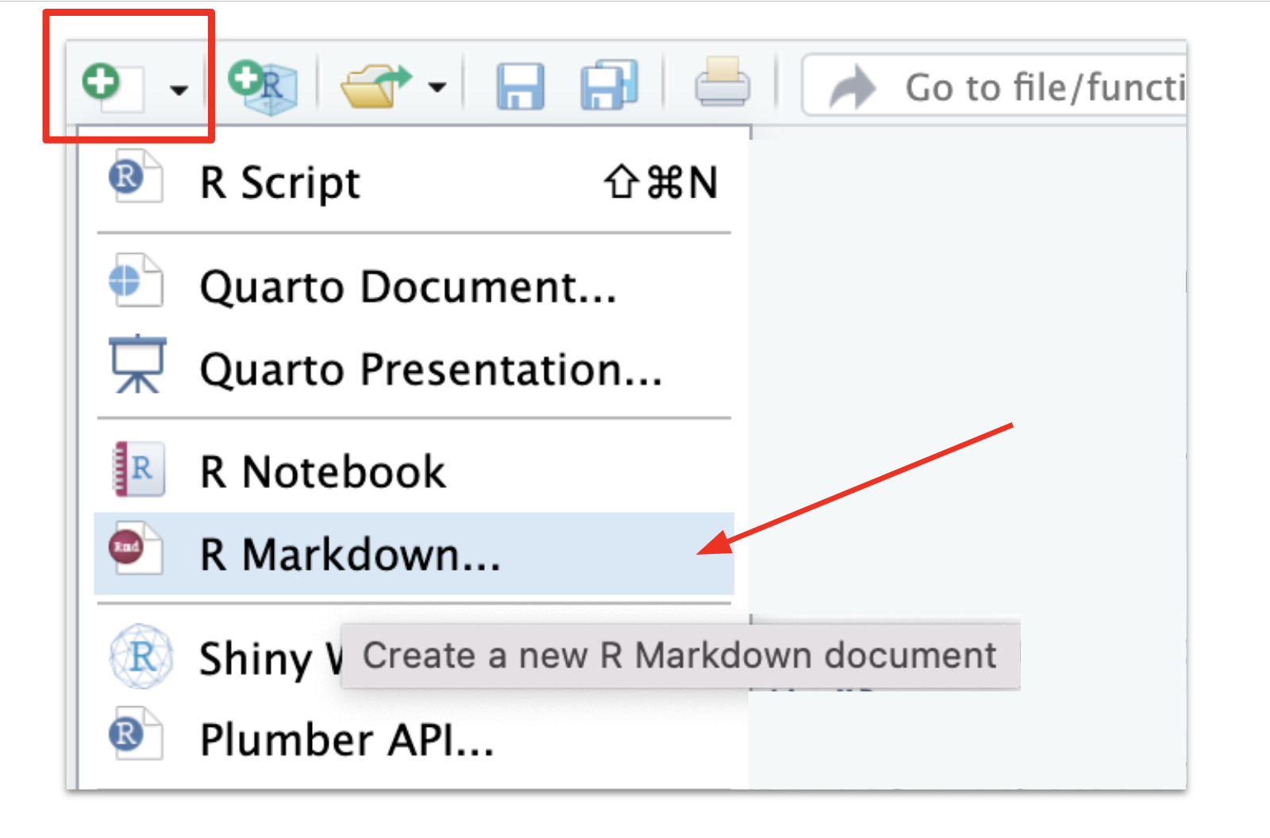

Slide 9
Hidden Pane
You will see a popup that you can just say “OK” to for now.

Slide 10
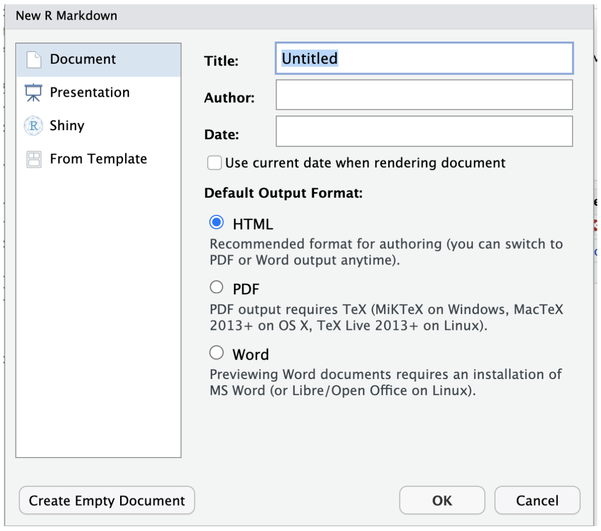

Slide 11
Hidden Pane
Nice! now we have a place to save code! This is where we will mostly be working.

Slide 12
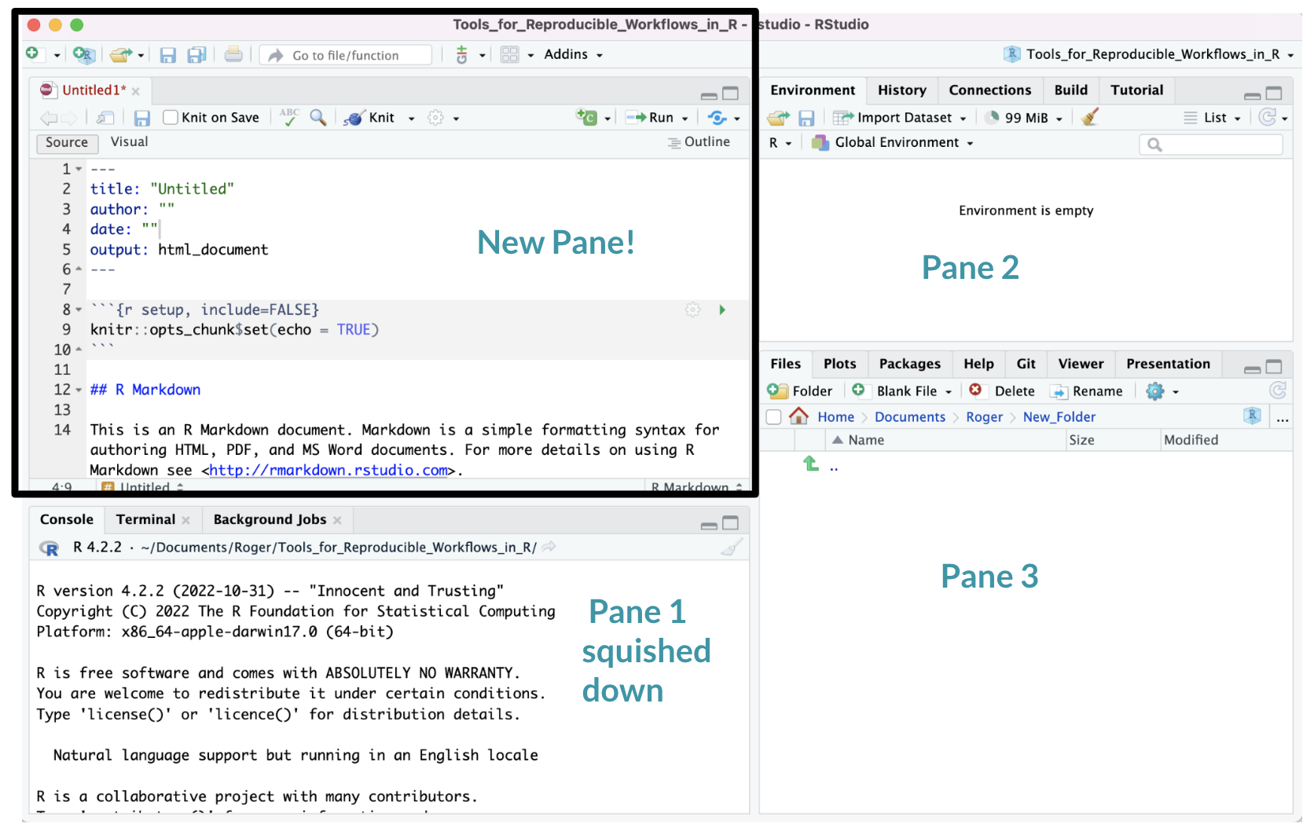

Slide 13
Working with R in R Studio - 2 major panes:
The Source/Editor:
Static copy of what you did (reproducibility)
Top by default
saves your code
The R Console:
Calculator
Try things out interactively, then add to your editor
Bottom by default
doesn’t save your code

Slide 14
RStudio
Super useful “cheatsheet”: LINK

Slide 15
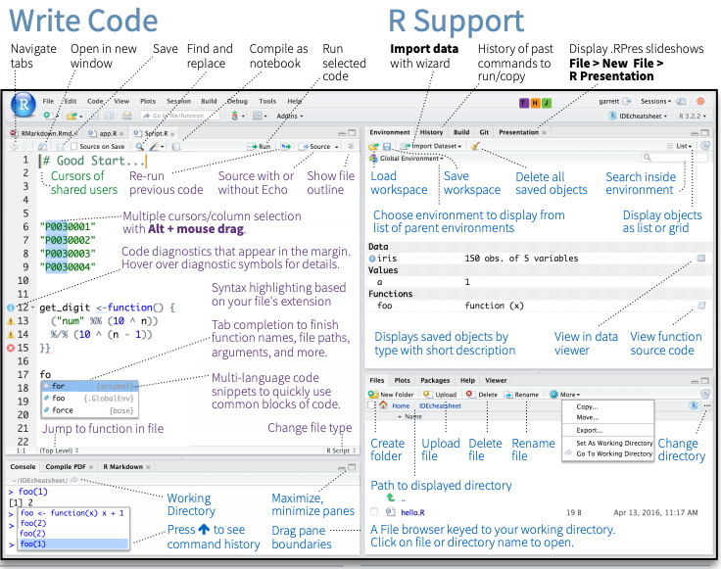

Slide 16
R Markdown files look different from scripts
It will look like this with text in it.

Slide 17
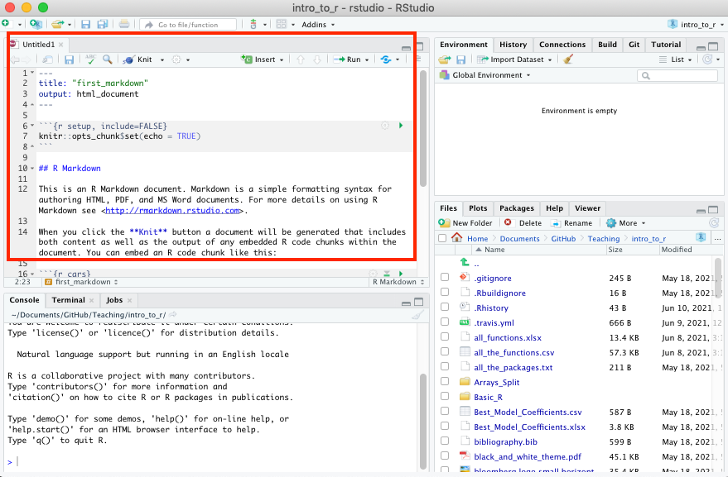

Slide 18
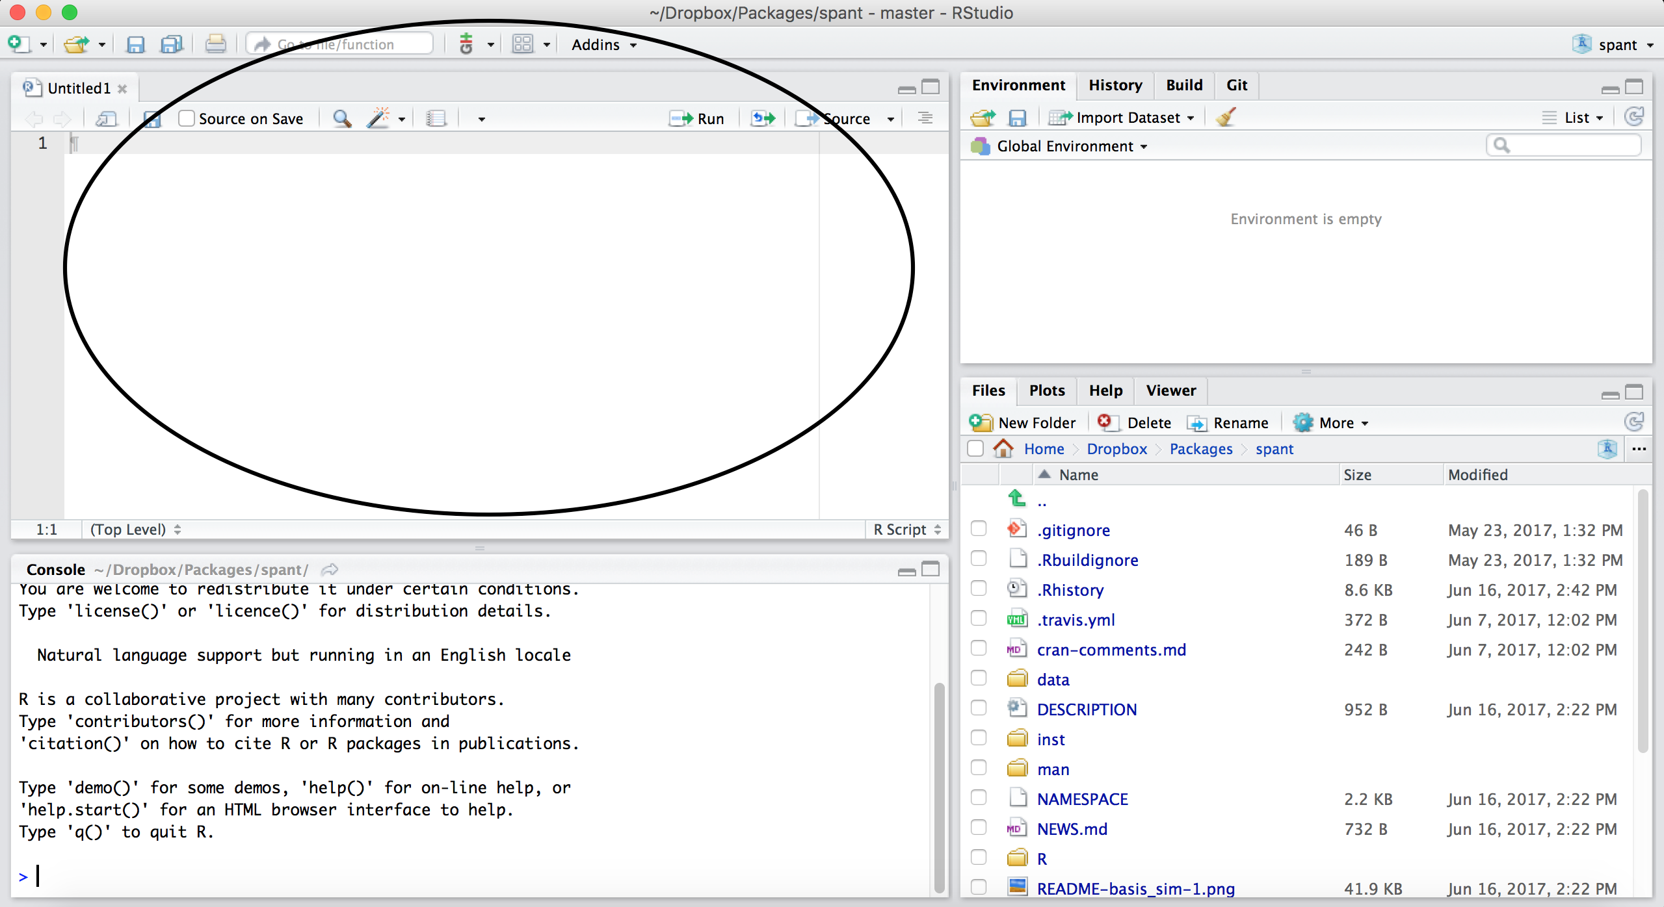
Scripts will just be empty

Slide 19
Scripts and R Markdown
Although people will use scripts often, and they are good for more programmatic purposes, we generally don’t recommend them for Public Health Researchers.
For data analyses, R Markdown files are generally superior because they allow you to check your code and write more info about your code.

Slide 20
Workspace/Environment

Slide 21
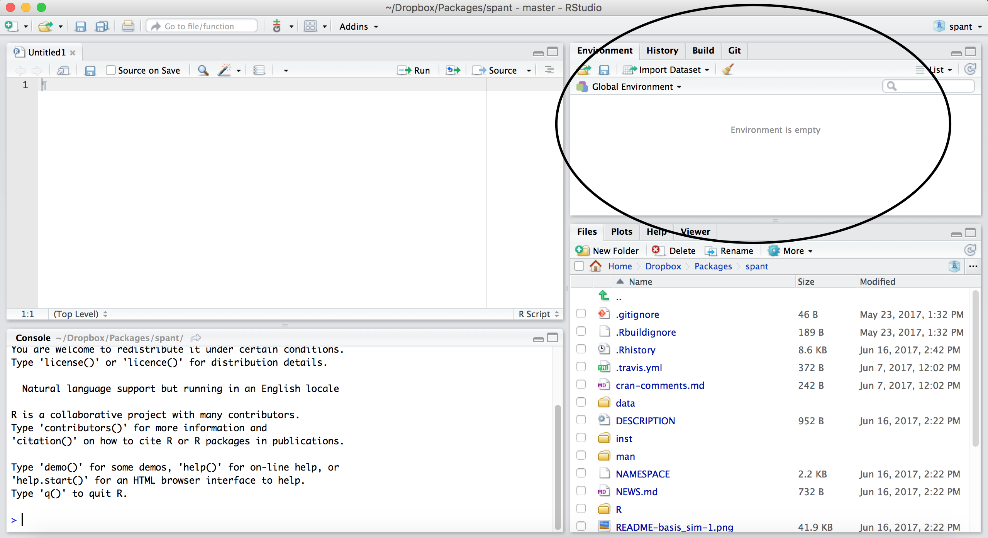

Slide 22
Workspace/Environment
Tells you what objects are in R
What exists in memory/what is loaded?/what did I read in?
History
Shows previous commands. Good to look at for debugging, but don’t rely on it. Instead use RMarkdown!
Also type the “up” key in the Console to scroll through previous commands

Slide 23
Lower right pane
Files - shows the files on your computer of the directory you are working in
Help - shows help of R commands
Plots - pictures and figures

Slide 24
RStudio Layout
If RStudio doesn’t look the way you want (or like our RStudio), then:
Click on the pane button, which looks like a waffle with 4 indentations. Scroll down to “Pane Layout”.

Slide 25
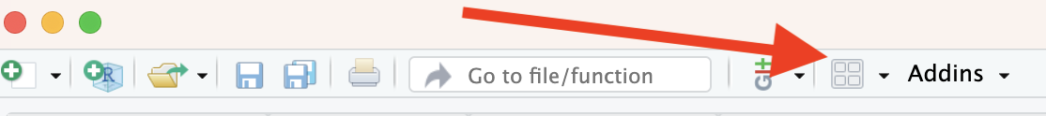

Slide 26
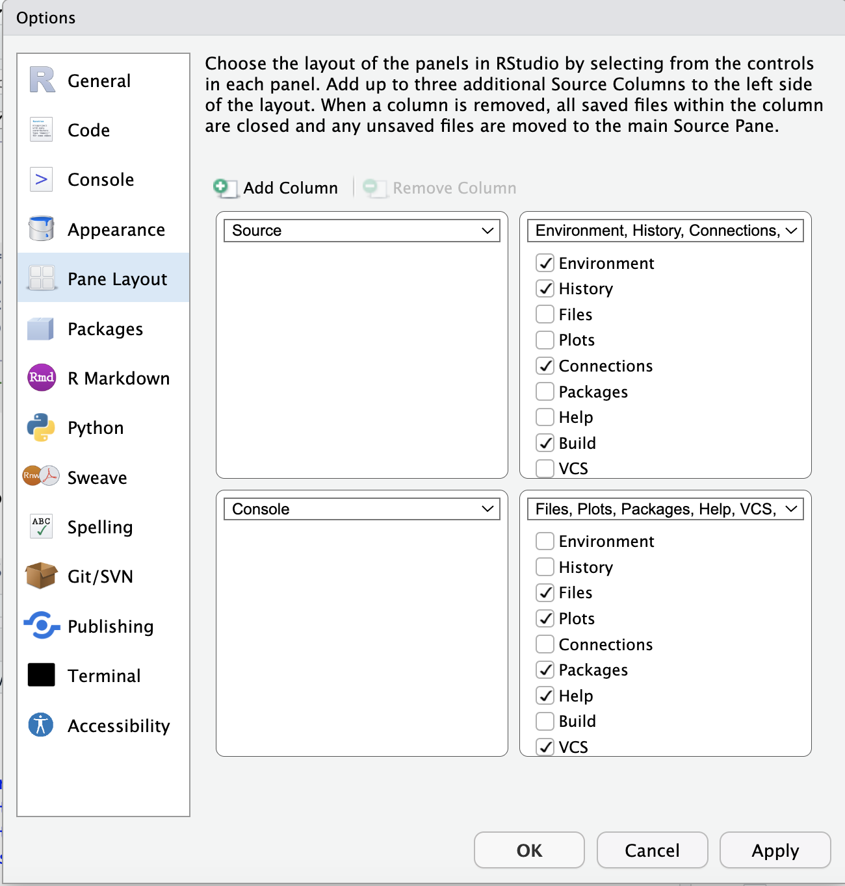
Default Layout

Slide 27
Let’s take a look at R Studio ourselves!

Slide 28
R Markdown file
R Markdown files (.Rmd) help generate reports that include your code and output.
Helps you describe your code
Allows you to check the output
Can create many different file types

Slide 29
Code chunks
Within R Markdown files are code “chunks”.
This is where you can type R code and run it!

Slide 30


Slide 31
Run code in a chunk
Clicking the run (play) button runs the code in the chunk.

Slide 33
Ctrl + Enter on Windows or Command + Enter on Mac in your script evaluates that line of code

Slide 34
Running a chunk executes the code
generally see a preview of the output of the code just below the chunk
see the code in the console

Slide 35
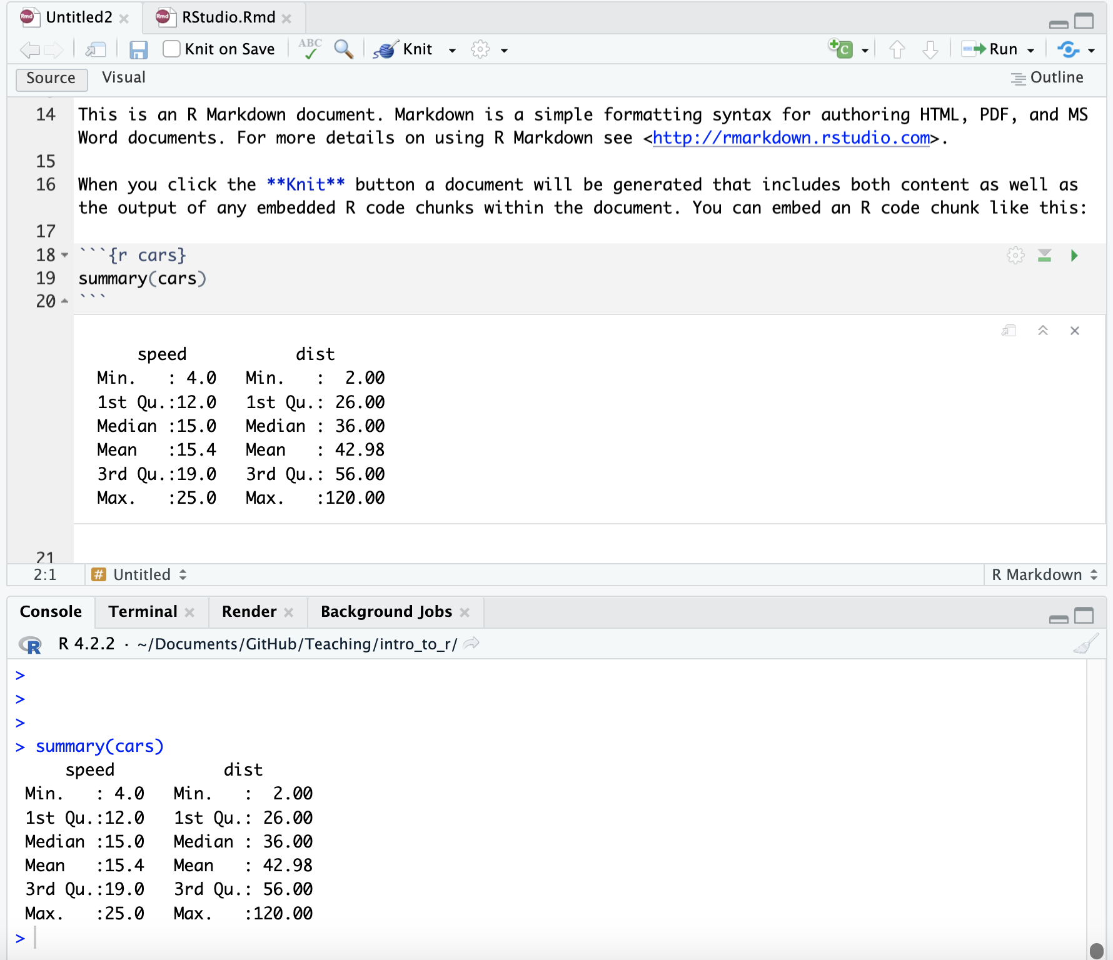

Slide 36
If you get annoyed by code previews in Markdown files…
See the Help page of the website. You can adjust this and change your RStudio settings:
Tools > Global Options > R Markdown

Slide 37
Knit file to html
Running all chunks - this will create a report from the R Markdown document! Note that it can’t use anything not included in the file, it can’t use objects in your environment that you were modifying interactively.

Slide 38
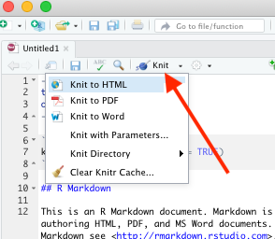

Slide 39
Nice report!
This generates a nice report that you can share with others who can open in any browser.

Slide 40
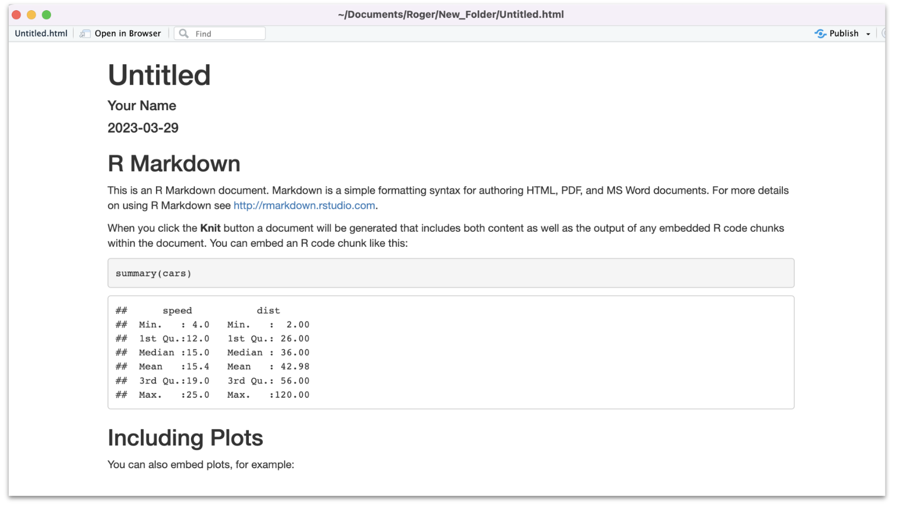

Slide 41
Create Chunks
To create a new R code chunk:
Use the insert code chunk button at the top of RStudio.

Slide 42
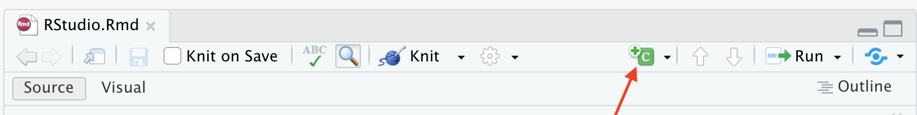

Slide 43
Select R (default) as the language:

Slide 44
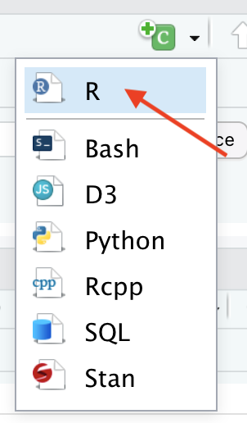

Slide 45
Create Chunks
If you like keyboard shortcuts:
Windows & Linux use Ctrl+Alt+I
Mac use Command+Option+I
I is for insert.

Slide 46
Run previous chunks button
You can run all chunks above a specific chunk using this button:

Slide 47
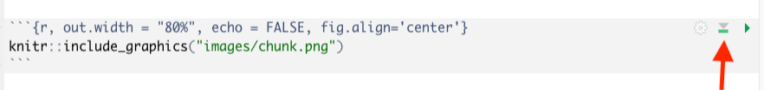

Slide 48
Errors
R studio can help you find issues in your code. Note that sometimes the error occurs earlier than RStudio thinks.

Slide 49
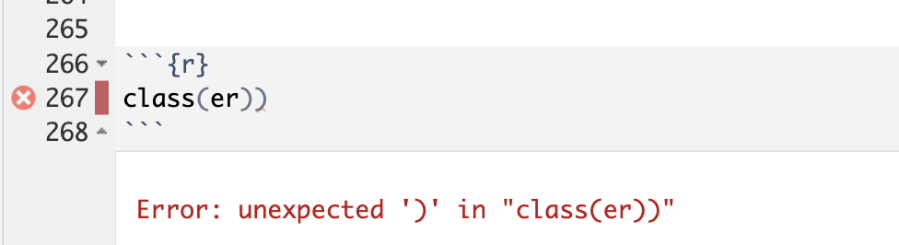

Slide 50
Recap of where code goes
you can test code in the console

Slide 51
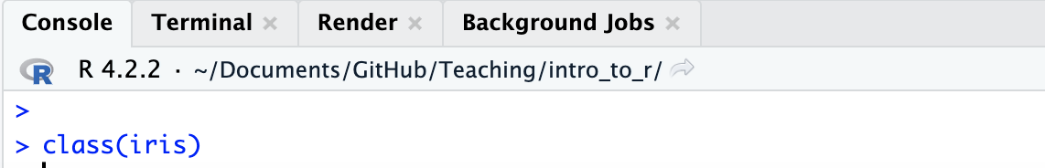

Slide 52
you can save code in a chunk in the editor (Markdown file)

Slide 53
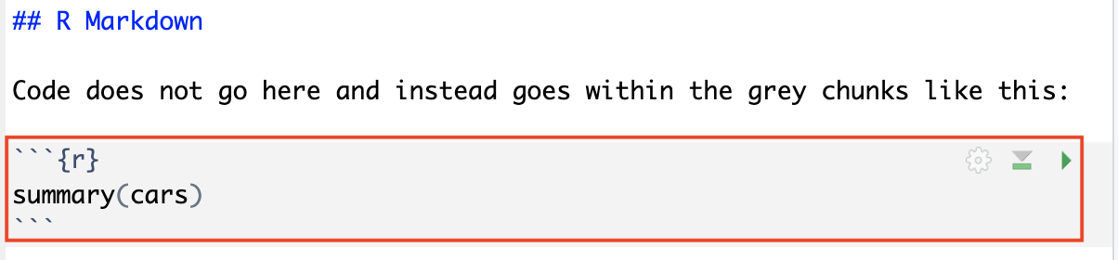

Slide 54
Getting help from the preview
When you type in a function name, a pop up will preview documentation to help you. It also helps you remember the name of the function if you don’t remember all of it!

Slide 55
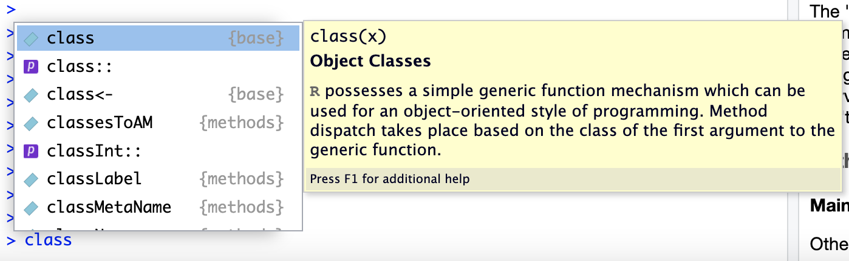

Slide 56
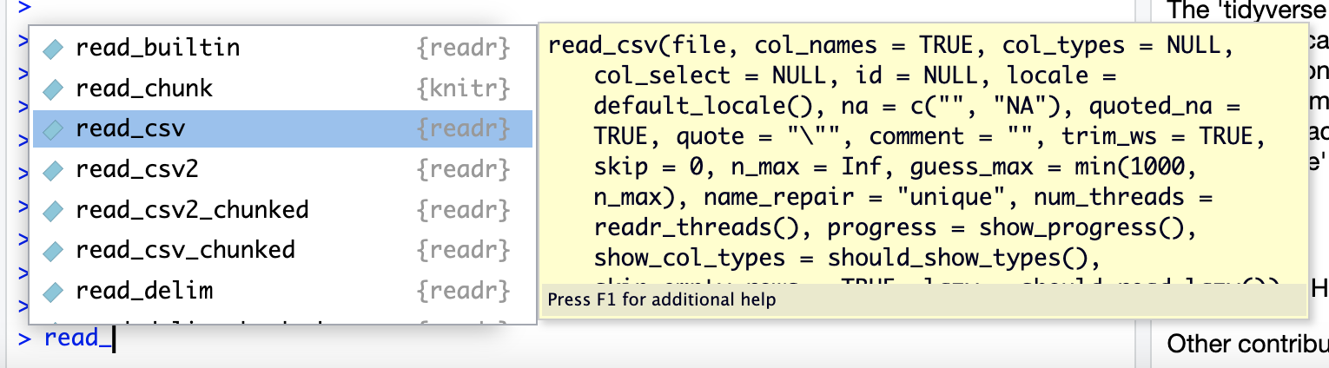

Slide 57
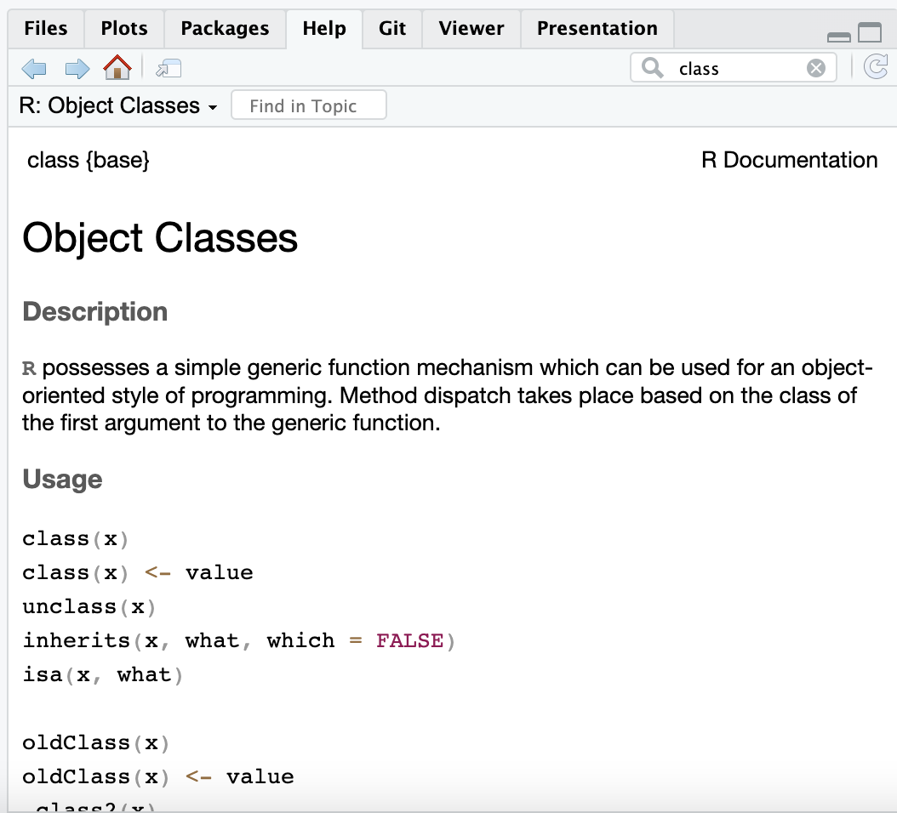
Get help with the help pane

Slide 58
Getting Help with ?
If you know the name of a package or function:
Type ?package_name or ?function_name in the console to get information about packages and functions.
For example: ?readr or ?read_csv.

Slide 59
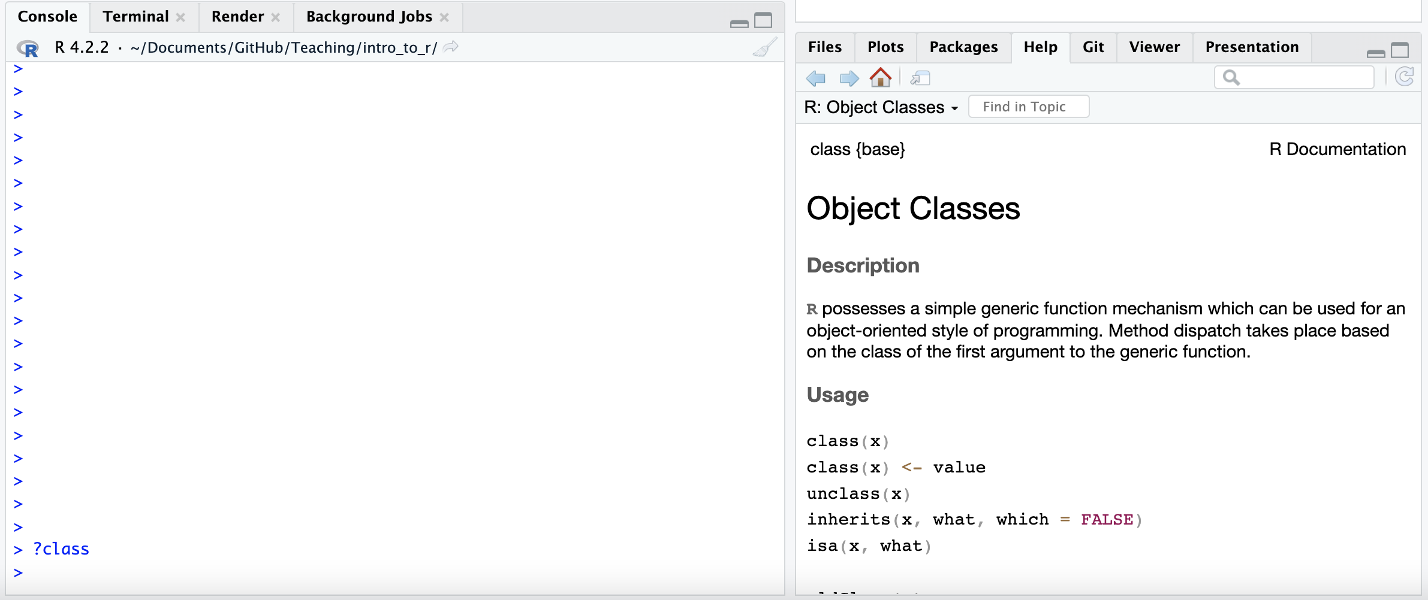

Slide 60
Double Question Mark
If you haven’t loaded a package yet into R than you may get a response that there is no documentation.
Typing in ??package_name can show you packages that you haven’t loaded yet.

Slide 61
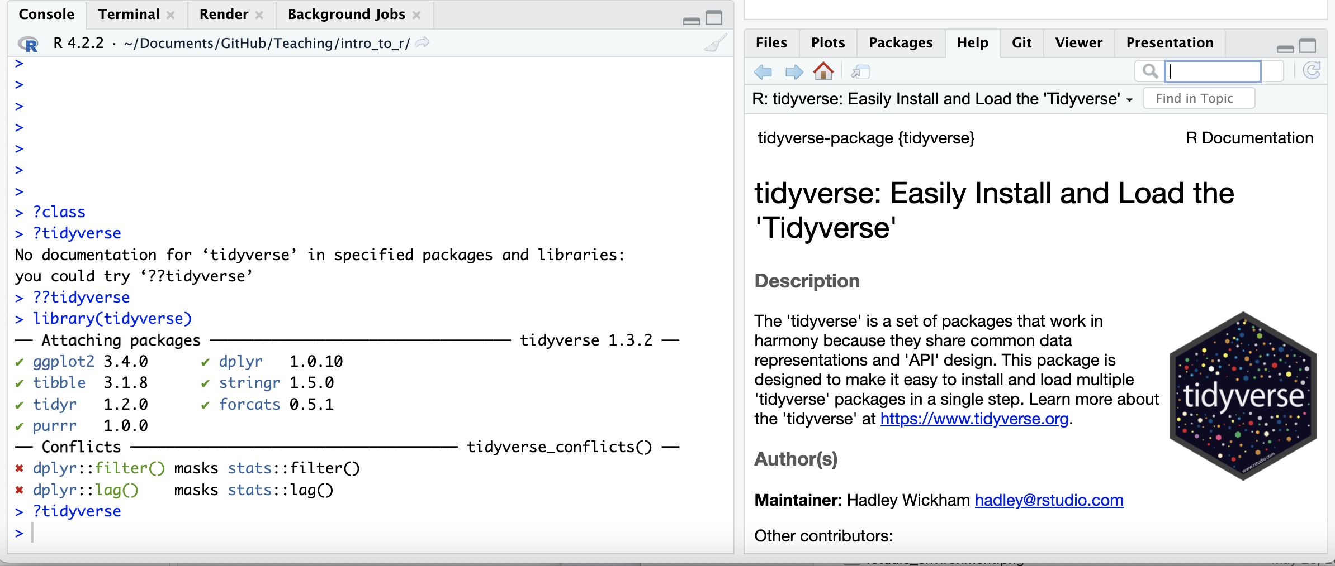

Slide 62
Gut Check
Why are R Markdown files so useful?
They let you test your code
They let you view the output of your code
They let you generate cool reports
All of the above

Slide 63
Gut Check
Where does code go typically in an Rmd file?

Slide 64
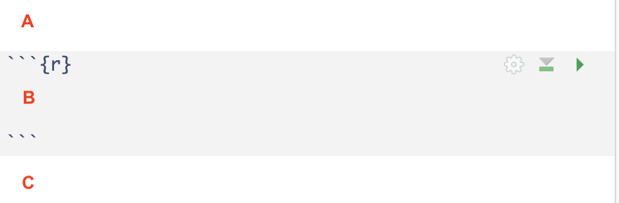

Slide 65
Gut Check
Which button do you click to run the code in a current chunk?

Slide 66
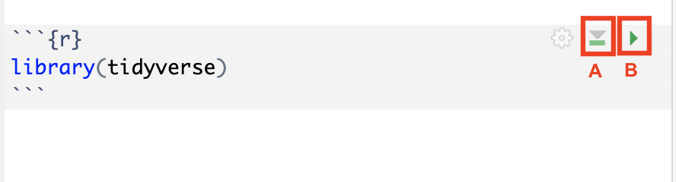

Slide 67
Lab: Getting started
To do this lab we need to:
Download the file at the link above by clicking on it or go to the website schedule page
Find the downloaded file on your computer
Open the file in RStudio (double clicking the file name typically works, otherwise right click)
Might need to restart RStudio
These videos can help if you aren’t sure where your downloads are:
If you have a PC: https://youtu.be/we6vwB7DsNU
If you have a Mac: https://www.youtube.com/watch?v=Ao9e0cDzMrE
You can find these on the resource page of the class website.

Slide 68
Summary
RStudio makes working in R easier
the Editor (top) is for static code like scripts or R Markdown documents
The console is for testing code (bottom) - best to save your code though!
R markdown documents are really helpful for lots of reasons!
R code goes within what is called a chunk (the gray box with a green play button)
Code chunks can be modified so that they show differently in reports
🏠 Class Website. 💻 Lab. 📃 Posit Cheatsheet. 📃 Day 1 Cheatsheet.

Slide 69


Slide 70
Image by Gerd Altmann from Pixabay

Slide 71
Extra Slides

Slide 72
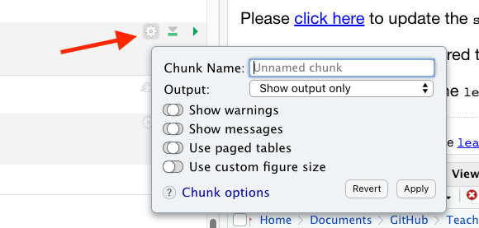
Chunk settings

Slide 73
Chunk settings
You can specify if a chunk will be seen in the report or not.

Slide 74
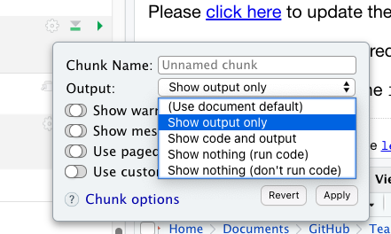

Slide 75
Sometimes you want to hide your code
If you want to keep your code so people can see it if they want to there is a nice option called code folding - check it out here: https://stackoverflow.com/questions/69326576/show-output-but-hide-code-when-sending-rmd-to-other-people

Slide 76
Rainbow Parentheses
Tools –> Global Options –> Code –> Display –> Use rainbow parentheses
This can help you see your code more easily.
Press enter to save this setting and get out of this menu.

