Slide 1
Manipulating Data in R

Slide 2
Recap of Data Cleaning
  is.na(),any(is.na()), all(is.na()),count(), and functions from naniar like gg_miss_var() and miss_var_summary can help determine if we have NA values
  miss_var_which() can help you drop columns that have any missing values.
  filter() automatically removes NA values
  drop_na() can help you remove NA values
  NA values can change your calculation results
  think about what NA values represent - don’t drop them if you shouldn’t
  replace_na() will replace `NA values with a particular value

Slide 3
Recap of Data Cleaning
  case_when() can recode entire values based on conditions
    remember case_when() needs TRUE ~ variable to keep values that aren’t specified by conditions, otherwise will be NA
  stringr package has great functions for looking for specific parts of values especially filter() and str_detect() combined
    also has other useful string manipulation functions like str_replace() and more!
    separate() can split columns into additional columns
    unite() can combine columns
📃Cheatsheet

Slide 4
Manipulating Data
In this module, we will show you how to:
  Reshape data from wide to long
  Reshape data from long to wide
  Merge Data/Joins

Slide 5
What is wide/long data?
Data is wide or long with respect to certain variables.

Slide 6
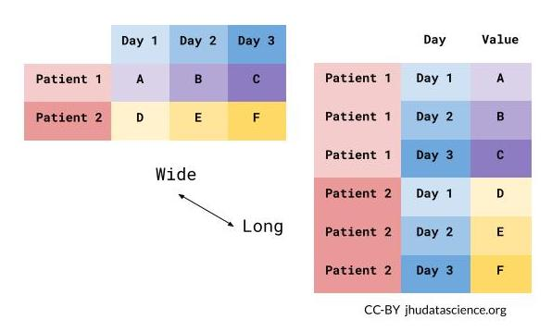

Slide 7
What is wide/long data?
Data is stored differently in the tibble.
Here’s a small dataset looking at vaccination rates over three months in Alabama.
Wide: has many columns
# A tibble: 1 × 4
State June_vacc_rate May_vacc_rate April_vacc_rate
<chr> <dbl> <dbl> <dbl>
1 Alabama 0.516 0.514 0.511
Long: column names become data
# A tibble: 3 × 3
State name value
<chr> <chr> <dbl>
1 Alabama June_vacc_rate 0.516
2 Alabama May_vacc_rate 0.514
3 Alabama April_vacc_rate 0.511

Slide 8
What is wide/long data?
Wide: multiple columns per individual, values spread across multiple columns
# A tibble: 2 × 4
State June_vacc_rate May_vacc_rate April_vacc_rate
<chr> <dbl> <dbl> <dbl>
1 Alabama 0.516 0.514 0.511
2 Alaska 0.627 0.626 0.623
Long: multiple rows per observation, a single column contains the values
# A tibble: 6 × 3
State name value
<chr> <chr> <dbl>
1 Alabama June_vacc_rate 0.516
2 Alabama May_vacc_rate 0.514
3 Alabama April_vacc_rate 0.511
4 Alaska June_vacc_rate 0.627
5 Alaska May_vacc_rate 0.626
6 Alaska April_vacc_rate 0.623

Slide 9
What is wide/long data?
https://github.com/gadenbuie/tidyexplain/blob/main/images/tidyr-pivoting.gif

Slide 10
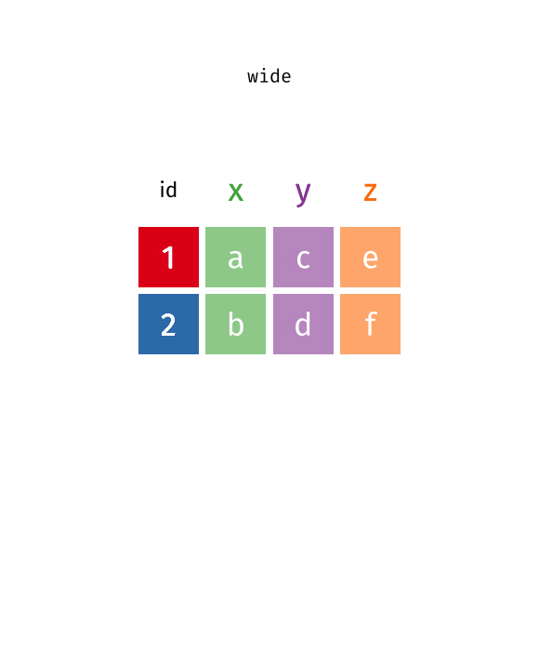

Slide 11
Why do we need to switch between wide/long data?
Wide: Easier for humans to read
# A tibble: 2 × 4
State June_vacc_rate May_vacc_rate April_vacc_rate
<chr> <dbl> <dbl> <dbl>
1 Alabama 0.516 0.514 0.511
2 Alaska 0.627 0.626 0.623
Long: Easier for R to make plots & do analysis
# A tibble: 6 × 3
State name value
<chr> <chr> <dbl>
1 Alabama June_vacc_rate 0.516
2 Alabama May_vacc_rate 0.514
3 Alabama April_vacc_rate 0.511
4 Alaska June_vacc_rate 0.627
5 Alaska May_vacc_rate 0.626
6 Alaska April_vacc_rate 0.623

Slide 12
Pivoting using the tidyr package (part of tidyverse)
We will be talking about:
  pivot_longer - make multiple columns into variables, (wide to long)
  pivot_wider - make a variable into multiple columns, (long to wide)
The reshape command exists. Its arguments are considered more confusing, so we don’t recommend it.
You might see old functions gather and spread when googling. These are older iterations of pivot_longer and pivot_wider, respectively.

Slide 13
pivot_longer…

Slide 14
Reshaping data from wide to long
pivot_longer() - puts column data into rows (tidyr package)
  First describe which columns we want to “pivot_longer”
{long_data} <- {wide_data} |> pivot_longer(cols = {columns to pivot})

Slide 15
Reshaping data from wide to long
ex_wide
# A tibble: 2 × 4
State June_vacc_rate May_vacc_rate April_vacc_rate
<chr> <dbl> <dbl> <dbl>
1 Alabama 0.516 0.514 0.511
2 Alaska 0.627 0.626 0.623
ex_long <- ex_wide |> pivot_longer(cols = ends_with("rate"))
ex_long
# A tibble: 6 × 3
State name value
<chr> <chr> <dbl>
1 Alabama June_vacc_rate 0.516
2 Alabama May_vacc_rate 0.514
3 Alabama April_vacc_rate 0.511
4 Alaska June_vacc_rate 0.627
5 Alaska May_vacc_rate 0.626
6 Alaska April_vacc_rate 0.623

Slide 16
GUT CHECK!
What does pivot_longer() do?
A. Summarize data
B. Import data
C. Reshape data

Slide 17
Reshaping wide to long: Better column names
pivot_longer() - puts column data into rows (tidyr package)
  First describe which columns we want to “pivot_longer”
  names_to = new name for old columns
  values_to = new name for old cell values
{long_data} <- {wide_data} |> pivot_longer(cols = {columns to pivot},
names_to = {name for old columns},
values_to = {name for cell values})

Slide 18
Reshaping wide to long: Better column names
Newly created column names (“Month” and “Rate”) are enclosed in quotation marks. It helps us be more specific than “name” and “value”.
ex_long <- ex_wide |> pivot_longer(cols = ends_with("rate"),
names_to = "Month",
values_to = "Rate")
ex_long
# A tibble: 6 × 3
State Month Rate
<chr> <chr> <dbl>
1 Alabama June_vacc_rate 0.516
2 Alabama May_vacc_rate 0.514
3 Alabama April_vacc_rate 0.511
4 Alaska June_vacc_rate 0.627
5 Alaska May_vacc_rate 0.626
6 Alaska April_vacc_rate 0.623

Slide 19
Data used: Nitrate exposure
Let’s look at some data on levels of nitrate in water from Washington. This dataset reports the amount of people in Washington exposed to excess levels of nitrate in their water between 1999 and 2020.
wide_nitrate <-
read_csv(file = "https://daseh.org/data/Nitrate_Exposure_for_WA_Public_Water_Systems_byquarter_data.csv")
head(wide_nitrate)
# A tibble: 6 × 11
year quarter pop_on_sampled_PWS `pop_0-3ug/L` `pop_>3-5ug/L` `pop_>5-10ug/L`
<dbl> <chr> <dbl> <dbl> <dbl> <dbl>
1 1999 Q1 106720 67775 0 32
2 1999 Q2 85541 55476 0 212
3 1999 Q3 559137 319252 231186 212
4 1999 Q4 26995 25969 420 0
5 2000 Q1 34793 5904 0 92
6 2000 Q2 184521 157396 0 32
# ℹ 5 more variables: `pop_>10-20ug/L` <dbl>, `pop_>20ug/L` <dbl>,
# `pop_on_PWS_with_non-detect` <dbl>, pop_exposed_to_exceedances <dbl>,
# perc_pop_exposed_to_exceedances <dbl>

Slide 20
Mission: Average population exposed by concentration
Let’s imagine we want to see what proportion of the population was exposed to different nitrate concentrations. Results should look something like:
# A tibble: 3 × 2
concentration_cat avg_prop_exposedpop
<chr> <dbl>
1 0-3ug/L 0.593
2 10-20ug/L 0.000678
3 more_than_20ug/L 0.000129

Slide 21
Remove some columns we don’t need
wide_nitrate <- wide_nitrate |>
select(!ends_with("exceedances"))
wide_nitrate
# A tibble: 88 × 9
year quarter pop_on_sampled_PWS `pop_0-3ug/L` `pop_>3-5ug/L` `pop_>5-10ug/L`
<dbl> <chr> <dbl> <dbl> <dbl> <dbl>
1 1999 Q1 106720 67775 0 32
2 1999 Q2 85541 55476 0 212
3 1999 Q3 559137 319252 231186 212
4 1999 Q4 26995 25969 420 0
5 2000 Q1 34793 5904 0 92
6 2000 Q2 184521 157396 0 32
7 2000 Q3 42081 20407 345 0
8 2000 Q4 407219 358828 995 412
9 2001 Q1 90054 49552 150 0
10 2001 Q2 83521 43633 2536 90
# ℹ 78 more rows
# ℹ 3 more variables: `pop_>10-20ug/L` <dbl>, `pop_>20ug/L` <dbl>,
# `pop_on_PWS_with_non-detect` <dbl>

Slide 22
Reshaping data from wide to long
long_nitrate <- wide_nitrate |>
pivot_longer(!c(year, quarter, pop_on_sampled_PWS))
long_nitrate
# A tibble: 528 × 5
year quarter pop_on_sampled_PWS name value
<dbl> <chr> <dbl> <chr> <dbl>
1 1999 Q1 106720 pop_0-3ug/L 67775
2 1999 Q1 106720 pop_>3-5ug/L 0
3 1999 Q1 106720 pop_>5-10ug/L 32
4 1999 Q1 106720 pop_>10-20ug/L 0
5 1999 Q1 106720 pop_>20ug/L 0
6 1999 Q1 106720 pop_on_PWS_with_non-detect 38913
7 1999 Q2 85541 pop_0-3ug/L 55476
8 1999 Q2 85541 pop_>3-5ug/L 0
9 1999 Q2 85541 pop_>5-10ug/L 212
10 1999 Q2 85541 pop_>10-20ug/L 60
# ℹ 518 more rows

Slide 23
Reshaping data from wide to long
Un-pivoted columns (year, quarter, pop_on_sampled_PWS) are still columns.
long_nitrate
# A tibble: 528 × 5
year quarter pop_on_sampled_PWS name value
<dbl> <chr> <dbl> <chr> <dbl>
1 1999 Q1 106720 pop_0-3ug/L 67775
2 1999 Q1 106720 pop_>3-5ug/L 0
3 1999 Q1 106720 pop_>5-10ug/L 32
4 1999 Q1 106720 pop_>10-20ug/L 0
5 1999 Q1 106720 pop_>20ug/L 0
6 1999 Q1 106720 pop_on_PWS_with_non-detect 38913
7 1999 Q2 85541 pop_0-3ug/L 55476
8 1999 Q2 85541 pop_>3-5ug/L 0
9 1999 Q2 85541 pop_>5-10ug/L 212
10 1999 Q2 85541 pop_>10-20ug/L 60
# ℹ 518 more rows

Slide 24
Cleaning up long data
Let’s make the conc_count into a proportion.
long_nitrate <- long_nitrate |>
mutate(conc_prop = value / pop_on_sampled_PWS)
long_nitrate
# A tibble: 528 × 6
year quarter pop_on_sampled_PWS name value conc_prop
<dbl> <chr> <dbl> <chr> <dbl> <dbl>
1 1999 Q1 106720 pop_0-3ug/L 67775 0.635
2 1999 Q1 106720 pop_>3-5ug/L 0 0
3 1999 Q1 106720 pop_>5-10ug/L 32 0.000300
4 1999 Q1 106720 pop_>10-20ug/L 0 0
5 1999 Q1 106720 pop_>20ug/L 0 0
6 1999 Q1 106720 pop_on_PWS_with_non-detect 38913 0.365
7 1999 Q2 85541 pop_0-3ug/L 55476 0.649
8 1999 Q2 85541 pop_>3-5ug/L 0 0
9 1999 Q2 85541 pop_>5-10ug/L 212 0.00248
10 1999 Q2 85541 pop_>10-20ug/L 60 0.000701
# ℹ 518 more rows

Slide 25
Mission: Average population exposed by concentration
Now our data is more tidy, and we can take the averages easily!
long_nitrate |>
group_by(name) |>
summarize("avg_prop_exposedpop" = mean(conc_prop))
# A tibble: 6 × 2
name avg_prop_exposedpop
<chr> <dbl>
1 pop_0-3ug/L 0.593
2 pop_>10-20ug/L 0.000678
3 pop_>20ug/L 0.000129
4 pop_>3-5ug/L 0.182
5 pop_>5-10ug/L 0.0189
6 pop_on_PWS_with_non-detect 0.206

Slide 26
Reshaping data from wide to long
There are many ways to select the columns we want. Check out https://dplyr.tidyverse.org/reference/dplyr_tidy_select.html to look at more column selection options.

Slide 27
pivot_wider…

Slide 28
Reshaping data from long to wide
pivot_wider() - spreads row data into columns (tidyr package)
  names_from = the old column whose contents will be spread into multiple new column names.
  values_from = the old column whose contents will fill in the values of those new columns.
{wide_data} <- {long_data} |>
pivot_wider(names_from = {Old column name: contains new column names},
values_from = {Old column name: contains new cell values})

Slide 29
Reshaping data from long to wide
We can use pivot_wider to convert long data to wide format. Let’s try it with the vaccine data from earlier.
ex_long
# A tibble: 6 × 3
State Month Rate
<chr> <chr> <dbl>
1 Alabama June_vacc_rate 0.516
2 Alabama May_vacc_rate 0.514
3 Alabama April_vacc_rate 0.511
4 Alaska June_vacc_rate 0.627
5 Alaska May_vacc_rate 0.626
6 Alaska April_vacc_rate 0.623

Slide 30
Reshaping data from long to wide
We can use pivot_wider to convert long data to wide format. Let’s try it with the vaccine data from earlier.
ex_wide2 <- ex_long |> pivot_wider(names_from = "Month",
values_from = "Rate")
ex_wide2
# A tibble: 2 × 4
State June_vacc_rate May_vacc_rate April_vacc_rate
<chr> <dbl> <dbl> <dbl>
1 Alabama 0.516 0.514 0.511
2 Alaska 0.627 0.626 0.623

Slide 31
Reshaping nitrate exposure data
Let’s go back to the nitrate exposure dataset. What if we wanted to make a wide version of the data that displayed the proportion of people at each level of nitrate exposure, with each quarter as a column?
long_nitrate
# A tibble: 528 × 6
year quarter pop_on_sampled_PWS name value conc_prop
<dbl> <chr> <dbl> <chr> <dbl> <dbl>
1 1999 Q1 106720 pop_0-3ug/L 67775 0.635
2 1999 Q1 106720 pop_>3-5ug/L 0 0
3 1999 Q1 106720 pop_>5-10ug/L 32 0.000300
4 1999 Q1 106720 pop_>10-20ug/L 0 0
5 1999 Q1 106720 pop_>20ug/L 0 0
6 1999 Q1 106720 pop_on_PWS_with_non-detect 38913 0.365
7 1999 Q2 85541 pop_0-3ug/L 55476 0.649
8 1999 Q2 85541 pop_>3-5ug/L 0 0
9 1999 Q2 85541 pop_>5-10ug/L 212 0.00248
10 1999 Q2 85541 pop_>10-20ug/L 60 0.000701
# ℹ 518 more rows

Slide 32
Reshaping nitrate exposure data
Drop some columns we don’t need.
long_nitrate <- long_nitrate |>
select(!c(pop_on_sampled_PWS, value))
long_nitrate
# A tibble: 528 × 4
year quarter name conc_prop
<dbl> <chr> <chr> <dbl>
1 1999 Q1 pop_0-3ug/L 0.635
2 1999 Q1 pop_>3-5ug/L 0
3 1999 Q1 pop_>5-10ug/L 0.000300
4 1999 Q1 pop_>10-20ug/L 0
5 1999 Q1 pop_>20ug/L 0
6 1999 Q1 pop_on_PWS_with_non-detect 0.365
7 1999 Q2 pop_0-3ug/L 0.649
8 1999 Q2 pop_>3-5ug/L 0
9 1999 Q2 pop_>5-10ug/L 0.00248
10 1999 Q2 pop_>10-20ug/L 0.000701
# ℹ 518 more rows

Slide 33
Reshaping nitrate exposure data
Pivot the data!
wide_nitrate <- long_nitrate |>
pivot_wider(names_from = "quarter", values_from = "conc_prop")
wide_nitrate
# A tibble: 132 × 6
year name Q1 Q2 Q3 Q4
<dbl> <chr> <dbl> <dbl> <dbl> <dbl>
1 1999 pop_0-3ug/L 0.635 0.649 0.571 0.962
2 1999 pop_>3-5ug/L 0 0 0.413 0.0156
3 1999 pop_>5-10ug/L 0.000300 0.00248 0.000379 0
4 1999 pop_>10-20ug/L 0 0.000701 0 0
5 1999 pop_>20ug/L 0 0 0 0
6 1999 pop_on_PWS_with_non-detect 0.365 0.348 0.0152 0.0224
7 2000 pop_0-3ug/L 0.170 0.853 0.485 0.881
8 2000 pop_>3-5ug/L 0 0 0.00820 0.00244
9 2000 pop_>5-10ug/L 0.00264 0.000173 0 0.00101
10 2000 pop_>10-20ug/L 0 0 0 0
# ℹ 122 more rows

Slide 34
Summary
  tidyr package helps us convert between wide and long data
  pivot_longer() goes from wide -> long
    Specify columns you want to pivot
    Specify names_to = and values_to = for custom naming
  pivot_wider() goes from long -> wide
    Specify names_from = and values_from =

Slide 35
Lab Part 1
🏠 Class Website
💻 Lab

Slide 36
Joining
“Combining datasets”

Slide 37
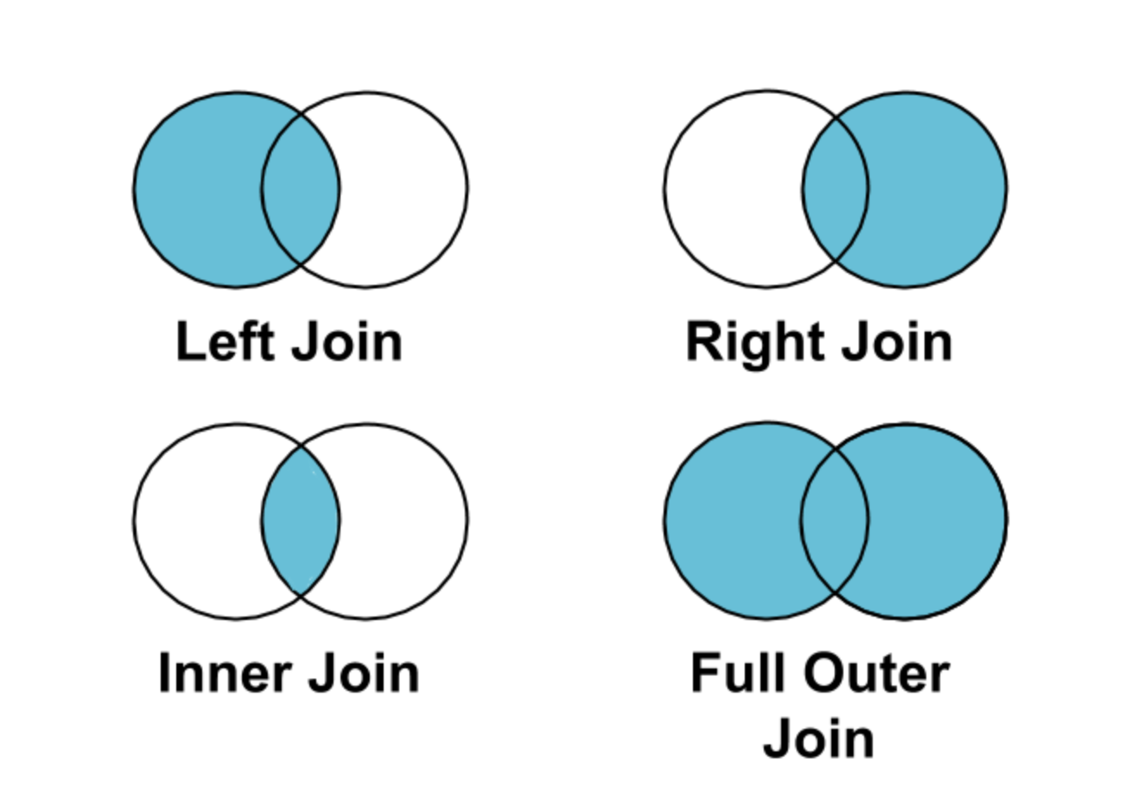

Slide 38
Joining in dplyr
  Merging/joining data sets together - usually on key variables, usually “id”
  ?join - see different types of joining for dplyr
  inner_join(x, y) - only rows that match for x and y are kept
  full_join(x, y) - all rows of x and y are kept
  left_join(x, y) - all rows of x are kept even if not merged with y
  right_join(x, y) - all rows of y are kept even if not merged with x
  anti_join(x, y) - all rows from x not in y keeping just columns from x.

Slide 39
Merging: Simple Data
data_As <- read_csv(
file = "https://daseh.org/data/data_As_1.csv")
data_cold <- read_csv(
file = "https://daseh.org/data/data_cold_1.csv")
data_As
# A tibble: 2 × 3
State June_vacc_rate May_vacc_rate
<chr> <dbl> <dbl>
1 Alabama 0.516 0.514
2 Alaska 0.627 0.626
data_cold
# A tibble: 2 × 2
State April_vacc_rate
<chr> <dbl>
1 Maine 0.795
2 Alaska 0.623

Slide 40
Inner Join
https://github.com/gadenbuie/tidyexplain/blob/main/images/inner-join.gif

Slide 41
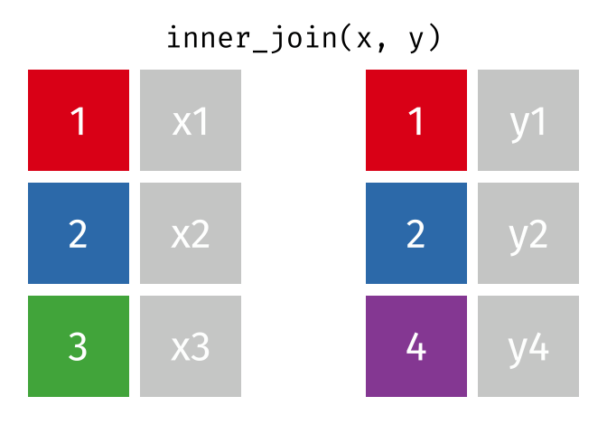

Slide 42
Inner Join
ij <- inner_join(data_As, data_cold)
Joining with `by = join_by(State)`
ij
# A tibble: 1 × 4
State June_vacc_rate May_vacc_rate April_vacc_rate
<chr> <dbl> <dbl> <dbl>
1 Alaska 0.627 0.626 0.623

Slide 43
Left Join
https://raw.githubusercontent.com/gadenbuie/tidyexplain/main/images/left-join.gif

Slide 44


Slide 45
Left Join
“Everything to the left of the comma”
lj <- left_join(data_As, data_cold)
Joining with `by = join_by(State)`
lj
# A tibble: 2 × 4
State June_vacc_rate May_vacc_rate April_vacc_rate
<chr> <dbl> <dbl> <dbl>
1 Alabama 0.516 0.514 NA
2 Alaska 0.627 0.626 0.623

Slide 46
Install tidylog package to log outputs
# install.packages("tidylog")
library(tidylog)
left_join(data_As, data_cold)
Joining with `by = join_by(State)`
left_join: added one column (April_vacc_rate)
> rows only in data_As 1
> rows only in data_cold (1)
> matched rows 1
> ===
> rows total 2
# A tibble: 2 × 4
State June_vacc_rate May_vacc_rate April_vacc_rate
<chr> <dbl> <dbl> <dbl>
1 Alabama 0.516 0.514 NA
2 Alaska 0.627 0.626 0.623

Slide 47
Right Join
https://raw.githubusercontent.com/gadenbuie/tidyexplain/main/images/right-join.gif

Slide 48


Slide 49
Right Join
“Everything to the right of the comma”
rj <- right_join(data_As, data_cold)
Joining with `by = join_by(State)`
right_join: added one column (April_vacc_rate)
> rows only in data_As (1)
> rows only in data_cold 1
> matched rows 1
> ===
> rows total 2
rj
# A tibble: 2 × 4
State June_vacc_rate May_vacc_rate April_vacc_rate
<chr> <dbl> <dbl> <dbl>
1 Alaska 0.627 0.626 0.623
2 Maine NA NA 0.795

Slide 50
Left Join: Switching arguments
lj2 <- left_join(data_cold, data_As)
Joining with `by = join_by(State)`
left_join: added 2 columns (June_vacc_rate, May_vacc_rate)
> rows only in data_cold 1
> rows only in data_As (1)
> matched rows 1
> ===
> rows total 2
lj2
# A tibble: 2 × 4
State April_vacc_rate June_vacc_rate May_vacc_rate
<chr> <dbl> <dbl> <dbl>
1 Maine 0.795 NA NA
2 Alaska 0.623 0.627 0.626

Slide 51
Full Join
https://raw.githubusercontent.com/gadenbuie/tidyexplain/main/images/full-join.gif

Slide 52
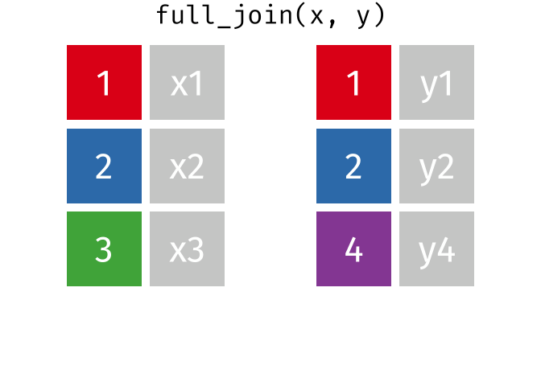

Slide 53
Full Join
fj <- full_join(data_As, data_cold)
Joining with `by = join_by(State)`
full_join: added one column (April_vacc_rate)
> rows only in data_As 1
> rows only in data_cold 1
> matched rows 1
> ===
> rows total 3
fj
# A tibble: 3 × 4
State June_vacc_rate May_vacc_rate April_vacc_rate
<chr> <dbl> <dbl> <dbl>
1 Alabama 0.516 0.514 NA
2 Alaska 0.627 0.626 0.623
3 Maine NA NA 0.795

Slide 54
“includes duplicates”
data_As <- read_csv(
file = "https://daseh.org/data/data_As_2.csv")
data_cold <- read_csv(
file = "https://daseh.org/data/data_cold_2.csv")
data_As
# A tibble: 2 × 2
State state_bird
<chr> <chr>
1 Alabama wild turkey
2 Alaska willow ptarmigan
data_cold
# A tibble: 3 × 3
State vacc_rate month
<chr> <dbl> <chr>
1 Maine 0.795 April
2 Alaska 0.623 April
3 Alaska 0.626 May

Slide 55
“includes duplicates”
lj <- left_join(data_As, data_cold)
Joining with `by = join_by(State)`
left_join: added 2 columns (vacc_rate, month)
> rows only in data_As 1
> rows only in data_cold (1)
> matched rows 2 (includes duplicates)
> ===
> rows total 3

Slide 56
“includes duplicates”
Data including the joining column (“State”) has been duplicated.
lj
# A tibble: 3 × 4
State state_bird vacc_rate month
<chr> <chr> <dbl> <chr>
1 Alabama wild turkey NA <NA>
2 Alaska willow ptarmigan 0.623 April
3 Alaska willow ptarmigan 0.626 May
Note that “Alaska willow ptarmigan” appears twice.

Slide 57
“includes duplicates”
https://github.com/gadenbuie/tidyexplain/blob/main/images/left-join-extra.gif

Slide 58
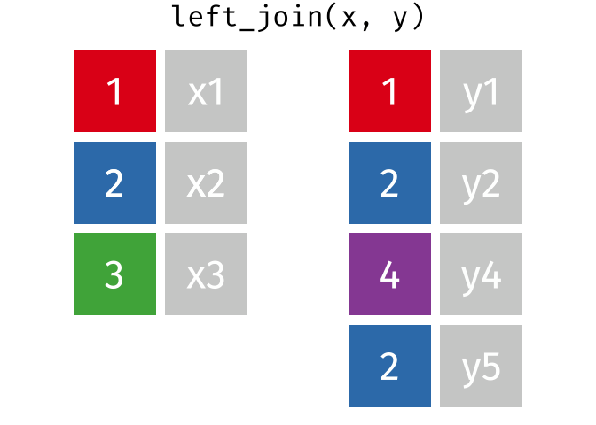

Slide 59
Stop tidylog
unloadNamespace() does the opposite of library().
unloadNamespace("tidylog")

Slide 60
Using the by argument
By default joins use the intersection of column names. If by is specified, it uses that.
full_join(data_As, data_cold, by = "State")
# A tibble: 4 × 4
State state_bird vacc_rate month
<chr> <chr> <dbl> <chr>
1 Alabama wild turkey NA <NA>
2 Alaska willow ptarmigan 0.623 April
3 Alaska willow ptarmigan 0.626 May
4 Maine <NA> 0.795 April

Slide 61
Using the by argument
You can join based on multiple columns by using something like by = c(col1, col2).
If the datasets have two different names for the same data, use:
full_join(x, y, by = c("a" = "b"))

Slide 62
anti_join : what’s missing
Entries in data_As but not in data_cold
anti_join(data_As, data_cold, by = "State")
# A tibble: 1 × 2
State state_bird
<chr> <chr>
1 Alabama wild turkey
Entries in data_cold but not in data_As
anti_join(data_cold, data_As, by = "State") # order switched
# A tibble: 1 × 3
State vacc_rate month
<chr> <dbl> <chr>
1 Maine 0.795 April

Slide 63
GUT CHECK!
Why use join functions?
A. Combine different data sources
B. Connect Rmd to other files
C. Using one data source is too easy and we want our analysis ~ fancy ~

Slide 64
Summary
  Merging/joining data sets together - assumes all column names that overlap
    use the by = c("a" = "b") if they differ
  inner_join(x, y) - only rows that match for x and y are kept
  full_join(x, y) - all rows of x and y are kept
  left_join(x, y) - all rows of x are kept even if not merged with y
  right_join(x, y) - all rows of y are kept even if not merged with x
  Use the tidylog package for a detailed summary
  anti_join(x, y) shows what is only in x (missing from y)

Slide 65
Lab Part 2
🏠 Class Website
💻 Lab
📃 Day 6 Cheatsheet
📃 Posit’s tidyr Cheatsheet
📃 Posit’s dplyr Cheatsheet

Slide 66


Slide 67
Image by Gerd Altmann from Pixabay

Slide 68
Additional Slides

Slide 69
Getting the set difference with setdiff
We might want to determine what indexes ARE in the first dataset that AREN’T in the second.
For this to work, the datasets need the same columns.
We’ll just select the index using select().
A_states <- data_As |> select(State)
cold_states <- data_cold |> select(State)

Slide 70
Getting the set difference with setdiff
States in A_states but not in cold_states
dplyr::setdiff(A_states, cold_states)
# A tibble: 1 × 1
State
<chr>
1 Alabama
States in cold_states but not in A_states
dplyr::setdiff(cold_states, A_states)
# A tibble: 1 × 1
State
<chr>
1 Maine

Slide 71
Getting the set difference with setdiff
Why did we use dplyr::setdiff?
There is a base R function, also called setdiff that requires vectors.
In other words, we use dplyr:: to be specific about the package we want to use.
More set operations can be found here: https://dplyr.tidyverse.org/reference/setops.html

Slide 72
Fast manipulation using collapse package
https://sebkrantz.github.io/collapse/
Might be helpful if your data is very large. However, dplyr and tidyr functions are great for most applications.

