Slide 1
Introduction

Slide 2
Welcome to class!
  Introductions
  Class overview
  Getting R up and running

Slide 3


Slide 4
[Photo by Belinda Fewings on Unsplash]

Slide 5
Before we start ..
Poll: How are you feeling right now?

Slide 6
About Us
Carrie Wright (she/her)
Senior Staff Scientist, Fred Hutchinson Cancer Center
Associate, Department of Biostatistics, JHSPH
PhD in Biomedical Sciences
Email: cwright2@fredhutch.org Web: https://carriewright11.github.io

Slide 7
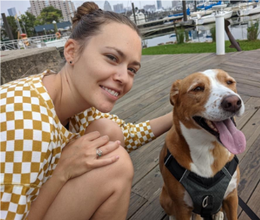

Slide 8
About Us
Ava Hoffman (she/her)
Senior Staff Scientist, Fred Hutchinson Cancer Center
Associate, Department of Biostatistics, JHSPH
PhD in Ecology
Email: ahoffma2@fredhutch.org Web: https://avahoffman.com

Slide 9
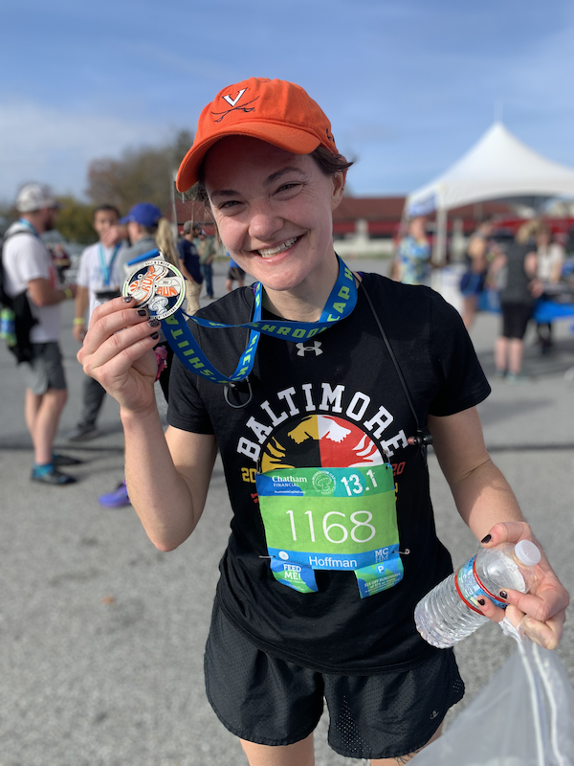

Slide 10
About Us: TA
Elizabeth Humphries (she/her)
Staff Scientist, Fred Hutchinson Cancer Center
PhD in Molecular Epidemiology
Email: ehumphri@fredhutch.org

Slide 11
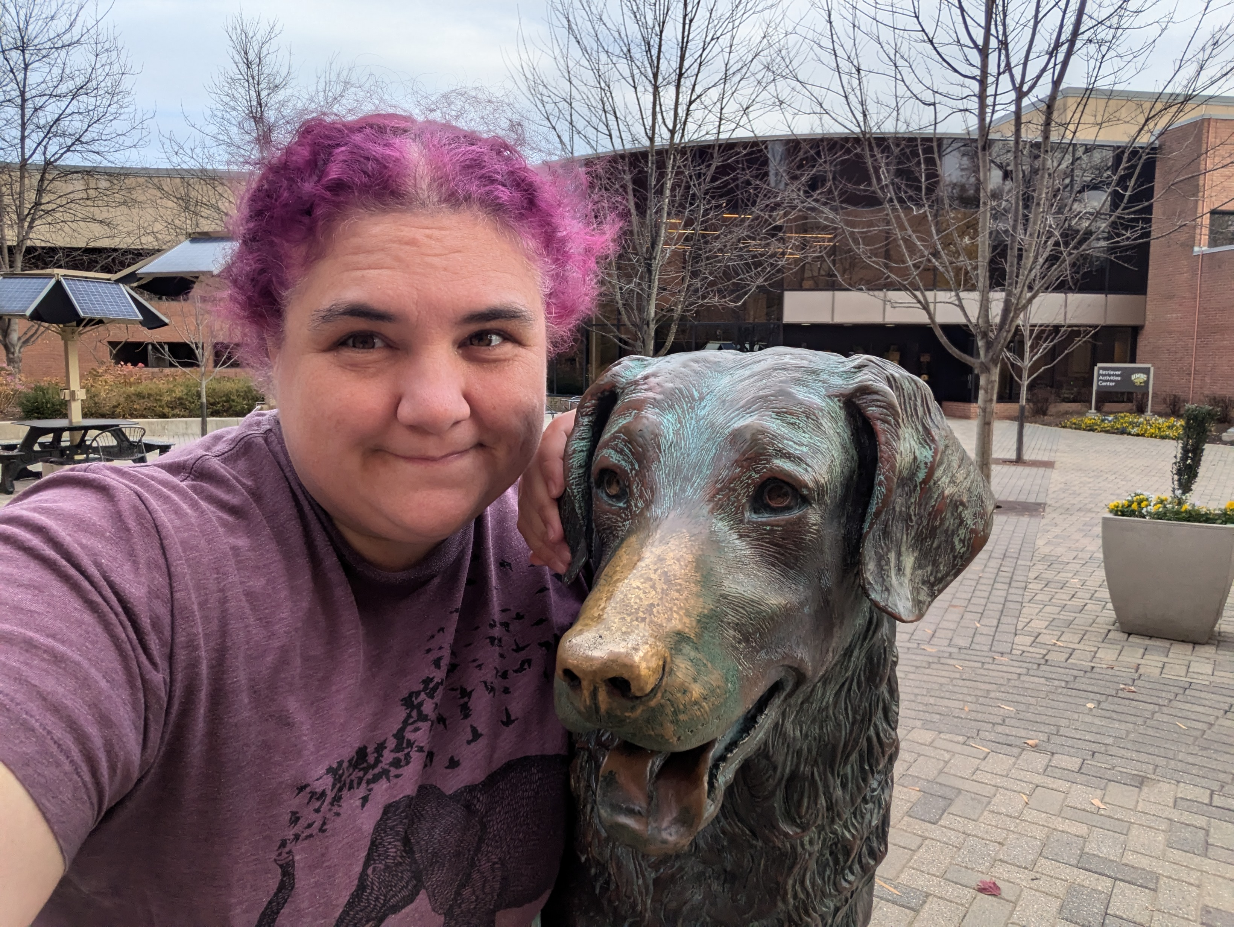

Slide 12
About you!
Please introduce yourself on Slack!
Slack Workspace

Slide 13
The Learning Curve
Learning a programming language can be very intense and sometimes overwhelming.
We recommend fully diving in and minimizing other commitments to get the most out of this course.
Like learning a spoken language, programming takes practice.

Slide 14


Slide 15
The Learning Curve
Learning R has been career changing for all of us, and we want to share that!
We want you to succeed – We will get through this together!

Slide 16


Slide 17
What is R?
  R is a language and environment for statistical computing and graphics developed in 1991
  R is both open source and open development

Slide 18


Slide 19
[source: http://www.r-project.org/]

Slide 20
Why R?
  Free (open source)
  High level language designed for statistical computing
  Powerful and flexible - especially for data wrangling and visualization
  Extensive add-on software (packages)
  Strong community

Slide 22
[source: https://github.com/rladies/meetup-presentations_baltimore]

Slide 23
Why not R?
  Little centralized support, relies on online community and package developers
  Annoying to update
  Slower, and more memory intensive, than the more traditional programming languages (C, Perl, Python)

Slide 24
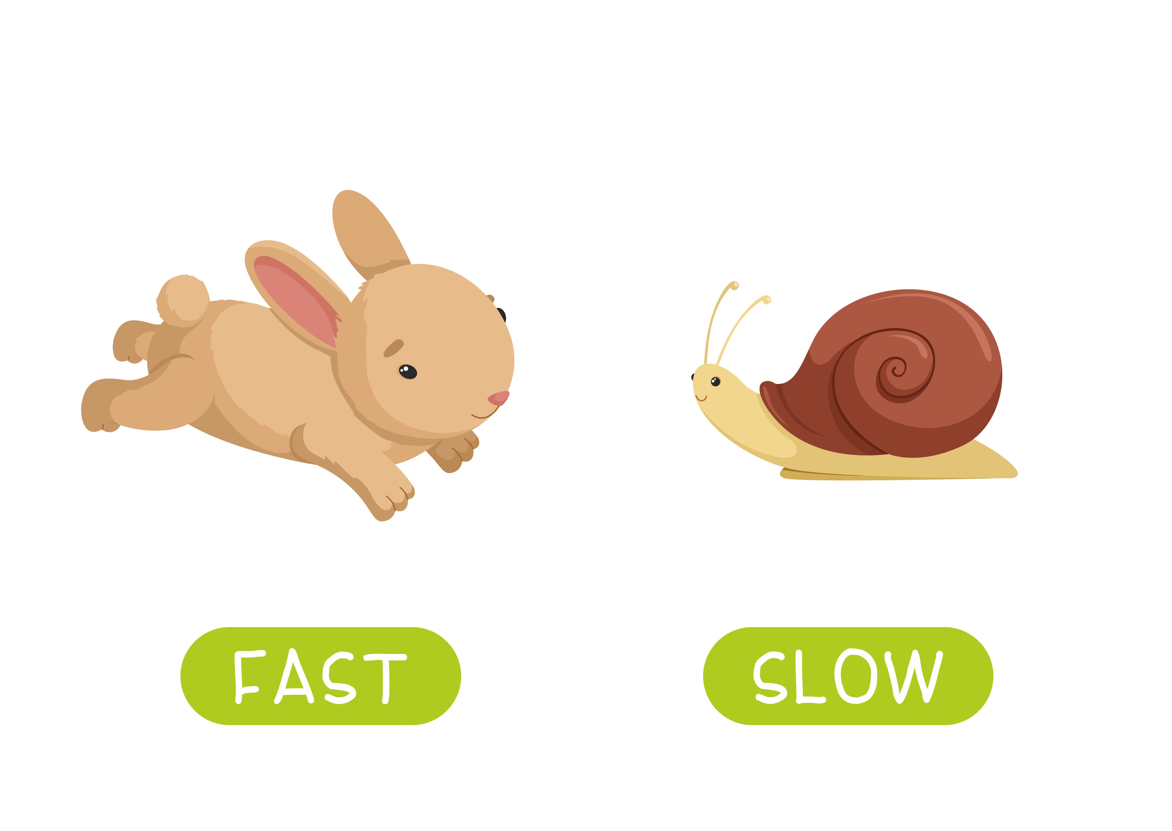

Slide 25
[source -School vector created by nizovatina - www.freepik.com]

Slide 26
Introductions
What do you hope to get out of the class?
Why do you want to use R?

Slide 27


Slide 28
[Photo by Nick Fewings on Unsplash]

Slide 29
Logistics

Slide 30
Course Website
https://daseh.org/
Materials will be uploaded the night before class. We are constantly trying to improve content! Please refresh/download materials before class.

Slide 31


Slide 32
Learning Objectives
  Understanding basic programming syntax
  Reading data into R
  Recoding and manipulating data
  Using add-on packages (more on what this is soon!)
  Making exploratory plots
  Performing basic statistical tests
  Writing R functions
  Building intuition

Slide 33
Course Format
ONLINE VIRTUAL COURSE
  Lecture with slides, interactive
  Lab/Practical experience
  Two 10 min breaks each day - timing may vary
  Sep 30 - Oct 10, 10:30am - 2:00pm PST on Zoom

Slide 34
Course Format
IN-PERSON CODE-A-THON
  Mostly independent group work
  Frequent check-ins with instructors and other groups
  Some lectures about the practical aspects of coding
  Oct 23 - 25 (in person in Seattle)
Deadline for arranging travel assistance is October 11!

Slide 35
Pulse Check Survey
Let us know anonymously how you’re doing with the material.

Slide 36


Slide 37
[source - Banner vector created by pch.vector - www.freepik.com]

Slide 38
Homework
While we do have homework assignments on the course schedule, these are strictly optional!!!
We encourage you to try the assignments, as the best way to get comfortable with any programming language is through practice.

Slide 39
Your Setup
If you can, we suggest working virtually with a large monitor or two screens.
This setup allows you to follow along on Zoom while also doing the hands-on coding.

Slide 40
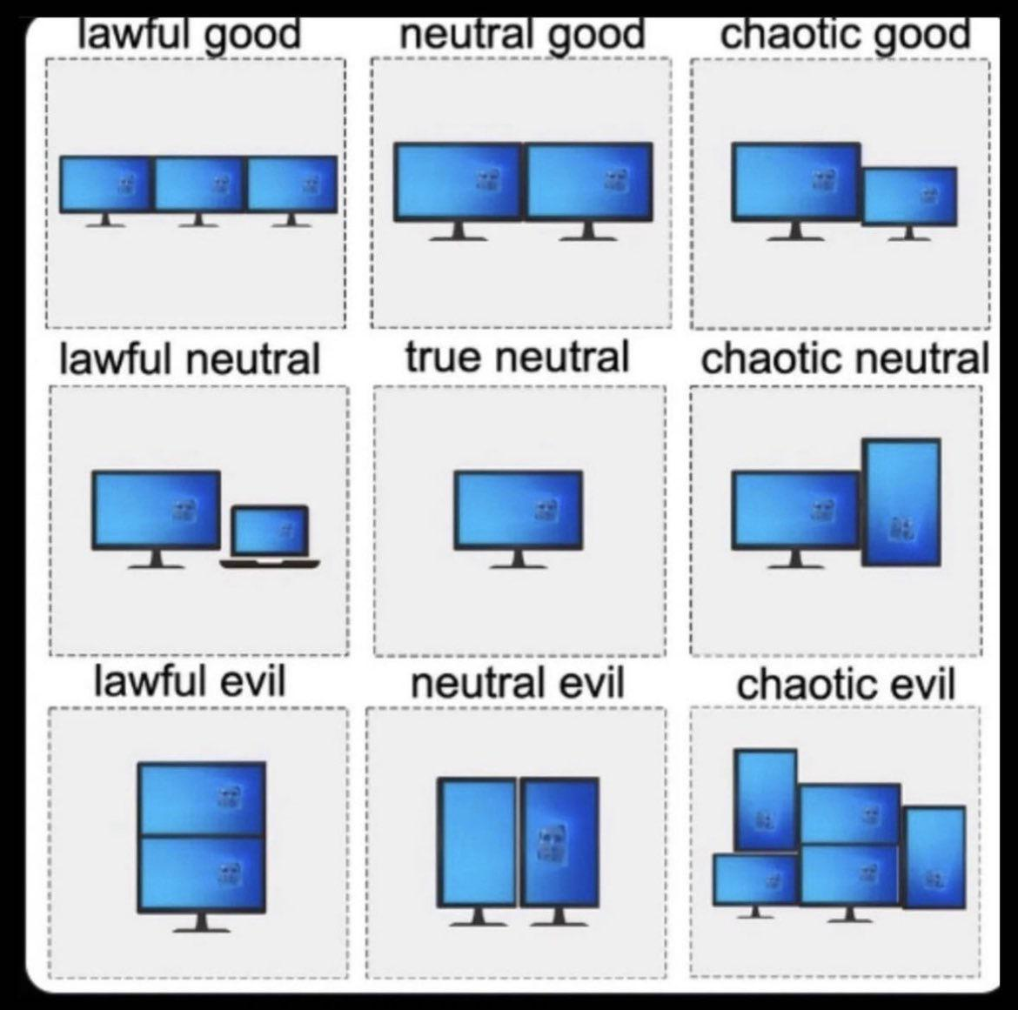

Slide 41
[source - reddit.com]

Slide 42
Research Survey

Slide 43
Research Survey
We are collecting data about user experience with our course to learn more about how to improve the data science education experience. This data may ultimately be used for a research publication and reporting to the NIH.
https://forms.gle/vxp8vxdN2Ck2j7uY6

Slide 44
Where to find help

Slide 45
Useful (+ mostly Free) Resources
Found on our website under the Resources tab: https://daseh.org/resources.html
  videos from previous offerings of the class
  cheatsheets for each class

Slide 46
Help!!!
Error messages can be scary!
  Check out the FAQ/Help page on the website: https://daseh.org/help.html
  Ask questions in Slack! Copy+pasting your error messages is really helpful!
We will also dedicate time today to debug any installation issues

Slide 47


Slide 48
Using AI
Large Language Models (ChatGPT, Claude, etc.) can be useful for programming. Specifically, it can help with:
  Writing or re-writing (refactoring) your code
  Annotation (code “notes”)
  Understanding unfamiliar code
We will talk more about AI + programming during the code-a-thon.
For best practices, we encourage you to check out our AI for Efficient Programming Course.

Slide 49
Installing R
  Install the latest R version (4.4.1 (called ‘Race for your Life’) as of June 14, 2024)
  Install RStudio
  R Tools Issue
More detailed instructions on the website.
RStudio is an integrated development environment (IDE) that makes it easier to work with R.
More on that soon!

Slide 50
Summary
🏠 Class Website - https://daseh.org/ - Logistics, resources, and help!
📝 Research Survey -
🩺 Pulse Check -
Image by Gerd Altmann from Pixabay

