Slide 1
Factors

Slide 2
Factors
A factor is a special character vector where the elements have pre-defined groups or ‘levels’. You can think of these as qualitative or categorical variables:
x <- c("yellow", "red", "red", "blue", "yellow", "blue") class(x)
## [1] "character"
x_fact <- factor(x) # factor() is a function class(x_fact)
## [1] "factor"

Slide 3
Factors
Factors have levels (character types do not).
x
## [1] "yellow" "red" "red" "blue" "yellow" "blue"
x_fact
## [1] yellow red red blue yellow blue ## Levels: blue red yellow
Note that levels are, by default, in alphanumerical order.

Slide 4
Factors
Extract the levels of a factor vector using levels():
levels(x_fact)
## [1] "blue" "red" "yellow"

Slide 5
forcats package
A package called forcats is really helpful for working with factors.

Slide 6


Slide 7
factor() vs as_factor()
factor() is from base R and as_factor() is from forcats
Both can change a variable to be of class factor.
factor() will order alphanumerically unless told otherwise.
as_factor() will order by first appearance unless told otherwise.
If you are assigning your levels manually either function is fine!

Slide 8
as_factor() function
x <- c("yellow", "red", "red", "blue", "yellow", "blue") x_fact_2 <- as_factor(x) x_fact_2
## [1] yellow red red blue yellow blue ## Levels: yellow red blue
# Compare to factor() method: x_fact
## [1] yellow red red blue yellow blue ## Levels: blue red yellow

Slide 9
A Factor Example
We will use a slightly different version of the data on heat-related visits to the ER from the State of Colorado.
For today, we are looking at data that reports ER visits by age category.
er_visits_age <- read_csv("https://daseh.org/data/CO_ER_heat_visits_by_age.csv")
## Rows: 60 Columns: 6 ## ── Column specification ──────────────────────────────────────────────────────── ## Delimiter: "," ## chr (1): age ## dbl (5): year, rate, lower95cl, upper95cl, visits ## ## ℹ Use `spec()` to retrieve the full column specification for this data. ## ℹ Specify the column types or set `show_col_types = FALSE` to quiet this message.

Slide 10
The data
head(er_visits_age)
## # A tibble: 6 × 6 ## year age rate lower95cl upper95cl visits ## <dbl> <chr> <dbl> <dbl> <dbl> <dbl> ## 1 2011 0-4 years 3.52 1.82 6.16 12 ## 2 2011 15-34 years 7.34 5.95 8.74 106 ## 3 2011 35-64 years 5.84 4.80 6.88 121 ## 4 2011 5-14 years 5.20 3.50 6.90 36 ## 5 2011 65+ years 8.34 5.98 10.7 48 ## 6 2012 0-4 years 3.58 1.85 6.25 12
Notice that age is a chr variable. This indicates that the values are character strings.
R does not realize that there is any order related to the AGE values. It will assume that it is alphanumeric (for numbers, this means ascending order).
However, we know that the order is: 0-4 years old, 5-14 years old, 15-34 years old, 35-64 years old, and 65+ years old.

Slide 11
For the next steps, let’s take a subset of data.
Use set.seed() to take the same random sample each time.
set.seed(123) er_visits_age_subset <- slice_sample(er_visits_age, n = 32)

Slide 12
Plot the data
Let’s make a plot first.
er_visits_age_subset |> ggplot(aes(x = age, y = rate)) + geom_boxplot() + theme_bw(base_size = 12) # make all labels size 12

Slide 13
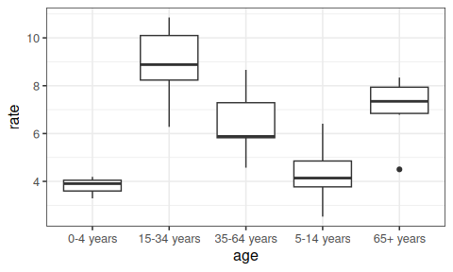

Slide 14
OK this is very useful, but it is a bit difficult to read. We expect the values to be plotted by the order that we know, not by alphabetical order.

Slide 15
Change to factor
Currently age is class character but let’s change that to class factor which allows us to specify the levels or order of the values.
er_visits_age_fct <- er_visits_age_subset |> mutate(age = factor(age, levels = c("0-4 years", "5-14 years", "15-34 years", "35-64 years", "65+ years") )) er_visits_age_fct |> pull(age) |> levels()
## [1] "0-4 years" "5-14 years" "15-34 years" "35-64 years" "65+ years"

Slide 16
Change to a factor
head(er_visits_age_fct)
## # A tibble: 6 × 6 ## year age rate lower95cl upper95cl visits ## <dbl> <fct> <dbl> <dbl> <dbl> <dbl> ## 1 2017 0-4 years 3.29 1.64 5.89 11 ## 2 2013 65+ years 4.50 2.86 6.14 29 ## 3 2021 0-4 years NA NA NA NA ## 4 2013 5-14 years 5.51 3.78 7.23 39 ## 5 2011 35-64 years 5.84 4.80 6.88 121 ## 6 2019 15-34 years 8.34 6.94 9.73 137

Slide 17
Plot again
Now let’s make our plot again:
er_visits_age_fct |> ggplot(aes(x = age, y = rate)) + geom_boxplot() + theme_bw(base_size = 12)

Slide 18
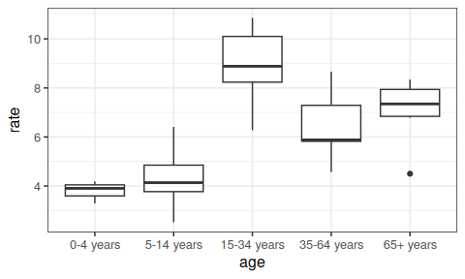

Slide 19
Now that’s more like it! Notice how the data is automatically plotted in the order we would like.

Slide 20
What about if we arrange() the data by age?
Character data is arranged alphabetically (if letters) or by ascending first number (if numbers).
er_visits_age_subset |> arrange(age)
## # A tibble: 32 × 6 ## year age rate lower95cl upper95cl visits ## <dbl> <chr> <dbl> <dbl> <dbl> <dbl> ## 1 2017 0-4 years 3.29 1.64 5.89 11 ## 2 2021 0-4 years NA NA NA NA ## 3 2016 0-4 years 4.19 2.29 7.03 14 ## 4 2018 0-4 years 3.91 2.08 6.68 13 ## 5 2019 15-34 years 8.34 6.94 9.73 137 ## 6 2018 15-34 years 10.1 8.60 11.7 165 ## 7 2022 15-34 years 10.0 8.52 11.6 167 ## 8 2016 15-34 years 10.9 9.23 12.5 171 ## 9 2012 15-34 years 8.88 7.36 10.4 130 ## 10 2014 15-34 years 6.28 5.02 7.54 95 ## # ℹ 22 more rows
Notice that the order is not what we would hope for!

Slide 21
Arranging Factors
Factor data is arranged by level.
er_visits_age_fct |> arrange(age)
## # A tibble: 32 × 6 ## year age rate lower95cl upper95cl visits ## <dbl> <fct> <dbl> <dbl> <dbl> <dbl> ## 1 2017 0-4 years 3.29 1.64 5.89 11 ## 2 2021 0-4 years NA NA NA NA ## 3 2016 0-4 years 4.19 2.29 7.03 14 ## 4 2018 0-4 years 3.91 2.08 6.68 13 ## 5 2013 5-14 years 5.51 3.78 7.23 39 ## 6 2012 5-14 years 4.14 2.63 5.64 29 ## 7 2016 5-14 years 6.41 4.56 8.26 46 ## 8 2020 5-14 years NA NA NA NA ## 9 2019 5-14 years 3.80 2.36 5.23 27 ## 10 2014 5-14 years 2.53 1.50 3.99 18 ## # ℹ 22 more rows
Nice! Now this is what we would want!

Slide 22
Making tables with characters
Tables grouped by a character are arranged alphabetically (if letters) or by ascending first number (if numbers).
er_visits_age_subset |> group_by(age) |> summarize(total_visits = sum(visits, na.rm = T))
## # A tibble: 5 × 2 ## age total_visits ## <chr> <dbl> ## 1 0-4 years 38 ## 2 15-34 years 986 ## 3 35-64 years 983 ## 4 5-14 years 215 ## 5 65+ years 296

Slide 23
Making tables with factors
Tables grouped by a factor are arranged by level.
er_visits_age_fct |> group_by(age) |> summarize(total_visits = sum(visits, na.rm = T))
## # A tibble: 5 × 2 ## age total_visits ## <fct> <dbl> ## 1 0-4 years 38 ## 2 5-14 years 215 ## 3 15-34 years 986 ## 4 35-64 years 983 ## 5 65+ years 296

Slide 24
forcats for ordering
What if we wanted to order age by increasing rate?
library(forcats) er_visits_age_fct |> ggplot(aes(x = age, y = rate)) + geom_boxplot() + theme_bw(base_size = 12)

Slide 26
This would be useful for identifying easily which age group to focus on.

Slide 27
forcats for ordering
We can order a factor by another variable by using the fct_reorder() function of the forcats package.
fct_reorder({column getting changed}, {guiding column}, {summarizing function})

Slide 28
forcats for ordering
We can order a factor by another variable by using the fct_reorder() function of the forcats package.
library(forcats) er_visits_age_fct |> ggplot(aes(x = fct_reorder(age, rate, mean), y = rate)) + geom_boxplot() + labs(x = "Age Category") + theme_bw(base_size = 12)

Slide 29
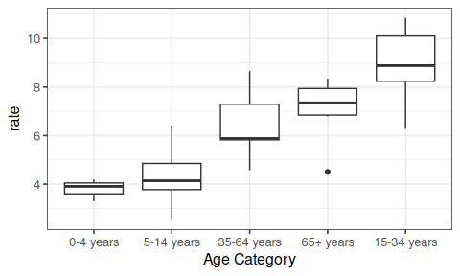

Slide 30
forcats for ordering.. with .desc = argument
library(forcats) er_visits_age_fct |> ggplot(aes(x = fct_reorder(age, rate, mean, .desc = TRUE), y = rate)) + geom_boxplot() + labs(x = "Age Category") + theme_bw(base_size = 12)

Slide 31
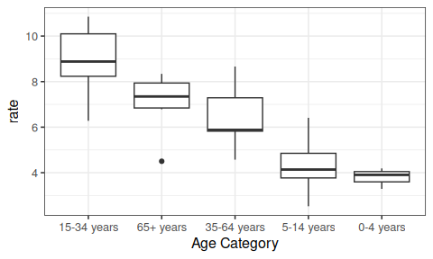

Slide 32
forcats for ordering… can be used to sort datasets
er_visits_age_fct |> pull(age) |> levels() # By year order
## [1] "0-4 years" "5-14 years" "15-34 years" "35-64 years" "65+ years"
er_visits_age_fct <- er_visits_age_fct |> mutate( age = fct_reorder(age, rate, mean) ) er_visits_age_fct |> pull(age) |> levels() # by increasing mean visits
## [1] "0-4 years" "5-14 years" "35-64 years" "65+ years" "15-34 years"

Slide 33
Checking Proportions with fct_count()
The fct_count() function of the forcats package is helpful for checking that the proportions of each level for a factor are similar. Need the prop = TRUE argument otherwise just counts are reported.
er_visits_age_fct |> pull(age) |> fct_count(prop = TRUE)
## # A tibble: 5 × 3 ## f n p ## <fct> <int> <dbl> ## 1 0-4 years 4 0.125 ## 2 5-14 years 8 0.25 ## 3 35-64 years 7 0.219 ## 4 65+ years 6 0.188 ## 5 15-34 years 7 0.219

Slide 34
GUT CHECK: Why is it useful to have the factor class as an option?
A. It helps us check the factual accuracy of our datasets.
B. It helps us change the order of variables in case the order has meaning.

Slide 35
GUT CHECK: What does the fct_reorder() function do?
A. It helps us reorder a factor based on the values of another variable.
B. It helps us reorder a factor based on a random change in the order.

Slide 36
Summary
the factor class allows us to have a different order from alphanumeric for categorical data
we can change data to be a factor variable using mutate and a factor creating function like factor() or as_factor
the as_factor() is from the forcats package (first appearance order by default)
the factor() base R function (alphanumeric order by default)
with factor() we can specify the levels with the levels argument if we want a specific order
the fct_reorder({variable_to_reorder}, {variable_to_order_by}, {summary function}) helps us reorder a variable by the values of another variable
arranging, tabulating, and plotting the data will reflect the new order

Slide 37
Lab
🏠 Class Website 💻 Lab. 📃Day 6 Cheatsheet 📃Posit’s forcats cheatsheet

Slide 38


Slide 39
Image by Gerd Altmann from Pixabay

