Slide 1
Data Visualization with Esquisse

Slide 2
Esquisse Package
# install.packages("esquisse")
library(esquisse)

Slide 3
Esquisse Package
The esquisse package is helpful for getting used to creating plots in R.
It is an interactive tool to help you in RStudio.
It’s super nifty!

Slide 4
First, get some data..
We can use the CO heat-related ER visits dataset. This dataset contains information about the number and rate of visits for heat-related illness to ERs in Colorado from 2011-2022, adjusted for age.
er <-
read_csv("https://daseh.org/data/CO_ER_heat_visits.csv")
head(er)
## # A tibble: 6 × 6
## county rate lower95cl upper95cl visits year
## <chr> <dbl> <dbl> <dbl> <dbl> <dbl>
## 1 Adams 6.73 NA 9.24 29 2011
## 2 Adams 4.84 2.85 NA 23 2012
## 3 Adams 6.84 4.36 9.31 31 2013
## 4 Adams 3.08 1.71 4.85 15 2014
## 5 Adams 3.36 1.89 5.23 16 2015
## 6 Adams 8.85 6.12 11.6 42 2016

Slide 5
Starting a plot
Using the esquisser() function you can start creating a plot for a data.frame or tibble. That’s it!
esquisser(er)

Slide 6
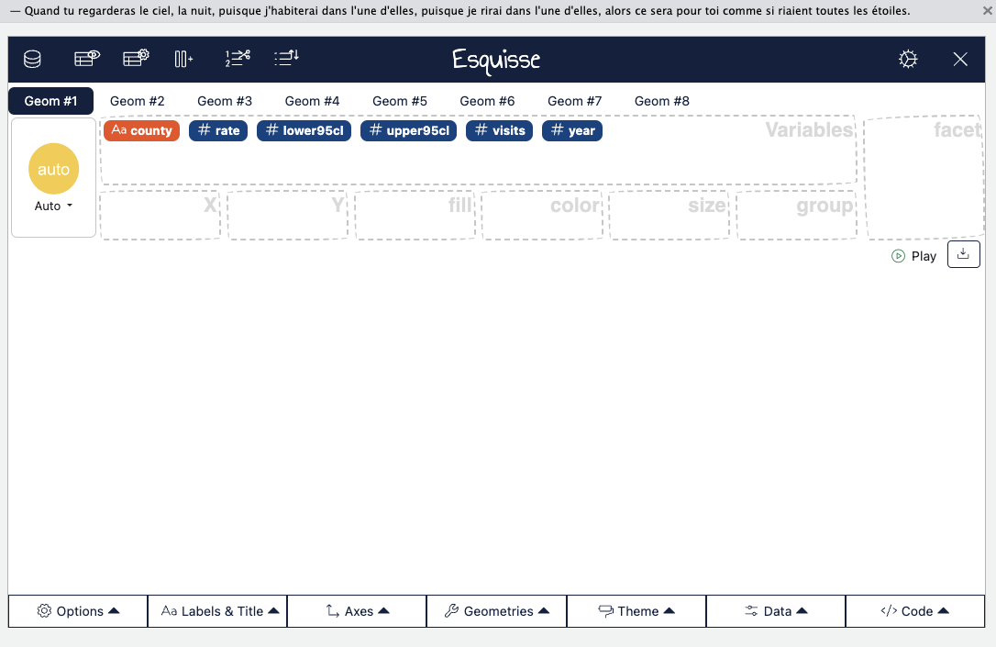

Slide 7
Show the plot in the browser
esquisse::esquisser(er, viewer = "browser")

Slide 8
Select Variables
To select variables you can drag and drop variables to the respective axis that you would like the variable to be plotted on.

Slide 9


Slide 10
Find code
To select variables you can drag and drop variables to the respective axis that you would like the variable to be plotted on.

Slide 11
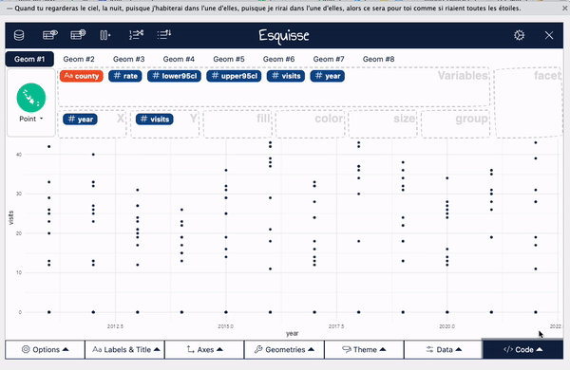

Slide 12
Change plot type
esquisse automatically assumes a plot type, but you might want to change this.

Slide 13
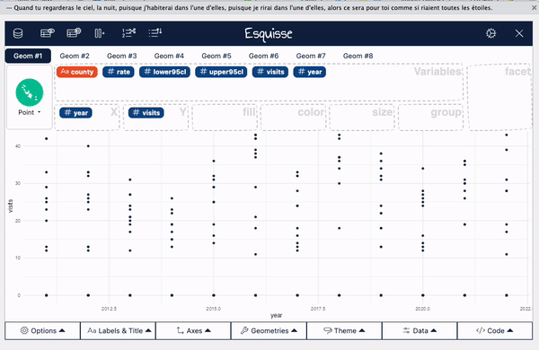

Slide 14
Add Facets
Facets create multiple plots based on the different values of a variable.

Slide 15
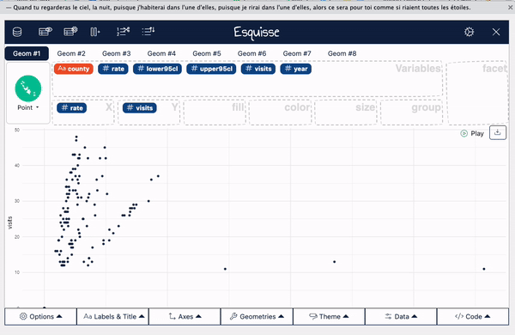

Slide 16
Add size
Sometimes it is useful to change the way points are plotted so that size represents a variable. This can especially be helpful if you need your plot to be black and white.

Slide 17
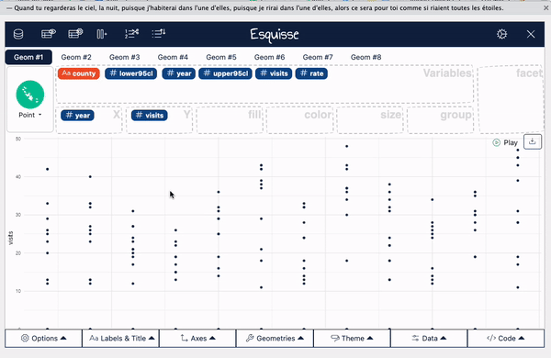

Slide 18
Add color
For plots with points use the color region to change coloring according to a variable. (use “fill” for bar plots)

Slide 19
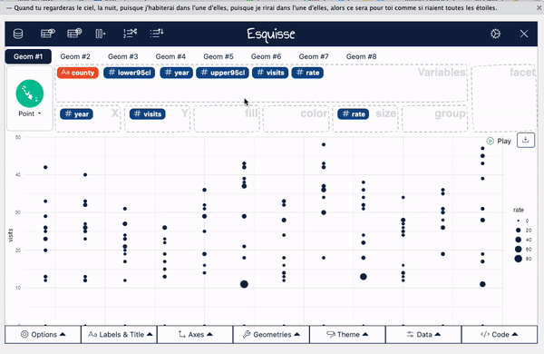

Slide 20
Appearance
You can change the overall appearance with “Geometries” and “Theme”.

Slide 21
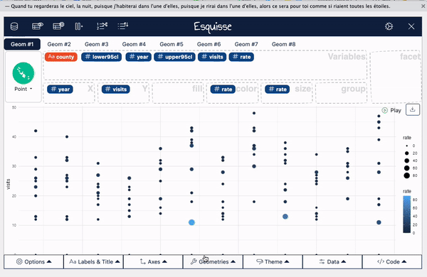

Slide 22
Change titles
To change titles on your plot, use the “Labels & Titles” tab.

Slide 23
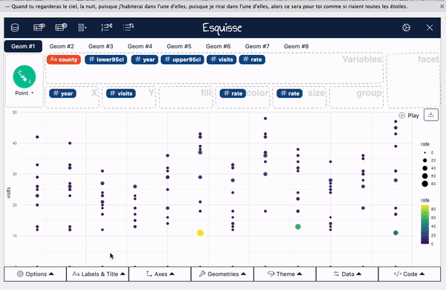

Slide 24
View data
You can also easily view data

Slide 25
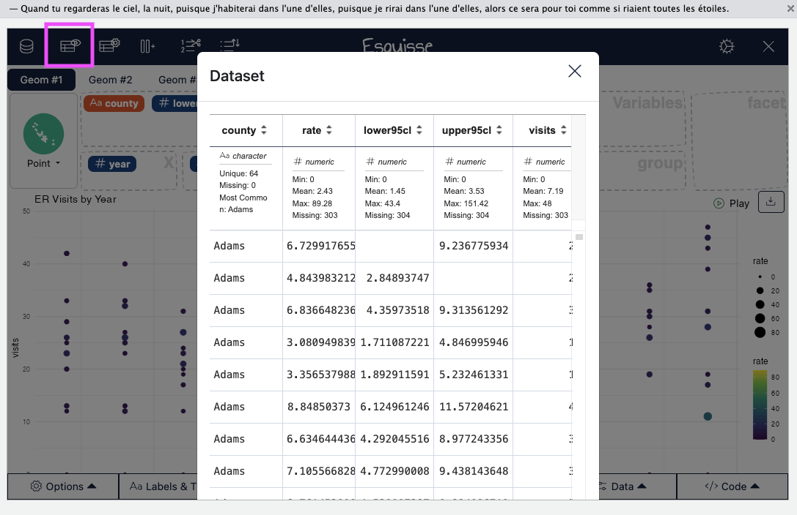

Slide 26
Interrupting Esquisse
You’ll need to “interrupt” Esquisse to launch it with a new dataset.
  Close the tab/window
  Use the stop button to stop the Esquisse app
If you don’t see the stop button, you need to resize your window.

Slide 27
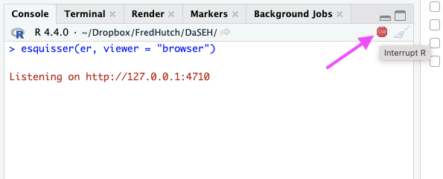

Slide 28
Wide & Long Data ?
Let’s look at why we might want long data using Esquisse.
library(tidyverse)
long_er <- er |>
select(c("county", "year", "visits"))
glimpse(long_er)
## Rows: 768
## Columns: 3
## $ county <chr> "Adams", "Adams", "Adams", "Adams", "Adams", "Adams", "Adams", …
## $ year <dbl> 2011, 2012, 2013, 2014, 2015, 2016, 2017, 2018, 2019, 2020, 202…
## $ visits <dbl> 29, 23, 31, 15, 16, 42, 32, 37, 36, 24, 35, 45, 0, 0, NA, 0, NA…

Slide 29
Wide Data
As a comparison, let’s also load a wide version of this dataset.
wide_er <- er |>
select(county, visits, year) |>
pivot_wider(names_from = county, values_from = visits)

Slide 30
Wide vs Long Data
head(long_er)
## # A tibble: 6 × 3
## county year visits
## <chr> <dbl> <dbl>
## 1 Adams 2011 29
## 2 Adams 2012 23
## 3 Adams 2013 31
## 4 Adams 2014 15
## 5 Adams 2015 16
## 6 Adams 2016 42
head(wide_er)
## # A tibble: 6 × 65
## year Adams Alamosa Arapahoe Archuleta Baca Bent Boulder Broomfield Chaffee
## <dbl> <dbl> <dbl> <dbl> <dbl> <dbl> <dbl> <dbl> <dbl> <dbl>
## 1 2011 29 0 33 0 0 0 12 NA 0
## 2 2012 23 0 27 0 0 NA 13 NA NA
## 3 2013 31 NA 20 0 0 0 12 NA NA
## 4 2014 15 0 NA 0 0 NA 19 NA NA
## 5 2015 16 NA 31 0 0 NA 14 NA NA
## 6 2016 42 NA 39 0 0 NA 18 NA 0
## # ℹ 55 more variables: Cheyenne <dbl>, `Clear Creek` <dbl>, Conejos <dbl>,
## # Costilla <dbl>, Crowley <dbl>, Custer <dbl>, Delta <dbl>, Denver <dbl>,
## # Dolores <dbl>, Douglas <dbl>, Eagle <dbl>, Elbert <dbl>, `El Paso` <dbl>,
## # Fremont <dbl>, Garfield <dbl>, Gilpin <dbl>, Grand <dbl>, Gunnison <dbl>,
## # Hinsdale <dbl>, Huerfano <dbl>, Jackson <dbl>, Jefferson <dbl>,
## # Kiowa <dbl>, `Kit Carson` <dbl>, Lake <dbl>, `La Plata` <dbl>,
## # Larimer <dbl>, `Las Animas` <dbl>, Lincoln <dbl>, Logan <dbl>, …

Slide 31
Make a plot of visits by year for different counties
esquisser(wide_er) # only one county at a time? Tricky!
esquisser(long_er) # county as color, visits as y, year as x!

Slide 32
GUT CHECK!
Why use Esquisse?
A. Explore your data
B. Get a “head start” on your code
C. Both of these!

Slide 33
Some Alternatives to esquisse
  ggquickeda: https://smouksassi.github.io/ggquickeda/
  ggraptR: https://github.com/cargomoose/ggraptR/
  autoplot can be helpful for some packages (see this blog post)

Slide 34
Summary
  Use the esquisser() function on a dataset
  Use the viewer = "browser" argument to launch in your browser.
  Code from Esquisse can copied into code chunks to be generated in the “Plots” pane
  It’s easier if your code is in “long” form!

Slide 35
Lab
🏠 Class Website
💻 Lab
📃 Day 6 Cheatsheet

Slide 36


Slide 37
Image by Gerd Altmann from Pixabay

