Slide 1
Data Visualization

Slide 2
Recap
pivot_longer() helps us take our data from wide to long format
names_to = gives a new name to the pivoted columns
values_to = gives a new name to the values that used to be in those columns
pivot_wider() helps us take our data from long to wide format
names_from specifies the old column name that contains the new column names
values_from specifies the old column name that contains new cell values
to merge/join data sets together need a variable in common - usually “id”
📃Cheatsheet

Slide 3
Recap continued
to merge/join data sets together need a variable in common - usually “id”
?join - see different types of joining for dplyr
inner_join(x, y) - only rows that match for x and y are kept
full_join(x, y) - all rows of x and y are kept
left_join(x, y) - all rows of x are kept even if not merged with y
right_join(x, y) - all rows of y are kept even if not merged with x
anti_join(x, y) - all rows from x not in y keeping just columns from x.
esquisser() function of the esquisse package can help make plot sketches
📃Cheatsheet

Slide 4

esquisse and ggplot2

Slide 5
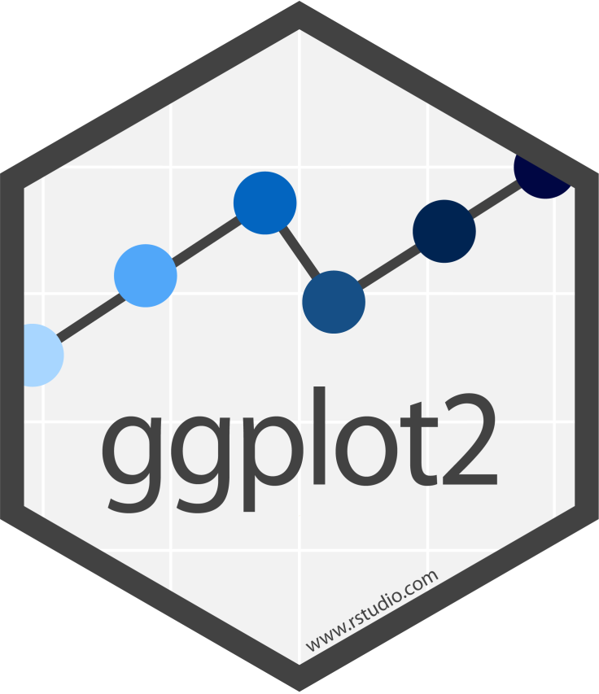

Slide 6
Why learn ggplot2?
More customization:
branding
making plots interactive
combining plots
Easier plot automation (creating plots in scripts)
Faster (eventually)

Slide 7
ggplot2
A package for producing graphics - gg = Grammar of Graphics
Created by Hadley Wickham in 2005
Belongs to “Tidyverse” family of packages
“Make a ggplot” = Make a plot with the use of ggplot2 package
Resources:
https://ggplot2-book.org/
https://www.opencasestudies.org/

Slide 8
ggplot2
Based on the idea of:
layering
plot objects are placed on top of each other with +
📉 + 📈

Slide 9
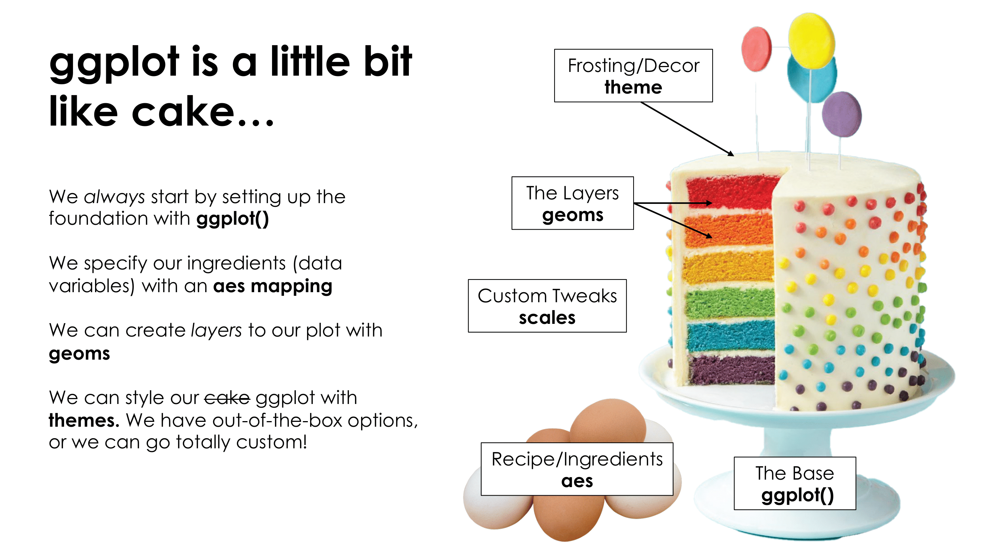
ggplot2

Slide 10
Slide Credit: Tanya Shapiro

Slide 11
ggplot2
Pros: extremely powerful/flexible – allows combining multiple plot elements together, allows high customization of a look, many resources online
Cons: ggplot2-specific “grammar of graphic” of constructing a plot
ggplot2 gallery

Slide 12
Tidy data
To make graphics using ggplot2, our data needs to be in a tidy format
Tidy data:
Each variable forms a column.
Each observation forms a row.
Messy data:
Column headers are values, not variable names.
Multiple variables are stored in one column.
Variables are stored in both rows and columns.

Slide 13
Tidy data: example
Ideally we want each variable as a column and we want each observation in a row.
Column headers are values, not variable names:

Slide 14
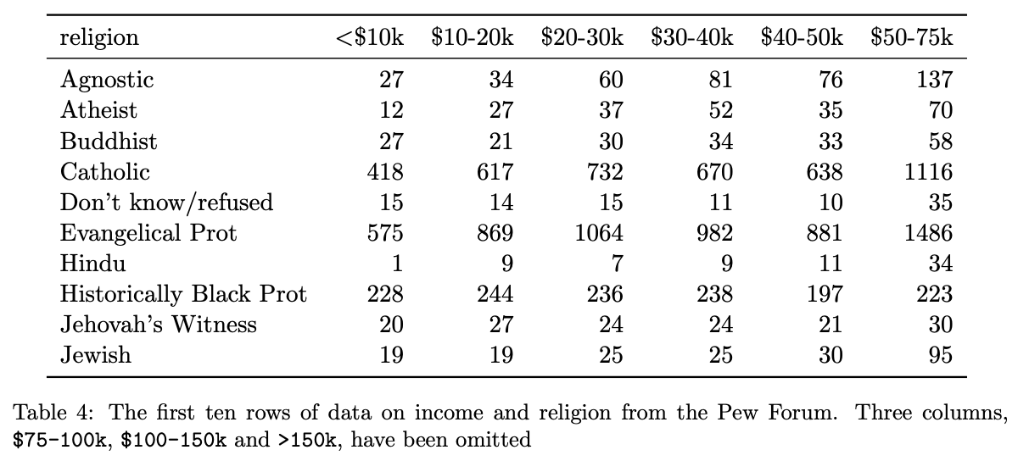

Slide 15
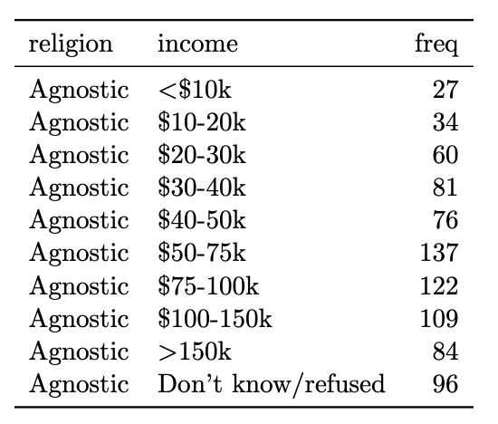
Now the the data is “tidy” and in long format

Slide 16
Read more about tidy data and see other examples: Tidy Data tutorial

Slide 17
Data to plot
Let’s plot the CO heat-related ER visits dataset we’ve been working with. First, we’ll only consider data from Boulder county.
Is the data in tidy? Is it in long format?
er <- read_csv("https://daseh.org/data/CO_ER_heat_visits.csv") er_Boulder <- er |> filter(county == "Boulder") head(er_Boulder)
# A tibble: 6 × 6 county rate lower95cl upper95cl visits year <chr> <dbl> <dbl> <dbl> <dbl> <dbl> 1 Boulder 4.03 2.05 6.67 12 2011 2 Boulder 4.08 2.15 6.62 13 2012 3 Boulder 3.79 1.90 6.32 12 2013 4 Boulder 6.29 3.71 9.54 19 2014 5 Boulder 4.76 2.57 7.61 14 2015 6 Boulder 5.68 3.31 8.67 18 2016

Slide 18
First plot with ggplot2 package

Slide 19
First layer of code with ggplot2 package
Will set up the plot - it will be empty!

Slide 20
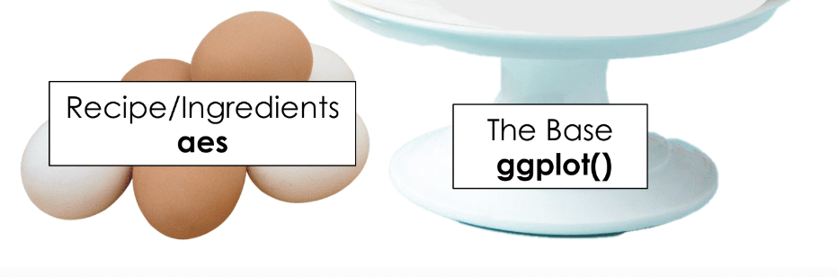

Slide 21
First layer of code with ggplot2 package
Aesthetic mapping aes(x= , y =) describes how variables in our data are mapped to elements of the plot - Note you don’t need to use mapping but it is helpful to know what we are doing.
library(ggplot2) # don't forget to load ggplot2 # This is not code but shows the general format ggplot({data_to plot}, aes(x = {var in data to plot}, y = {var in data to plot}))
ggplot(er_Boulder, aes(x = year, y = rate))

Slide 22
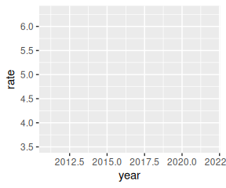

Slide 23
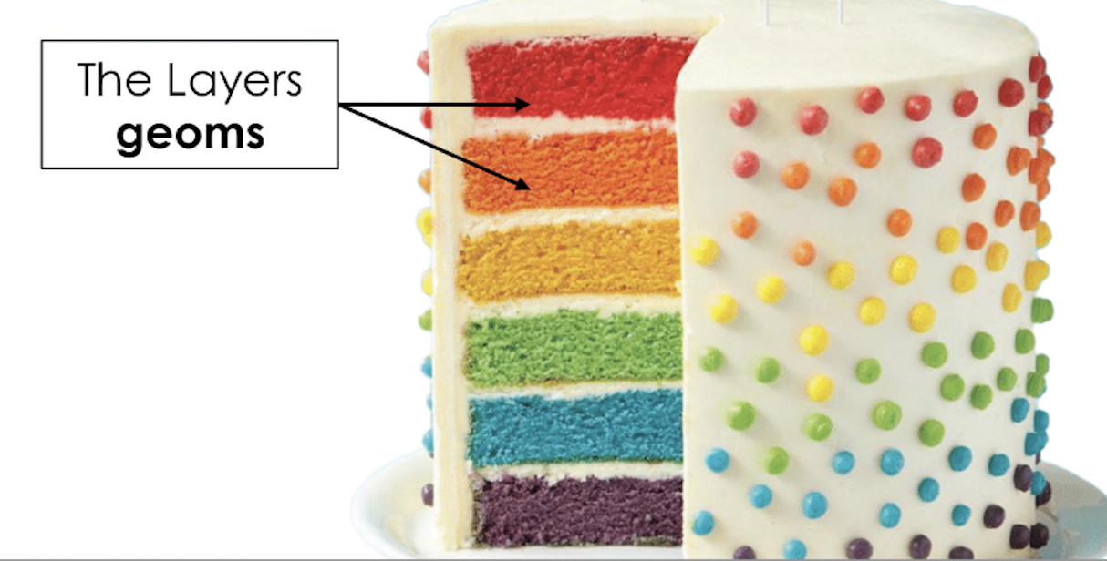
Next layer code with ggplot2 package

Slide 24
There are many to choose from, to list just a few:
geom_point() – points (we have seen)
geom_line() – lines to connect observations
geom_boxplot() – boxplots
geom_histogram() – histogram
geom_bar() – bar plot
geom_col() – column plot
geom_tile() – blocks filled with color

Slide 25
Next layer code with ggplot2 package
When to use what plot? A few examples:
a scatterplot (geom_point()): to examine the relationship between two sets of continuous numeric data
a barplot (geom_bar()): to compare the distribution of a quantitative variable (numeric) between groups or categories
a histogram (geom_hist()): to observe the overall distribution of numeric data
a boxplot (geom_boxplot()): to compare values between different factor levels or categories

Slide 26
Next layer code with ggplot2 package
Need the + sign to add the next layer to specify the type of plot
ggplot({data_to plot}, aes(x = {var in data to plot}, y = {var in data to plot})) + geom_{type of plot}</div>
ggplot(er_Boulder, aes(x = year, y = rate)) + geom_point()

Slide 27
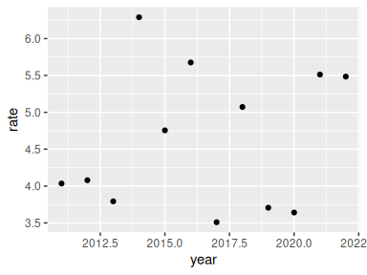

Slide 28
Read as: using CO statewide ER heat visits data, and provided aesthetic mapping, add points to the plot

Slide 29
Tip - plus sign + must come at end of line
Having the + sign at the beginning of a line will not work!
ggplot(er_Boulder, aes(x = year, y = rate, fill = item_categ)) + geom_boxplot()
Pipes will also not work in place of +!
ggplot(er_Boulder, aes(x = year, y = rate, fill = item_categ)) |> geom_boxplot()

Slide 30
Plots can be assigned as an object
plt1 <- ggplot(er_Boulder, aes(x = year, y = rate)) + geom_point() plt1

Slide 32
Examples of different geoms
plt1 <- ggplot(er_Boulder, aes(x = year, y = rate)) + geom_point() plt2 <- ggplot(er_Boulder, aes(x = year, y = rate)) + geom_line() plt1 # fig.show = "hold" makes plots appear plt2 # next to one another in the chunk settings

Slide 33
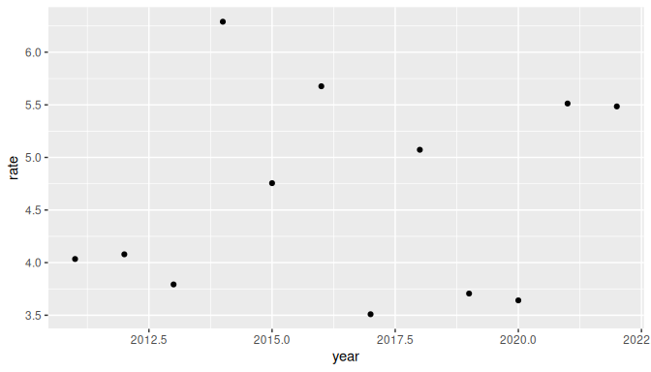

Slide 34
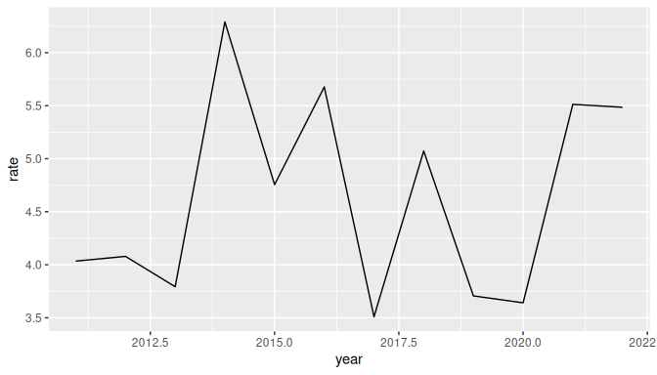

Slide 35
Specifying plot layers: combining multiple layers
Layer a plot on top of another plot with +
ggplot(er_Boulder, aes(x = year, y = rate)) + geom_point() + geom_line()

Slide 36
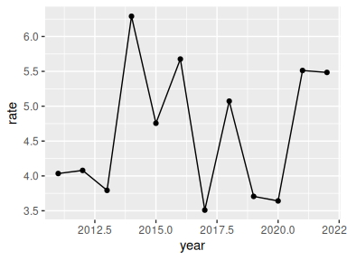

Slide 37
Adding color - can map color to a variable
Let’s map ER visit rates for four CO counties on the same plot
er_visits_4 <- er |> filter(county %in% c("Denver", "Weld", "Pueblo", "Jackson")) ggplot(er_visits_4, aes(x = year, y = rate, color = county)) + geom_point() + geom_line()

Slide 38
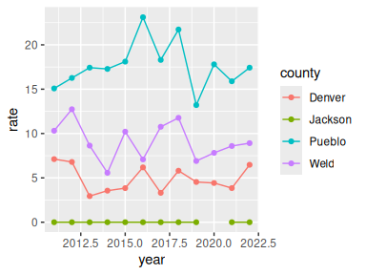

Slide 39
Customize the look of the plot

Slide 40
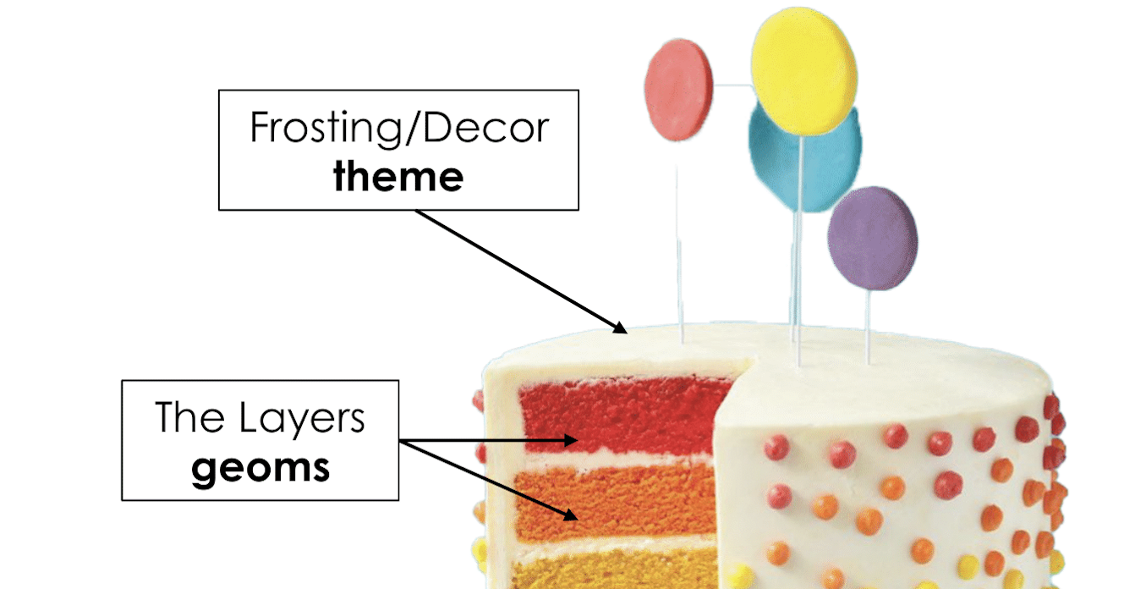

Slide 41
Customize the look of the plot
You can change the look of whole plot using theme_*() functions.
There are also size, color, alpha, and linetype arguments.
ggplot(er_Boulder, aes(x = year, y = rate)) + geom_point(size = 5, color = "green", alpha = 0.5) + geom_line(size = 0.8, color = "blue", linetype = 2) + theme_dark()

Slide 42
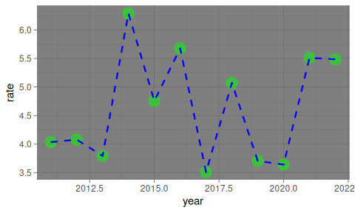

Slide 43
More themes!
There’s not only the built in ggplot2 themes but all kinds of themes from other packages! - ggthemes - ThemePark package - hrbr themes

Slide 44
Adding labels
The labs() function can help you add or modify titles on your plot. The title argument specifies the title. The x argument specifies the x axis label. The y argument specifies the y axis label.
ggplot(er_Boulder, aes(x = year, y = rate)) + geom_point(size = 5, color = "red", alpha = 0.5) + geom_line(size = 0.8, color = "brown", linetype = 2) + labs(title = "Heat-Related ER Visits:Boulder", x = "Year", y = "Age-adjusted Visit Rate")

Slide 45
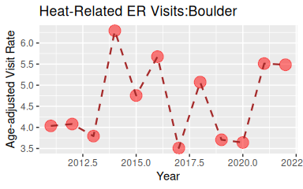

Slide 46
Changing axis: specifying axis scale
scale_x_continuous() and scale_y_continuous() can change how the axis is plotted. Can use the breaks argument to specify how you want the axis ticks.
plot_scale <- ggplot(er_Boulder, aes(x = year, y = rate)) + geom_point(size = 5, color = "green", alpha = 0.5) + geom_line(size = 0.8, color = "blue", linetype = 2) + scale_x_continuous(breaks = seq(from = 2011, to = 2022, by = 1)) plot_scale

Slide 47
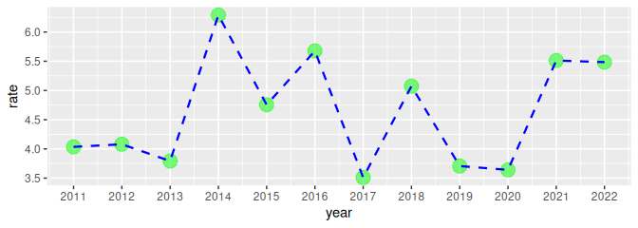

Slide 48
Modifying plot objects
You can add to a plot object to make changes! Note that we can save our plots as an object like plt1 below. And now if we reference plt1 again our plot will print out!
plt1 <- ggplot(er_Boulder, aes(x = year, y = rate,)) + geom_point(size = 5, color = "green", alpha = 0.5) +geom_line(size = 0.8, color = "blue", linetype = 2) + labs(title = "Heat-Related ER Visits:Boulder", x = "Year", y = "Age-adjusted Visit Rate") plt1 + theme_minimal()

Slide 49
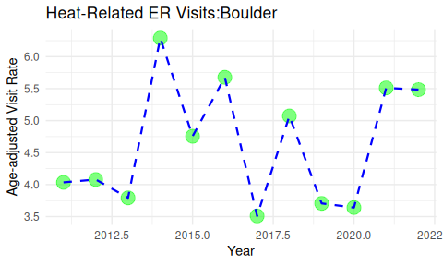

Slide 50
Removing the legend label
You can use theme(legend.position = "none") to remove the legend.
er_visits_4 |> ggplot(aes(x = year, y = rate, color = county)) + geom_line(size = 0.8) + theme(legend.position = "none")

Slide 51
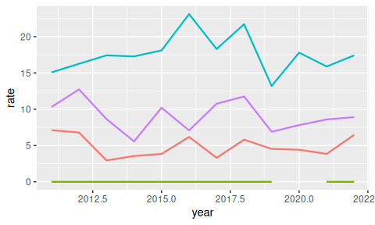

Slide 52
Overwriting specifications
It’s possible to go in and change specifications with newer layers. Here is our original plot.
er_visits_4 |> ggplot(aes(x = year, y = rate, color = county)) + geom_line(size = 0.8)

Slide 53
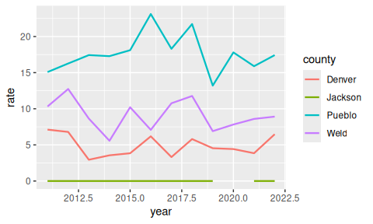

Slide 54
Overwriting specifications
It’s possible to go in and change specifications with newer layers.
er_visits_4 |> ggplot(aes(x = year, y = rate, color = county)) + geom_line(size = 0.8, color = "black")

Slide 55
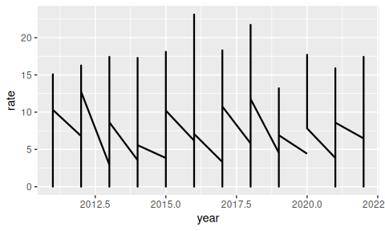

Slide 56
GUT CHECK: If we get an empty plot what might we need to do?
A. Add a plot_ layer like plot_point()
B. Add a geom_ layer like geom_point()

Slide 57
GUT CHECK: How do we add more layers in ggplot2 plots?
A. |>
B. &
C. +

Slide 58
Summary
ggplot() specifies what data use and what variables will be mapped to where
inside ggplot(), aes(x = , y = , color =) specify what variables correspond to what aspects of the plot in general
layers of plots can be combined using the + at the end of lines
special theme_*() functions can change the overall look
individual layers can be customized using arguments like: size, color alpha (more transparent is closer to 0), and linetype
labels can be added with the labs() function and x, y, title arguments
scale_x_continuous() and scale_y_continuous() can modify the scale of the axes
by default, ggplot() removes points with missing values from plots.

Slide 59
Lab 1
🏠 Class Website
💻 Lab
📃Day 6 Cheatsheet

Slide 60
theme() function:
The theme() function can help you modify various elements of your plot. Here we will adjust the font size of the plot title.
ggplot(er_Boulder, aes(x = year, y = rate)) + geom_point(size = 5, color = "green", alpha = 0.5) + geom_line(size = 0.8, color = "blue", linetype = 2) + labs(title = "Heat-Related ER Visits:Boulder") + theme(plot.title = element_text(size = 20))

Slide 61
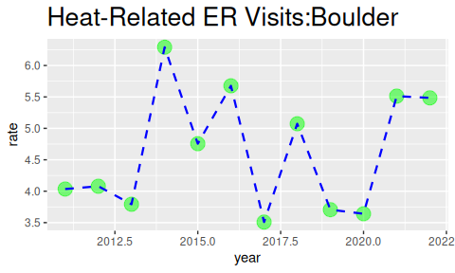

Slide 62
theme() function
The theme() function always takes:
an object to change (use ?theme() to see - plot.title, axis.title, axis.ticks etc.)
the aspect you are changing about this: element_text(), element_line(), element_rect(), element_blank()
what you are changing:
text: size, color, fill, face, alpha, angle
position: "top", "bottom", "right", "left", "none"
rectangle: size, color, fill, linetype
line: size, color, linetype

Slide 63
theme() function: center title and change size
The theme() function can help you modify various elements of your plot. Here we will adjust the horizontal justification (hjust) of the plot title.
ggplot(er_Boulder, aes(x = year, y = rate)) + geom_point(size = 5, color = "green", alpha = 0.5) + geom_line(size = 0.8, color = "blue", linetype = 2) + labs(title = "Heat-Related ER Visits:Boulder") + theme(plot.title = element_text(hjust = 0.5, size = 20))

Slide 64
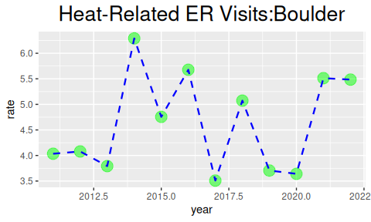

Slide 65
theme() function: change title and axis format
ggplot(er_Boulder, aes(x = year, y = rate)) + geom_point(size = 5, color = "green", alpha = 0.5) + geom_line(size = 0.8, color = "blue", linetype = 2) + labs(title = "Heat-Related ER Visits: Boulder") + theme(plot.title = element_text(hjust = 0.5, size = 20), axis.title = element_text(size = 16))

Slide 66
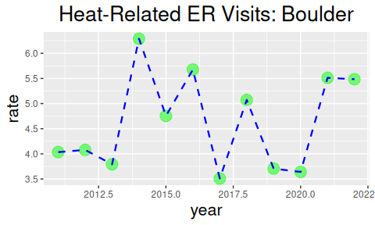

Slide 67
Cheatsheet about theme
https://github.com/claragranell/ggplot2/blob/main/ggplot_theme_system_cheatsheet.pdf

Slide 68
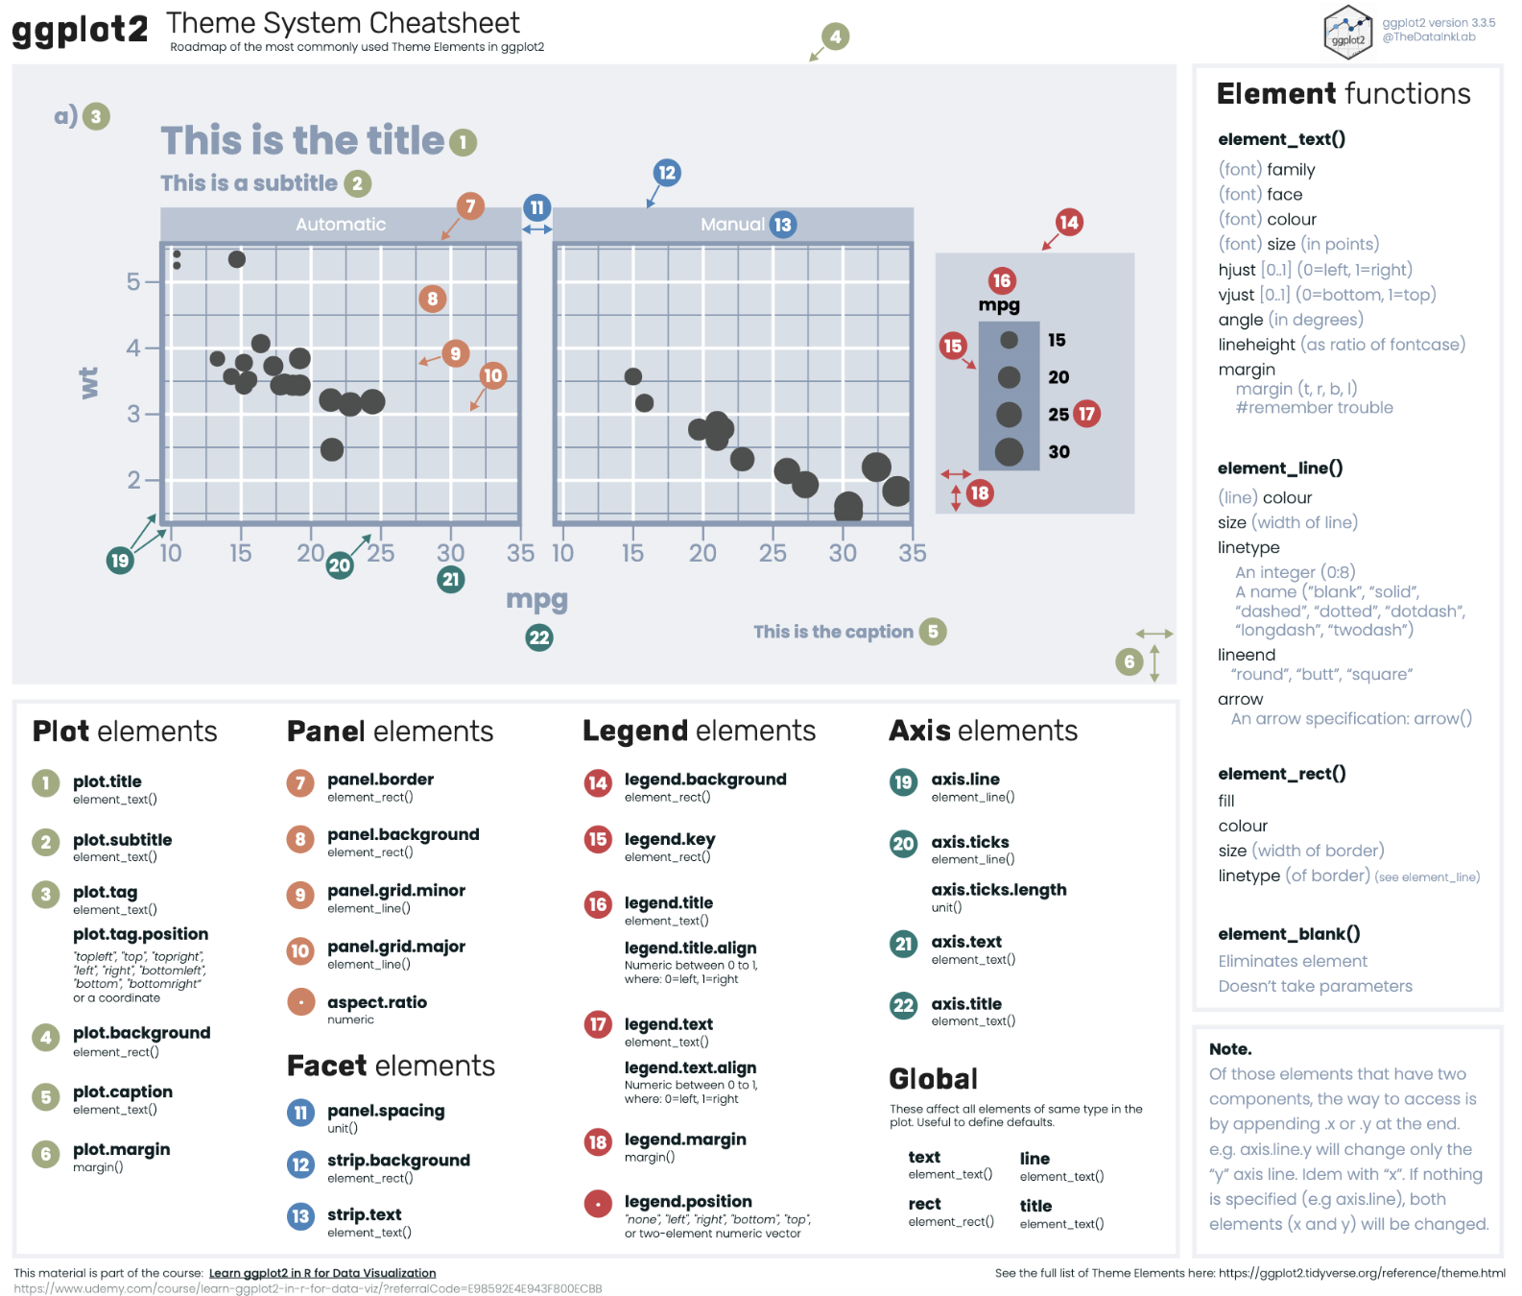

Slide 69
Starting a plot
Let’s start with er_visits_4.
ggplot(er_visits_4, aes(x = year, y = rate)) + geom_line()

Slide 70
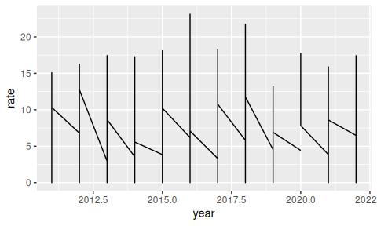

Slide 71

If it looks confusing to you, try again

Slide 72
Using group in plots
You can use group element in a mapping to indicate that each county will have a rate line.
ggplot(er_visits_4, aes(x = year, y = rate, group = county)) + geom_line()

Slide 73
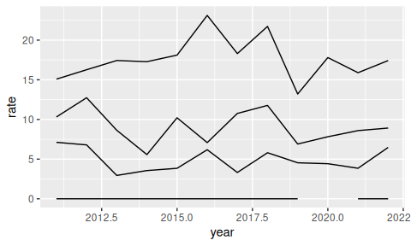

Slide 74
Adding color will automatically group the data
ggplot(er_visits_4, aes(x = year, y = rate, color = county)) + geom_line()+ theme(legend.position = "bottom")

Slide 75
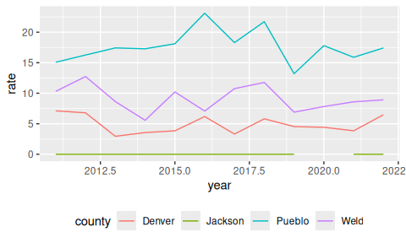

Slide 76
Tips!
Let’s talk additional tricks and tips for making ggplots!

Slide 77
Tips - Color vs Fill
color is needed for points and lines
fill is generally needed for boxes and bars
ggplot(er_visits_4, aes(x = county, y = visits, color = county)) + #color creates an outline geom_boxplot() ggplot(er_visits_4, aes(x = county, y = rate, fill = county)) + # fills the boxplot geom_boxplot()

Slide 78
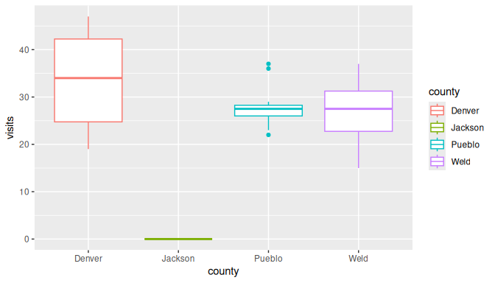

Slide 79
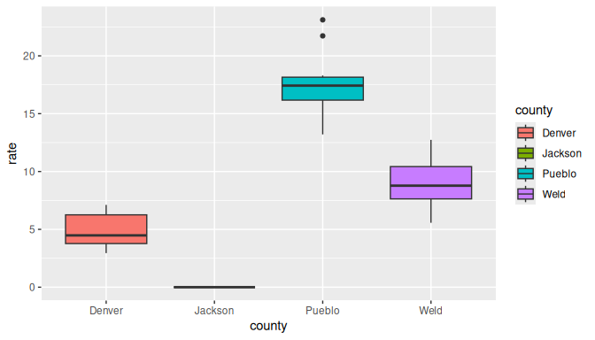

Slide 80
Tip - Good idea to add jitter layer to top of box plots
Can add width argument to make the jitter more narrow.
ggplot(er_visits_4, aes(x = county, y = rate, fill = county)) + geom_boxplot() + geom_jitter(width = .06)

Slide 81
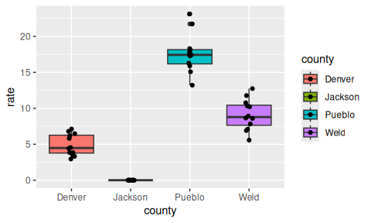

Slide 82
Tip - be careful about colors for color vision deficiency
scale_fill_viridis_d() for discrete /categorical data scale_fill_viridis_c() for continuous data
ggplot(er_visits_4, aes(x = county, y = rate, fill = county)) + geom_boxplot() + geom_jitter(width = .06) + scale_fill_viridis_d()

Slide 83
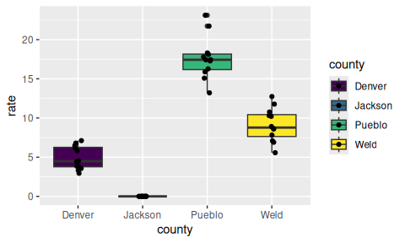

Slide 84
Tip - can pipe data after wrangling into ggplot()
er_bar <- er_visits_4 |> group_by(county) |> summarize("max_rate" = max(rate, na.rm=T)) |> ggplot(aes(x = county, y = max_rate, fill = county)) + scale_fill_viridis_d()+ geom_col() + theme(legend.position = "none") er_bar

Slide 85
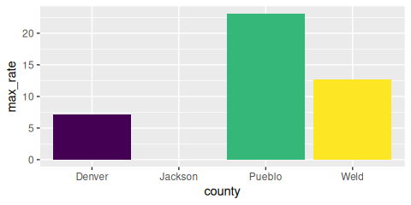

Slide 86
Tip - color outside of aes()
Can be used to add an outline around column/bar plots.
er_bar + geom_col(color = "black")

Slide 87
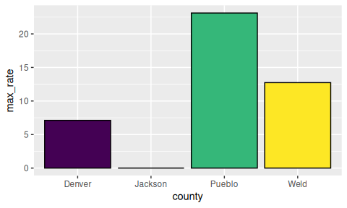

Slide 88
Tip - col vs bar
geom_bar(x =) can only use one aes mapping geom_col(x = , y = ) can have two

Slide 89
Tip - Check what you plot
⚠️ May not be plotting what you think you are! ⚠️
ggplot(er_visits_4, aes(x = county, y = visits, fill = county)) + geom_col()

Slide 90
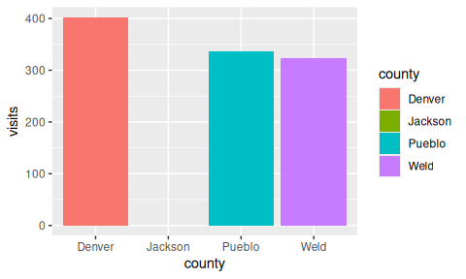

Slide 91
What did we plot? Always good to check it is correct!
head(er_visits_4, n = 3)
# A tibble: 3 × 6 county rate lower95cl upper95cl visits year <chr> <dbl> <dbl> <dbl> <dbl> <dbl> 1 Denver 7.11 4.89 9.34 42 2011 2 Denver 6.79 4.62 8.97 40 2012 3 Denver 2.95 1.75 4.46 19 2013
er_visits_4 |> group_by(county) |> summarize(sum = sum(visits, na.rm=T))
# A tibble: 4 × 2 county sum <chr> <dbl> 1 Denver 402 2 Jackson 0 3 Pueblo 336 4 Weld 324

Slide 92
Try that again
er_visits_4 |> group_by(county) |> summarize(mean_visits = mean(visits, na.rm=T))
# A tibble: 4 × 2 county mean_visits <chr> <dbl> 1 Denver 33.5 2 Jackson 0 3 Pueblo 28 4 Weld 27

Slide 93
Try that again
er_visits_4 |> group_by(county) |> summarize(mean_visits = mean(visits, na.rm=T)) |> ggplot(aes(x = county, y = mean_visits, fill = county)) + geom_col()

Slide 94
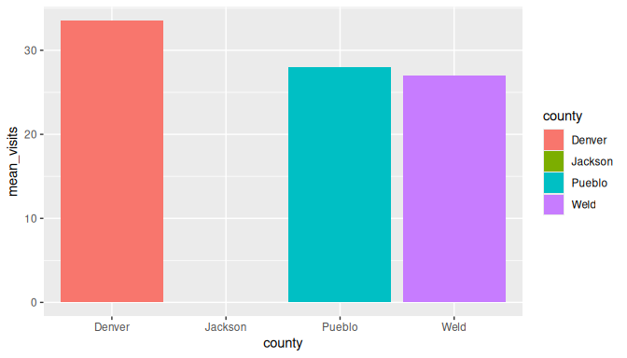

Slide 95
Tip - make sure labels aren’t too small
er_bar + theme(text = element_text(size = 20))

Slide 96
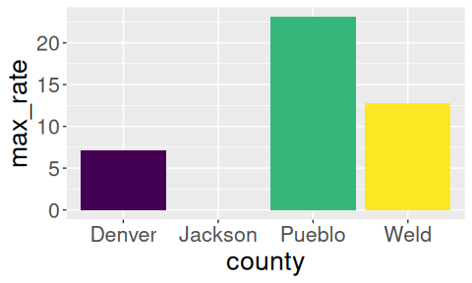

Slide 97
Sometimes we have many lines and it is hard to see what is happening
Let’s look at visit rates for 9 CO counties.
er_visits_9 <- er |> filter(county %in% c("Denver", "Weld", "Pueblo", "Jackson", "San Juan", "Mesa", "Jefferson", "Larimer", "Boulder")) lots_of_lines <- ggplot(er_visits_9, aes(x = year, y = rate, color = county)) + geom_line() lots_of_lines

Slide 98
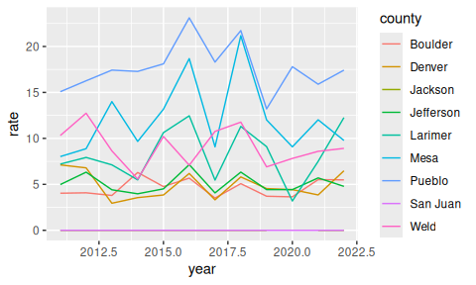

Slide 99
Adding a facet can help make it easier to see what is happening
Sometimes we have two many lines and can git difficult to see what is happening, facets can help!
Two options: facet_grid()- creates a grid shape facet_wrap() -more flexible
Need to specify how you are faceting with the ~ sign.
lots_of_lines + facet_grid( ~ county) + theme(legend.position = "bottom")

Slide 100
Adding a facet can help make it easier to see what is happening
lots_of_lines + facet_grid( ~ county) + theme(legend.position = "none") + theme(axis.text.x = element_text(angle = 90))

Slide 101
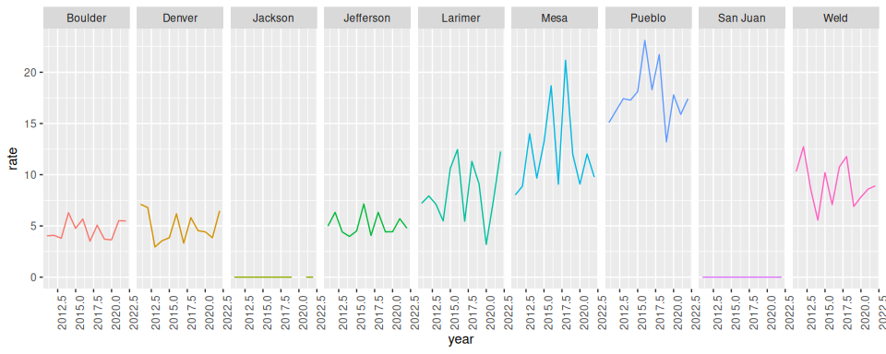

Slide 102
facet_wrap()
more flexible - arguments ncol and nrow can specify layout
can have different scales for axes using scales = "free"
rp_fac_plot <- lots_of_lines + facet_wrap( ~ county, ncol = 4, scales = "free") + theme(legend.position = "none")
rp_fac_plot

Slide 103
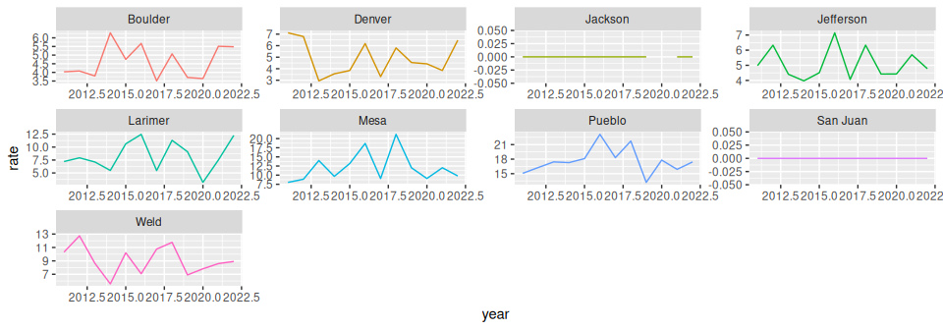

Slide 104
plotly
#install.packages("plotly") library(plotly) # creates interactive plots! ggplotly(lots_of_lines)
Also check out the ggiraph package

Slide 105
patchwork package
Great for combining plots together
Also check out the patchwork package
#install.packages("patchwork") library(patchwork) lots_of_lines + er_bar

Slide 106
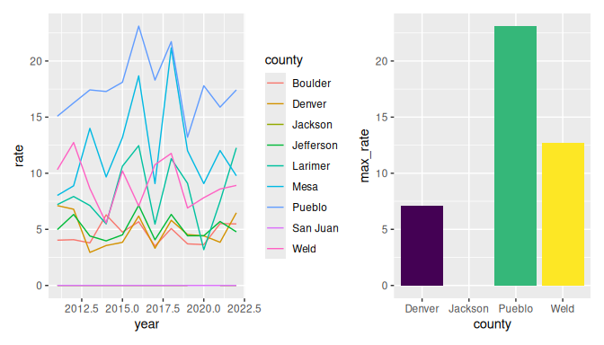

Slide 107
Saving plots

Slide 108
Saving a ggplot to file
A few options:
RStudio > Plots > Export > Save as image / Save as PDF
RStudio > Plots > Zoom > [right mouse click on the plot] > Save image as
In the code
ggsave(filename = "saved_plot.png", # will save in working directory plot = rp_fac_plot, width = 6, height = 3.5) # by default in inches

Slide 109
GUT CHECK: How to we make sure that the boxplots are filled with color instead of just the outside boarder?
A. Use the fill argument in the aes specification
B. Use color argument in geom_boxplot()

Slide 110
GUT CHECK: If our plot is too complicated to read, what might be a good option to fix this?
A. add more theme() layers
B. Use facet_grid() to split the plot up

Slide 111
Summary
The theme() function helps you specify aspects about your plot
move or remove a legend with theme(legend.position = "none")
change font aspects of individual text elements theme(plot.title = element_text(size = 20))
center a title: theme(plot.title = element_text(hjust = 0.5))
sometimes you need to add a group element to aes() if your plot looks strange
make sure you are plotting what you think you are by checking the numbers!
facet_grid(~ variable) and facet_wrap(~variable) can be helpful to quickly split up your plot
facet_wrap() allows for a scales = "free" argument so that you can have a different axis scale for different plots
use fill to fill in boxplots

Slide 112
Good practices for plots
Check out this guide for more information!

Slide 113
Lab 2
🏠 Class Website
💻 Lab
📃Day 6 Cheatsheet
📃Posit’s theme cheatsheet

Slide 114


Slide 115
Image by Gerd Altmann from Pixabay

Slide 116
Extra Slides

Slide 117
Adding color - or change the color of each plot layer
You can change look of each layer separately. Note the arguments like linetype and alpha that allow us to change the opacity of the points and style of the line respectively.
ggplot(er_Boulder, aes(x = year, y = rate)) + geom_point(size = 5, color = "red", alpha = 0.5) + geom_line(size = 0.8, color = "black", linetype = 2)

Slide 118
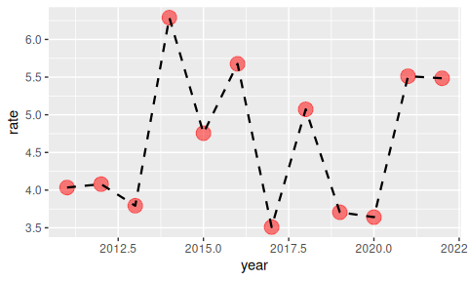

Slide 119
linetype can be given as a number. See the docs for what numbers correspond to what linetype!

Slide 120
Customize the look of the plot
You can change the look of whole plot - specific elements, too - like changing font and font size - or even more fonts
ggplot(er_Boulder, aes(x = year, y = rate)) + geom_point(size = 5, color = "green", alpha = 0.5) + geom_line(size = 0.8, color = "blue", linetype = 2) + theme_bw() + theme(text=element_text(size=16, family="Comic Sans MS"))

Slide 121
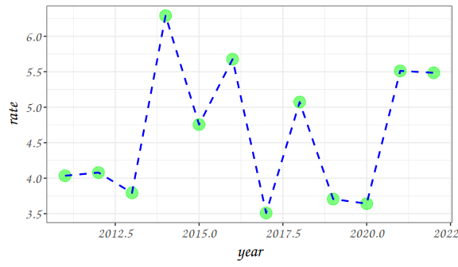

Slide 122
Adding labels line break
Line breaks can be specified using \n within the labs() function to have a label with multiple lines.
ggplot(er_Boulder, aes(x = year, y = rate)) + geom_point(size = 5, color = "red", alpha = 0.5) + geom_line(size = 0.8, color = "brown", linetype = 2) + labs(title = "Heat-Related ER Visits in Boulder Co.: \n age-adjusted visit rate by year", x = "Year", y = "Age-adjusted Visit Rate")

Slide 123
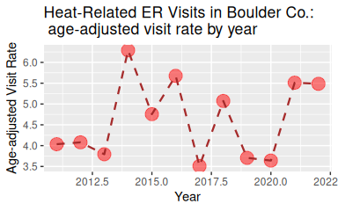

Slide 124
Changing axis: specifying axis limits
xlim() and ylim() can specify the limits for each axis
ggplot(er_Boulder, aes(x = year, y = rate)) + geom_point(size = 5, color = "green", alpha = 0.5) + geom_line(size = 0.8, color = "blue", linetype = 2) + labs(title = "Heat-Related ER Visits in Boulder Co.", x = "Year", y = "Age-adjusted Visit Rate") + ylim(0, max(pull(er_visits_4, rate)))

Slide 125
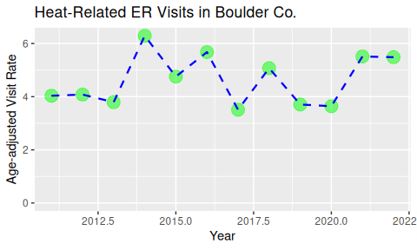

Slide 126
theme() function: moving (or removing) legend
If specifying position - use: “top”, “bottom”, “right”, “left”, “none”
ggplot(er_visits_4, aes(x = year, y = rate, color = county)) + geom_line() ggplot(er_visits_4, aes(x = year, y = rate, color = county)) + geom_line() + theme(legend.position = "bottom")

Slide 127
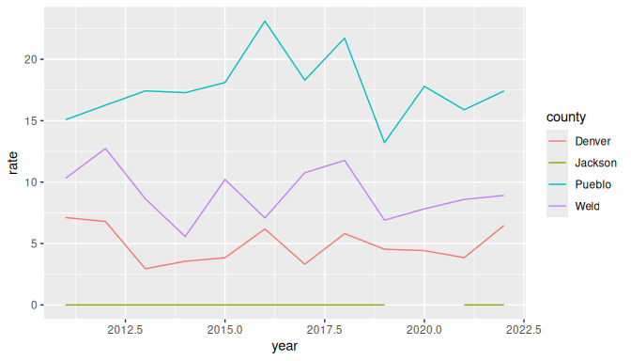

Slide 128
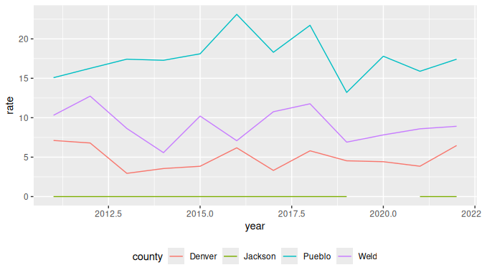

Slide 129
Keys for specifications
linetype

Slide 130
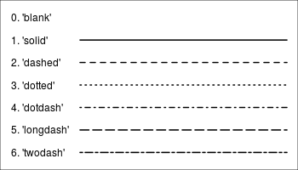

Slide 131
source

Slide 132
Linetype key
geoms that draw lines have a linetype parameter
these include values that are strings like “blank”, “solid”, “dashed”, “dotdash”, “longdash”, and “twodash”
er_Boulder |> ggplot(aes(x = year, y = rate)) + geom_line(size = 0.8, linetype = "twodash")

Slide 133
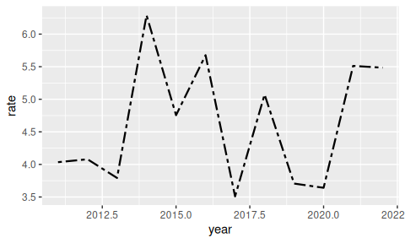

Slide 134
Keys for specifications
shape

Slide 135
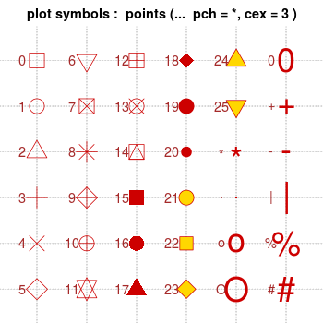

Slide 136
source

Slide 137
shape key
geoms that draw have points have a shape parameter
these include numeric values (don’t need quotes for these) and some characters values (need quotes for these)
er_Boulder |> ggplot(aes(x = year, y = rate)) + geom_point(size = 2, shape = 12)

Slide 138
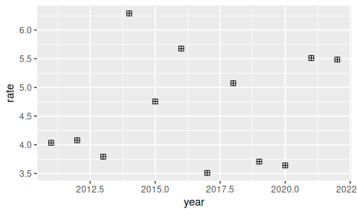

Slide 139
Can make your own theme to use on plots!
Guide on how to: https://rpubs.com/mclaire19/ggplot2-custom-themes

Slide 140
Tip- if you need you can remove outliers
Set outlier.shape = NA to get ride of outliers. Be careful about if you really should remove these!
However, if can be helpful if your plot is getting stretched to accommodate plotting an outlier. You can always say in the figure legend what you removed.
er_no_out1 <- ggplot(er_visits_4, aes(y = visits, x = county)) + geom_boxplot() er_no_out2 <- ggplot(er_visits_4, aes(y = visits, x = county)) + geom_boxplot(outlier.shape = NA) + ylim(0,40)

Slide 141


Slide 142


Slide 143
Tip - NA Values
if it is a numeric value it will just get dropped from the graph and you will see a warning
it is categorical you will see it on the graph and will need to filter to remove the NA category
icecream <-tibble(flavor = rep(c("chocolate", "vanilla", NA,"chocolate", "vanilla"), 8)) icecream1 <- ggplot(icecream, aes(x = flavor)) + geom_bar() + theme(text=element_text(size=24)) icecream2 <- icecream |> drop_na(flavor) |> ggplot( aes(x = flavor)) + geom_bar() + theme(text=element_text(size=24))

Slide 144


Slide 145


Slide 146
Extensions

Slide 147
directlabels package
Great for adding labels directly onto plots https://www.opencasestudies.org/ocs-bp-co2-emissions/
#install.packages("directlabels") library(directlabels) direct.label(lots_of_lines, method = list("angled.boxes"))

Slide 148


