Slide 1
Data Input

Slide 2
Quick reminder - Getting files from downloads
This course will involve moving files around on your computer and downloading files.
If you are new to this - check out the videos on the resource page of the website.

Slide 3
R Projects

Slide 4
R Projects
R Projects are a super helpful feature of RStudio. They help you:
  Stay organized. R Projects help in organizing your work into self-contained directories (folders), where all related scripts, data, and outputs are stored together. This organization simplifies file management and makes it easier to locate and manage files associated with your analysis or project.
  Find the right files. When you open an R Project, RStudio automatically sets the working directory to the project’s directory. This is where RStudio “looks” for files. Because it’s always the Project folder, it can help avoid common issues with file paths.
  Be more reproducible. You can share the entire project directory with others, and they can replicate your environment and analysis without much hassle.

Slide 5
Why projects?
“The chance of the setwd() command having the desired effect – making the file paths work – for anyone besides its author is 0%. It’s also unlikely to work for the author one or two years or computers from now. The project is not self-contained and portable.”
  Jenny Bryan
Let’s go over how to create and use an R Project!

Slide 6
New R Project
Let’s make an R Project so we can stay organized in the next steps. Click the new R Project button at the top left of RStudio:

Slide 7
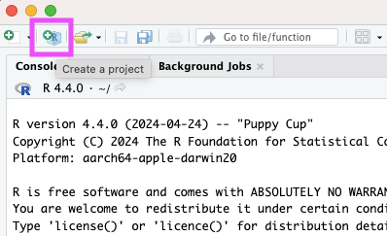

Slide 8
New R Project
In the New Project Wizard, click “New Directory”:

Slide 9
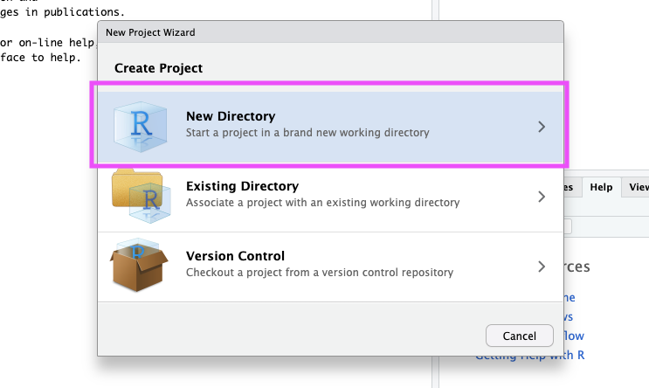

Slide 10
New R Project
Click “New Project”:

Slide 11
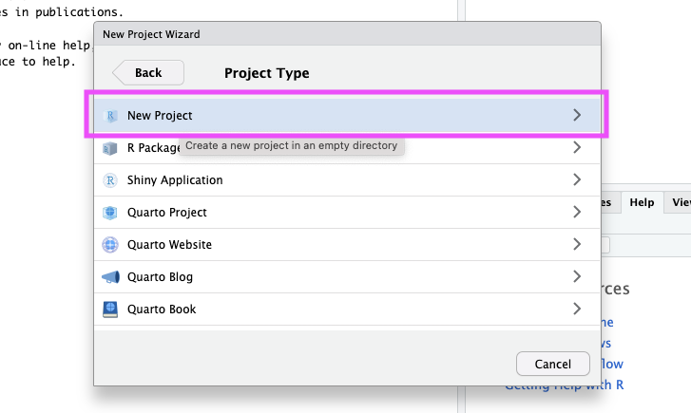

Slide 12
New R Project
Type in a name for your new folder.
Store it somewhere easy to find, such as your Desktop:

Slide 13
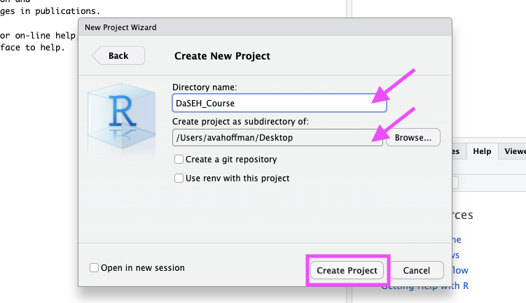

Slide 14
New R Project
You now have a new R Project folder on your Desktop!
Make sure you add any scripts or data files to this folder as you go through your Intro to R lessons, or work on a new project. This will make sure R is able to “find” your files.

Slide 15
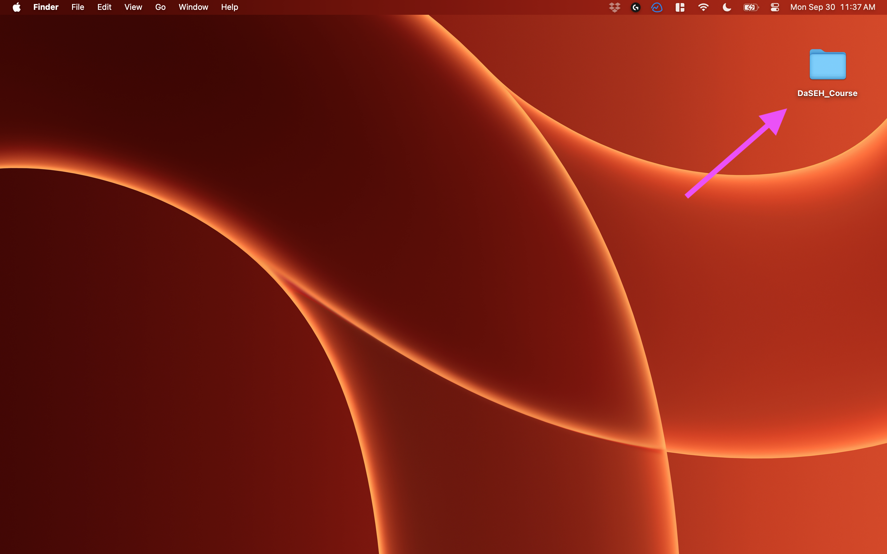

Slide 16
See and change projects
You can see what project you have open in the top right corner.

Slide 17
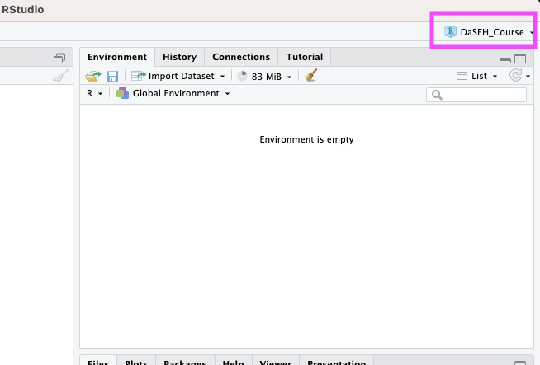

Slide 18
Getting data into R (manual/point and click)

Slide 19
Data Input
  ‘Reading in’ data is the first step of any real project/analysis
  R can read almost any file format, especially via add-on packages
  We are going to focus on simple delimited files first
    comma separated (e.g. ‘.csv’)
    tab delimited (e.g. ‘.txt’)
delimiters are symbols that separate cells in a simple-text file.

Slide 20
Data Input
CO Heat-related ER visits dataset:
We’re going to load a dataset from the Colorado Environmental Public Health Tracking Program. This dataset has age-adjusted visit rates and total number of visits for all genders by Colorado county for 2011-2023.
  Check out the data at: https://coepht.colorado.gov/heat-related-illness

Slide 21
Import Dataset (URL)
  > File
  > Import Dataset
  > From Text (readr)
  > paste the url (https://daseh.org/data/CO_ER_heat_visits.csv)
  > click “Update” and “Import”
Saves data in memory, not to hard drive

Slide 22
What Just Happened?
You see a preview of the data on the top left pane.

Slide 23
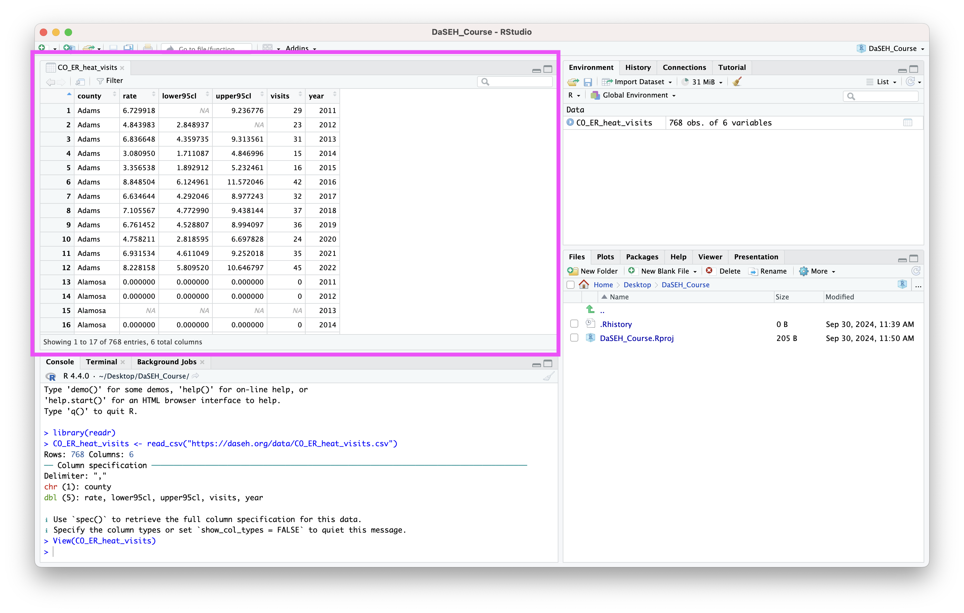

Slide 24
What Just Happened?
You see a new object called CO_ER_heat_visits in your environment pane (top right). The table button opens the data for you to view.

Slide 25
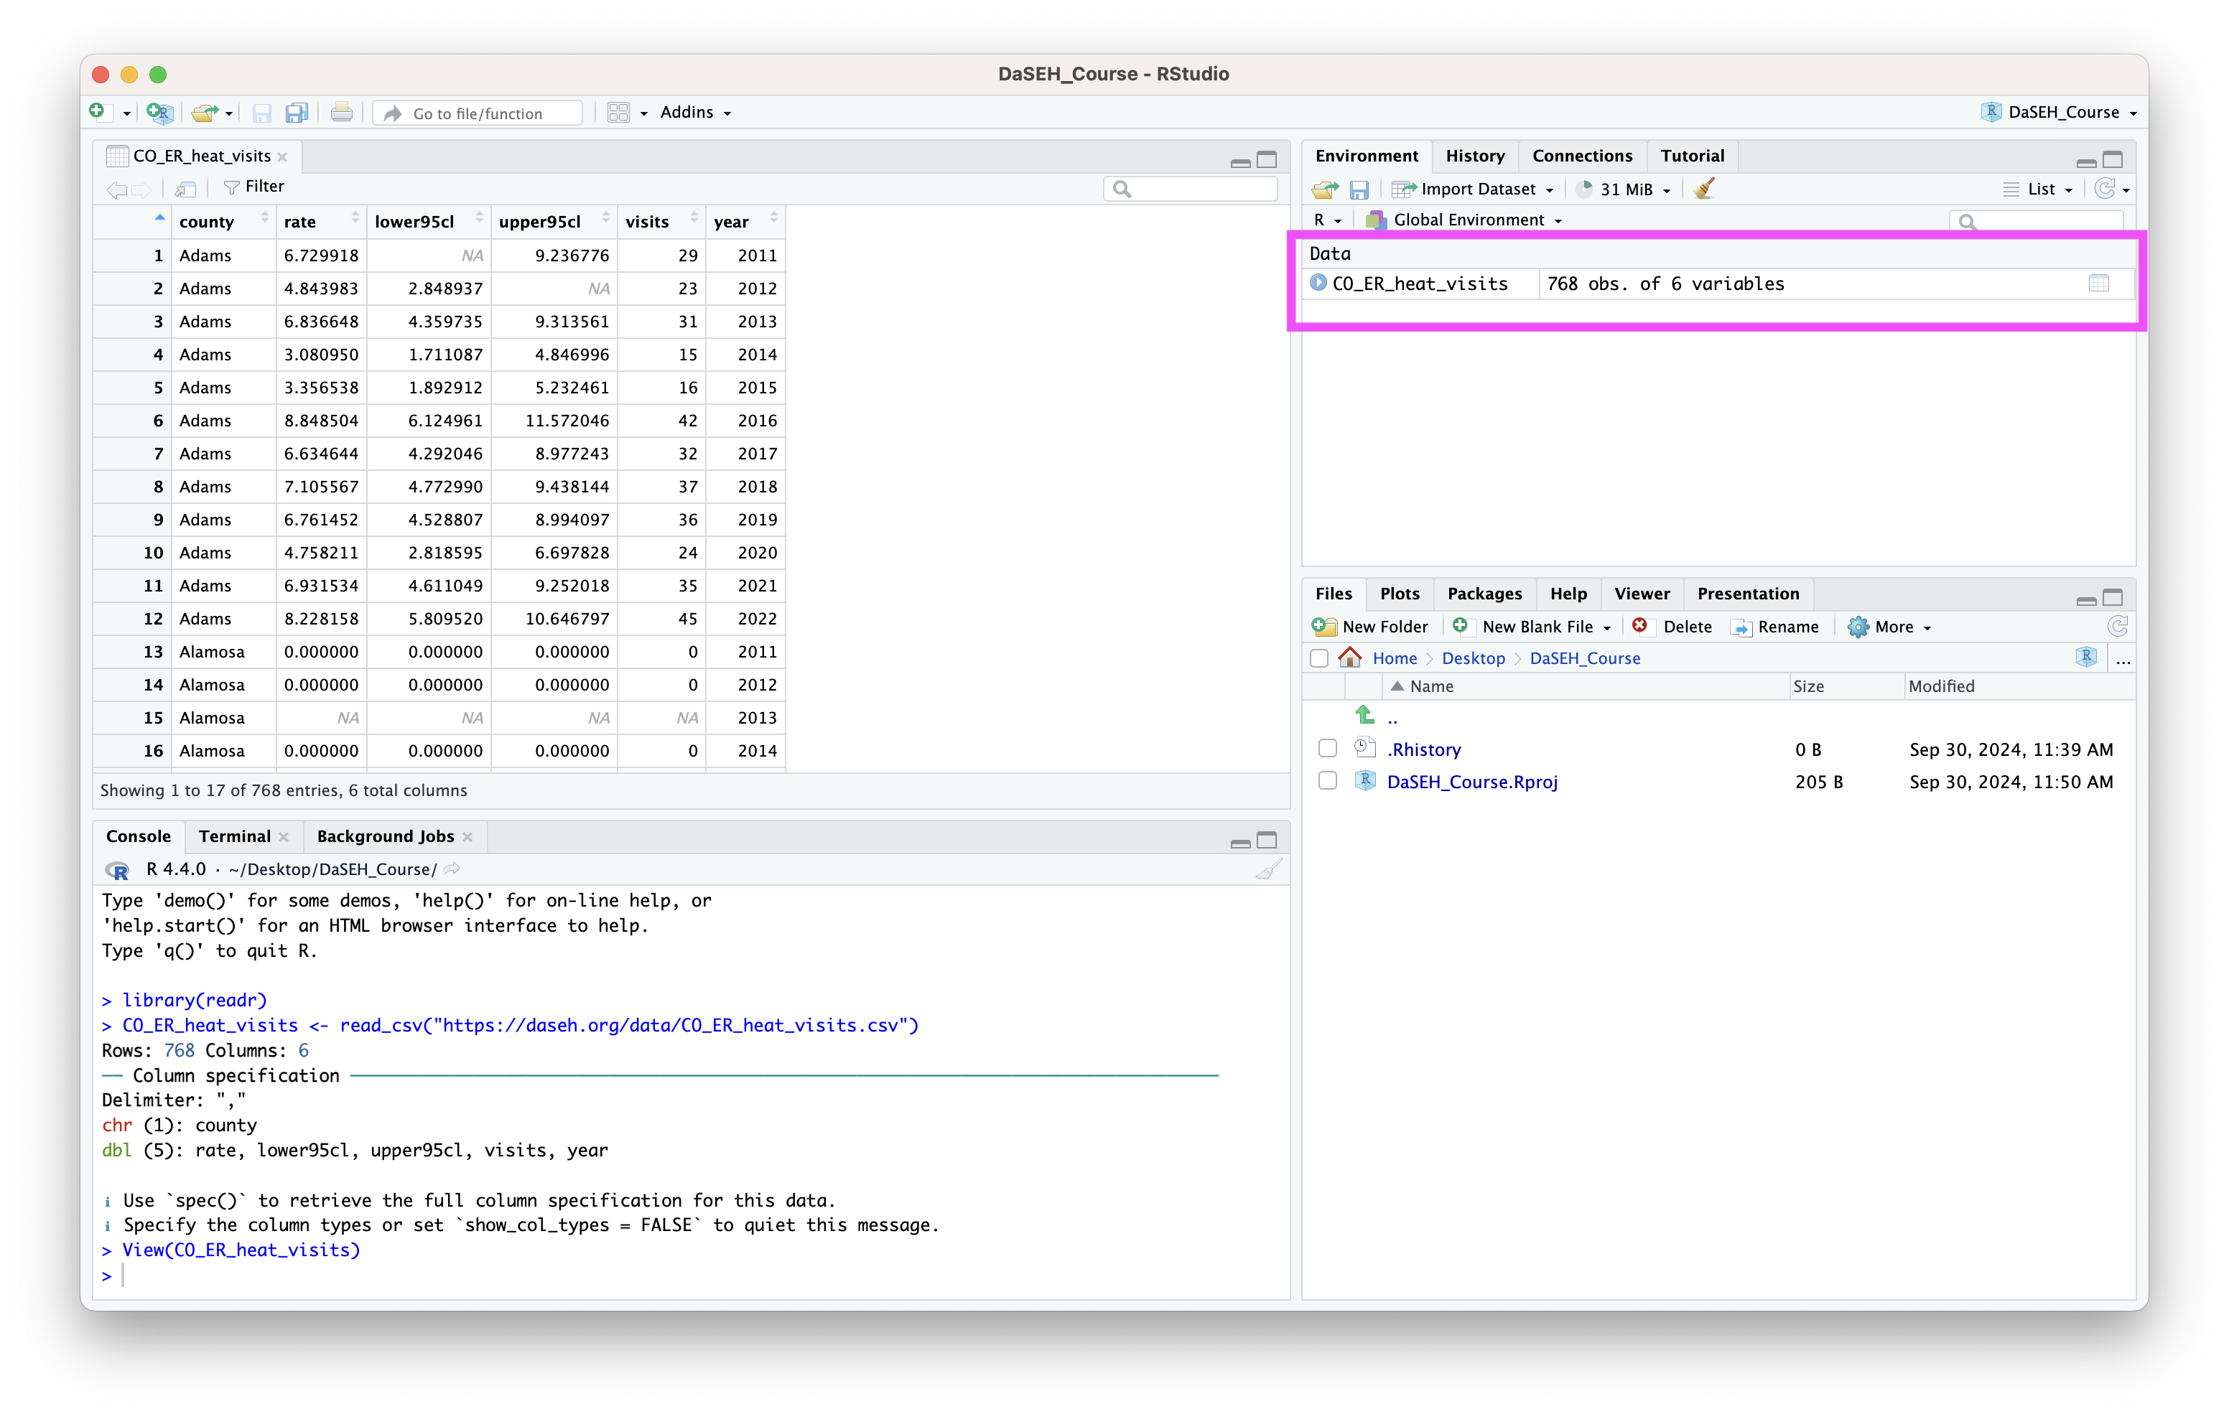

Slide 26
What Just Happened?
R ran some code in the console (bottom left).

Slide 27
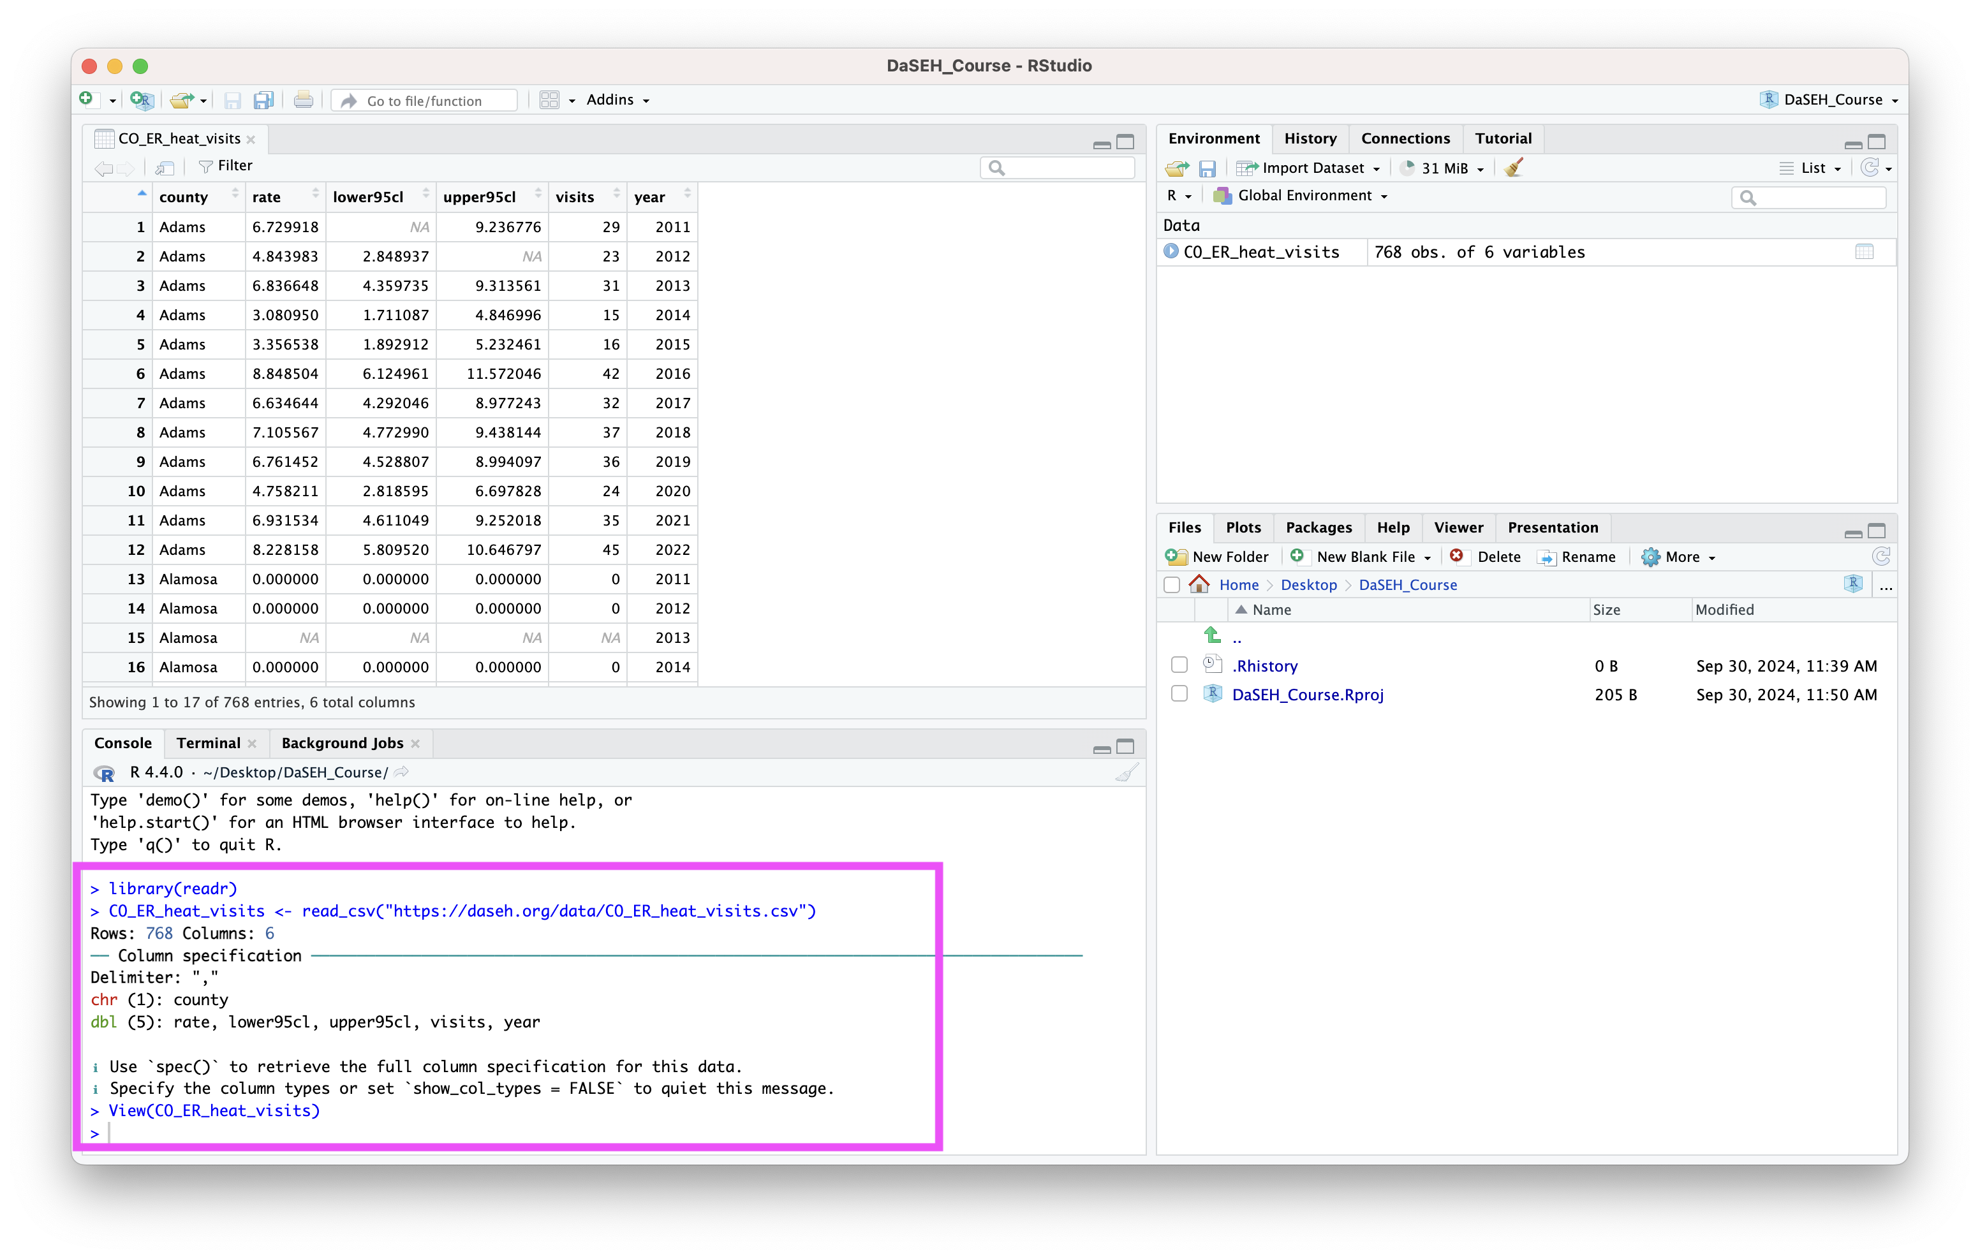

Slide 28
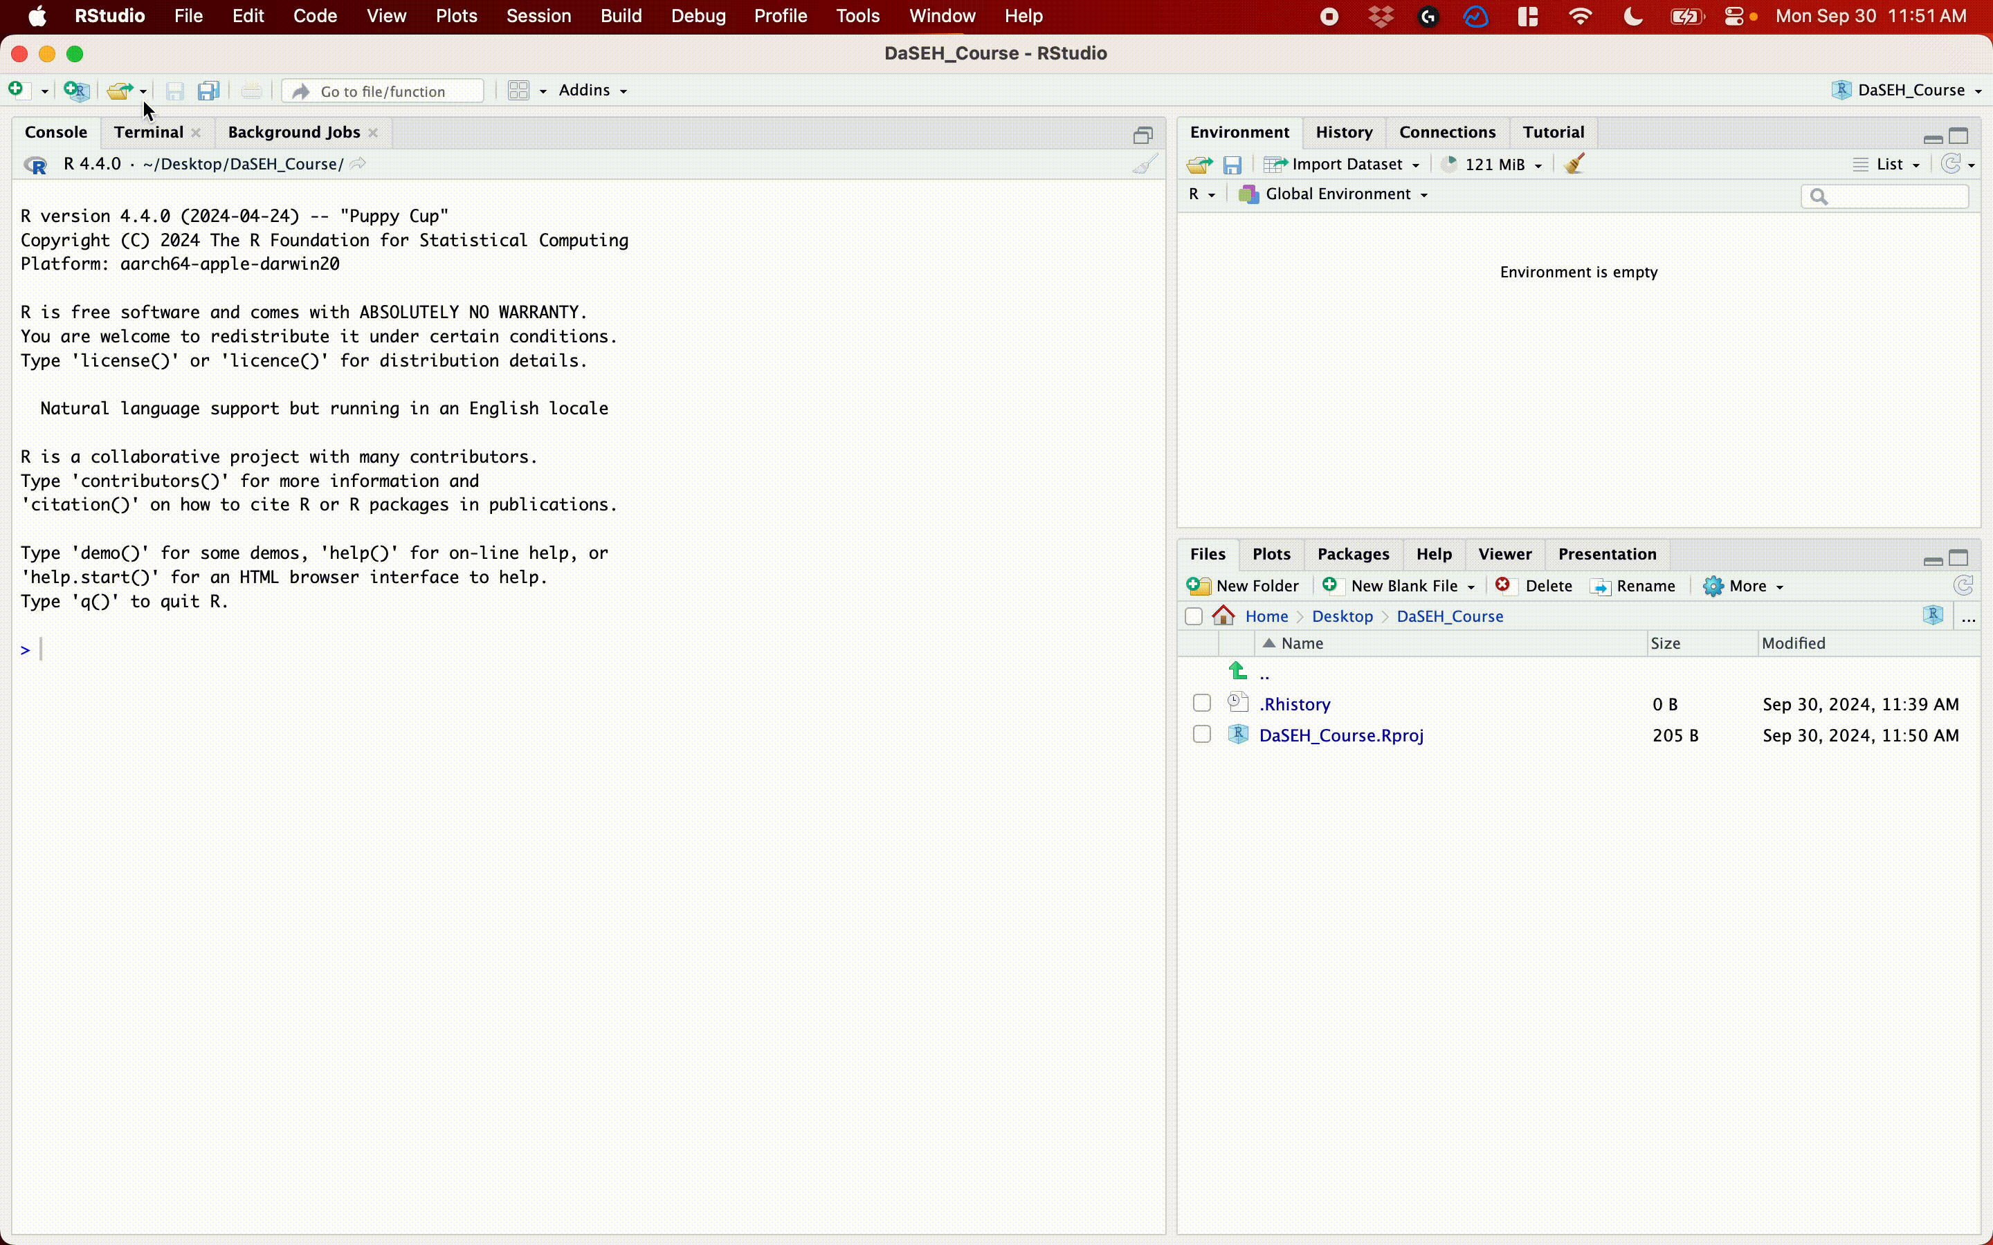
Import Dataset

Slide 29
Import Dataset (file)
  > Download the data
  > Put data in the project folder
  > File, Import Dataset, From Text (readr)
  > browse for the file
  > click “Update” and “Import”

Slide 30
GUT CHECK!
How can we get data into R?
A. From a URL
B. From a file we downloaded
C. Both of these!

Slide 31
Lab - Part 1
🏠 Class Website
💻 Data Input Lab

Slide 32
Manual Import: Pros and Cons
Pros: easy!!
Cons: obscures some of what’s happening, others will have difficulty running your code

Slide 33
Getting data into R (directly)

Slide 34
Data Input: Read in Directly
The tidyverse contains a package readr that is handy for importing data.
library(tidyverse)
dat <- read_csv(
file = "https://daseh.org/data/CO_ER_heat_visits.csv"
)
# `head` displays first few rows of a data frame. `tail()` works the same way.
head(dat, n = 5)
# A tibble: 5 × 6
county rate lower95cl upper95cl visits year
<chr> <dbl> <dbl> <dbl> <dbl> <dbl>
1 Adams 6.73 NA 9.24 29 2011
2 Adams 4.84 2.85 NA 23 2012
3 Adams 6.84 4.36 9.31 31 2013
4 Adams 3.08 1.71 4.85 15 2014
5 Adams 3.36 1.89 5.23 16 2015

Slide 35
Data Input: Declaring Arguments
dat <- read_csv(
file = "https://daseh.org/data/CO_ER_heat_visits.csv"
)
# EQUIVALENT TO
dat <- read_csv(
"https://daseh.org/data/CO_ER_heat_visits.csv"
)

Slide 36
Data Input: Read in Directly
read_csv() needs an argument file = in quotation marks.
  can be path to a file on a website (URL)
  can be path in your local computer – absolute file path or relative file path
# URL
dat <- read_csv("https://daseh.org/data/CO_ER_heat_visits.csv")
# In project folder
dat <- read_csv("CO_ER_heat_visits.csv")

Slide 37
The working directory
When we work in an R Project, our project folder is our working directory.
Working directory is a folder (directory) that RStudio will use to find files.

Slide 38


Slide 39
Checking the working directory
Run the getwd() function to determine your working directory.
# Get the working directory
getwd()

Slide 40
Setting the working directory
You can set the working directory manually with the setwd() function. But it’s easier to set up a project :)
# set the working directory
setwd("/Users/avahoffman/Desktop")

Slide 41
Now what? Checking data & Other formats

Slide 42
Data Input: Checking the data
  the View() function shows your data in a new tab, in spreadsheet format
  be careful if your data is big!
View(dat)

Slide 43
Data Input: Other delimiters
read_tsv() can read tab delimited (separated) files.
read_delim() can be used to specify the delimiter.
  file is the path to your file, in quotes
  delim is what separates the fields within a record
## Examples
dat2 <- read_tsv(file = "table1.tsv", delim = "\t")
dat3 <- read_delim(file = "data.txt", delim = ":")

Slide 44
Data input: other file types
  readxl package can read excel files
  haven package has functions to read SAS, SPSS, Stata formats
  There are also resources for REDCap : REDCapR

Slide 45
WARNING! read.csv is * base R *
There are also data importing functions provided in base R (rather than the readr package), like read.delim() and read.csv().
These functions have slightly different syntax for reading in data (e.g. header argument).
However, while many online resources use the base R tools, the latest version of RStudio switched to use these new readr data import tools, so we will use them in the class for slides. They are also up to two times faster for reading in large datasets, and have a progress bar which is nice.

Slide 46
Other Useful Functions
  The str() function can tell you about data/objects.
  We will also discuss the glimpse() function later, which does something very similar.
  head() shows first few rows
  tail() shows the last few rows

Slide 47
Summary
R Projects can make it easier to find files.
Importing data manually:
  File > Import Dataset > From Text (readr)
  Paste the url / browse
  Click “Update” and “Import”
  Review the process: https://youtu.be/LEkNfJgpunQ
Importing data programmatically:
  read_csv() function from tidyverse (readr) package
  Use getwd() to check your working directory, where R looks for your data files

Slide 48
Summary - Part 2
Look at your data!
  Check the environment for a data object
  View() gives you a preview of the data in a new tab
Other file types
  readr package: read_delim() for general delimited files
  other packages for more complicated files.
Don’t forget to use <- to assign your data to an object!

Slide 49
Lab - Part 2
🏠 Class Website
💻 Data Input Lab
📃 Posit’s Data Import Cheatsheet
📃 Day 2 Cheatsheet

Slide 50


Slide 51
Image by Gerd Altmann from Pixabay

